Slide 1
Green(er) Cars & Trucks
John C. Bean
Outline
Energy spent moving Cars & Trucks
"Greener" vehicles mitigating the impact of internal combustion engines (ICEs):
Improving ICE fuel/air mixing, injection & spark ignition
Using gasoline ICEs more effectively:
Improved transmissions, including Dual Clutch & Continuously Variable (CVTs)
Combined electric motor / ICE drives => Hybrid Electric Vehicles (HEVs)
Storing (rather than dissipating) kinetic energy when vehicles slow or stop
Kinetic Energy Recovery Systems (KERs) or Regenerative Braking Systems
"Green" electric vehicles
Powered by a not yet Green Grid => "Well-to-Wheel" / Lifecycle Energy & GHG analyses
Green Grid + Battery Plug-in Electric Vehicles
Challenges & possible benefits for the Grid
Including one weirdly plausible Grid-vehicle synergy: "Vehicle-to-Grid (V2G)"
Green Grid + Combined Hydrogen Fuel Cell / Battery Vehicles
Impacts of Autonomous Vehicles
(Written / Revised: December 2020)

Slide 2
Car & Truck Acronyms:
4WD = Four wheel drive
ATDC = (degrees) After Top Dead Center
AV = Autonomous Vehicle
BEV = Battery Electric Vehicle = PEV
BTDC = (degrees) Before Top Dead Center
CD = Cylinder Deactivation
CGI = Charged Gasoline Injection = FSI
CV = Conventional Vehicle (diesel or gas ICE)
CVT = Continuously Variable Transmission
Diesel = my term for a Diesel ICE
diesel = my term for diesel fuel
DOHC = Dual Over Head Camshaft
e-Motor = Electric Motor
EV = Electric Vehicle (e.g., PEV or FCEV)
FC = Fuel Cell
FCEV = Fuel Cell Electric Vehicle
FSI = Fuel Stratified Injection = CGI
GDI = Gasoline Direct Injection = SIDI
GHG = Greenhouse Gas
ICE = Internal Combustion Engine = Diesel or SI-ICE
KERS = Kinetic Energy Recover System
HEV = Hybrid Electric Vehicle
MPFi = Multi Port Fuel Injection = PFI
NG = Natural Gas
MPG = Miles per Gallon => 2.35 Liters per km
OHC = Over Head Camshaft (SOHC or DOHC)
OHV = Over Head Valve (OHC, SOHC, or DOHC)
PEV = Plug-in Electric Vehicle (a.k.a. EV & BEV)
PFI = Port Fuel Injection = MPFi
PHEV = Plug-in Hybrid gasoline Electric Vehicle
PTDI = Petroleum Turbocharged Direct Injection
RPM = Revolutions per Minute
SIDI = Spark Ignited Direct Injection = GDI
SI-ICE = Spark Ignition ICE = gasoline ICE
SOHC = Single Over Head Camshaft
TDC = Top Dead Center (see also ATDC & BTDC)
TtW = T2W = Tank to Wheel energy / GHG analysis
VVT = Variable Valve Timing
WtW = W2W = Well to Wheel energy / GHG analysis
WtT = W2T = Well to Tank energy / GHG analysis
ZEV = Zero (GHG) Emission Vehicle (BEV or FCEV)

Slide 3
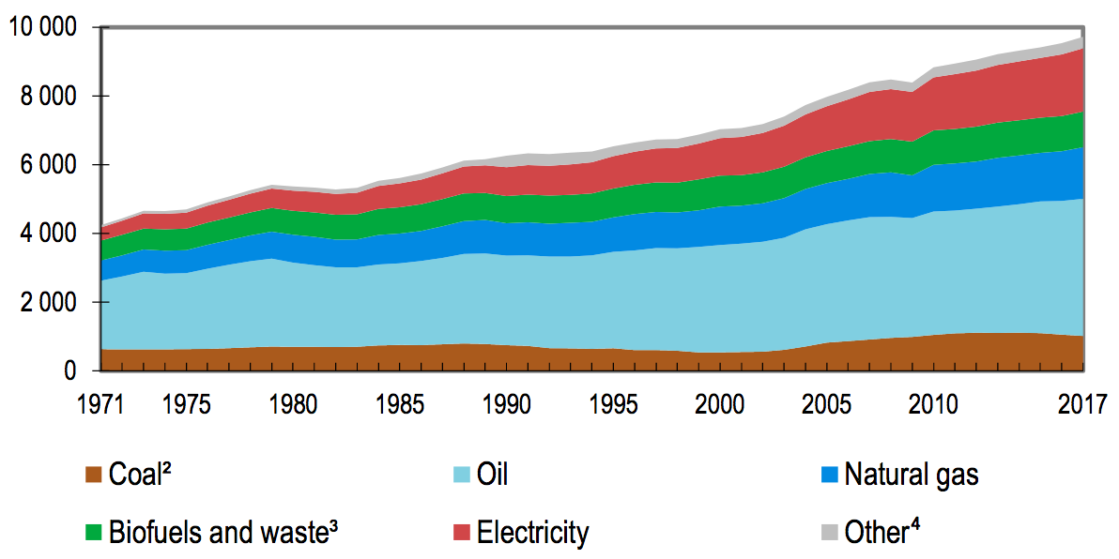
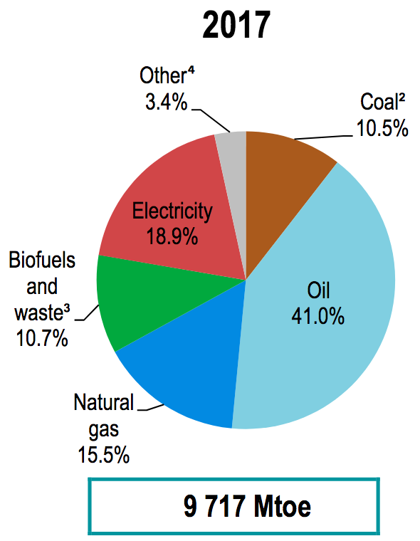
Why is Car & Truck energy use particularly important?
First, because it is the second largest contributor to overall human energy use:
International Energy Agency (IEA) plot of annual world energy consumption:
The figure's units are MTOe = Million Tonnes Oil equivalent
Its conversion to metric units is 1 MTOe = 11.63 TW-h (T = Tera = 10¹²)
From those figures, making that metric conversion for the final year of 2017:
Total World Energy Consumption = 9717 MTOe => 113,000 TW-h
Total Electrical Energy Consumption = (18.9%) (9717 MTOe) => 21,357 TW-h
1) Page 34 in: https://webstore.iea.org/key-world-energy-statistics-2019

Slide 4
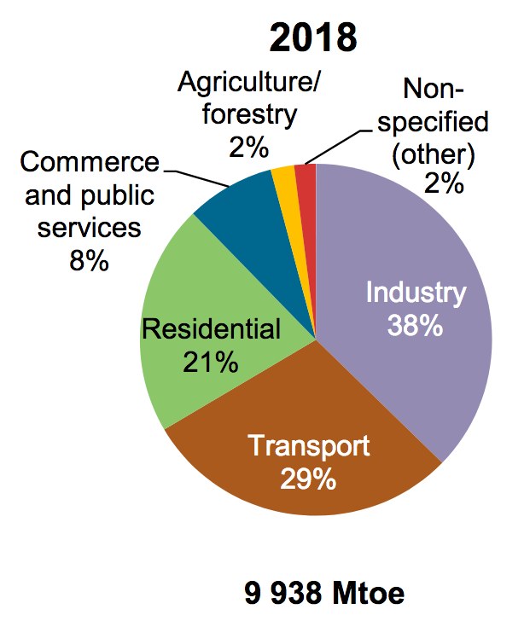
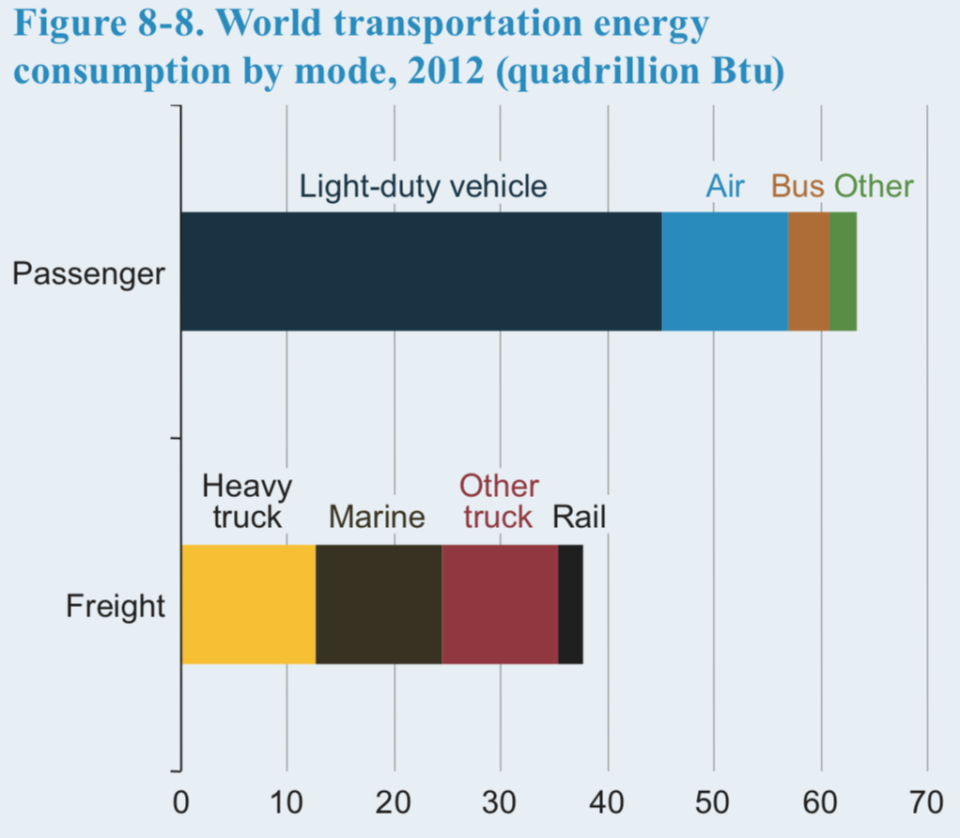
What part of the total energy was used by Cars & Trucks?
Pertaining to that question, the same IEA report provided data for only 2018:
Total Energy Consumption = 9,938 MTOe => 115,580 TW-h
Of which 29% was used for transport:
Total Transport Energy = 2,853 MTOe => 33,180 TW-h
The U.S. Energy Information Administration (EIA) broke down Transport Energy as: ¹
Light duty vehicles (cars & light trucks) = 44%
Heavy trucks = 13% Other trucks = 12%
Car & Truck total = 69% of Total Transport Energy
Combining that with the IEA value given above:
Cars & Trucks = (.69)(33,180 TW-h) => 22,890 TW-h
1) Page 131 in: https://www.eia.gov/outlooks/ieo/pdf/0484(2016).pdf

Slide 5
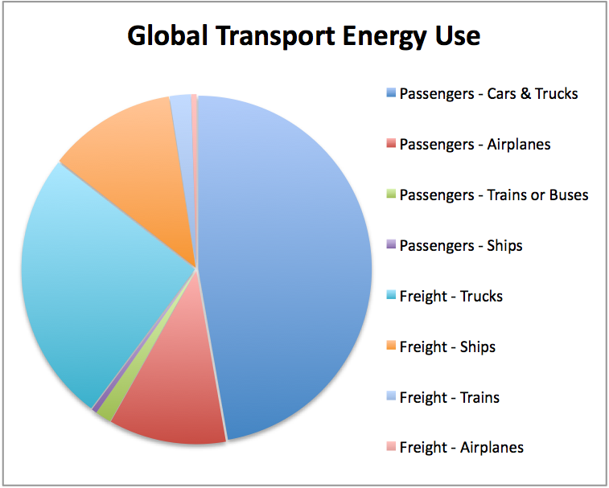
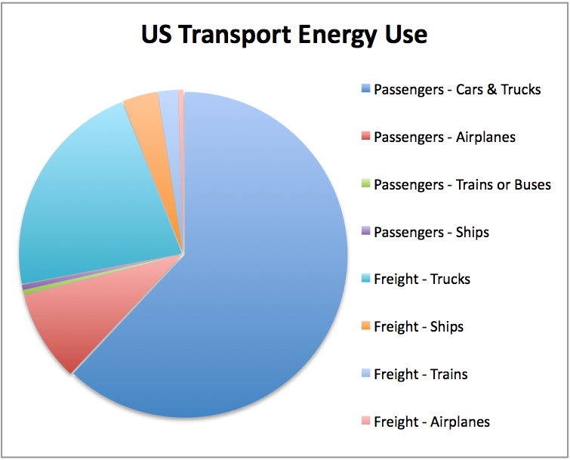
The Car & Truck share of Transport Energy is even larger in the U.S.
From my note set Energy Consumption in Transportation (pptx / pdf / key),
the large blue slices of these pie charts depict Car & Truck energy use:
An Introduction to Sustainable Energy Systems: WeCanFigureThisOut.org/ENERGY/Energy_home.htm

Slide 6

The second reason Car & Truck energy use is particularly important:
Because so much of that energy use is based upon OUR personal decisions:
From the IEA (above), 44% of World Transport Energy = "Light Cars & Trucks"
Which is to say: cars & pick-up trucks that we have personally chosen,
or vehicles chosen mostly by local business owners
So we can't just push responsibility off onto far distant corporations & governments
We (personally & locally) largely created this problem
Giving us the means & responsibility for dealing with this problem
From Walt Kelly's now iconic cartoon on the occasion of the 2nd World Earth Day in 1971 (Post Hall Syndicate)

Slide 7
To which your very personal & local response might well be:
"But I'm already fixing things:
I drive (or will likely soon buy) a Hybrid Electric Vehicle (HEV)
And, when "they" get the range & number of charging stations high enough
  I'll happily move up to an all-electric Plug-in Electric Vehicle (PEV)
Problem Solved (or, at least I'll have personally done my part)!"
But it's not that simple:
PEVs will only be truly green when the Grid charging them is also green
If it isn't, you'll just be shifting your Greenhouse Gas (GHG) emissions
from your car's tailpipe to your power plant's smokestack
And to charge all those green PEVs, a green Grid will need a lot more capacity
But how difficult can those changes be? Let's try for some quick estimates:
An Introduction to Sustainable Energy Systems: WeCanFigureThisOut.org/ENERGY/Energy_home.htm

Slide 8
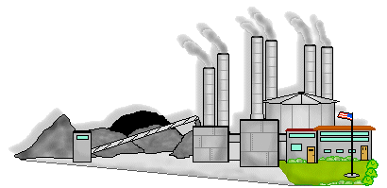

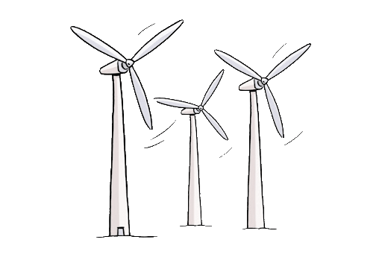
Challenge #1: Cleaning up the Electric Power Grid
    Today
    Tomorrow
http://clipart-library.com/clipart/419820.htm
http://clipart-library.com/wind-turbine-clipart.html
https://www.autoloans.ca/blog/are-you-ready-to-drive-an-electric-vehicle/

Slide 9
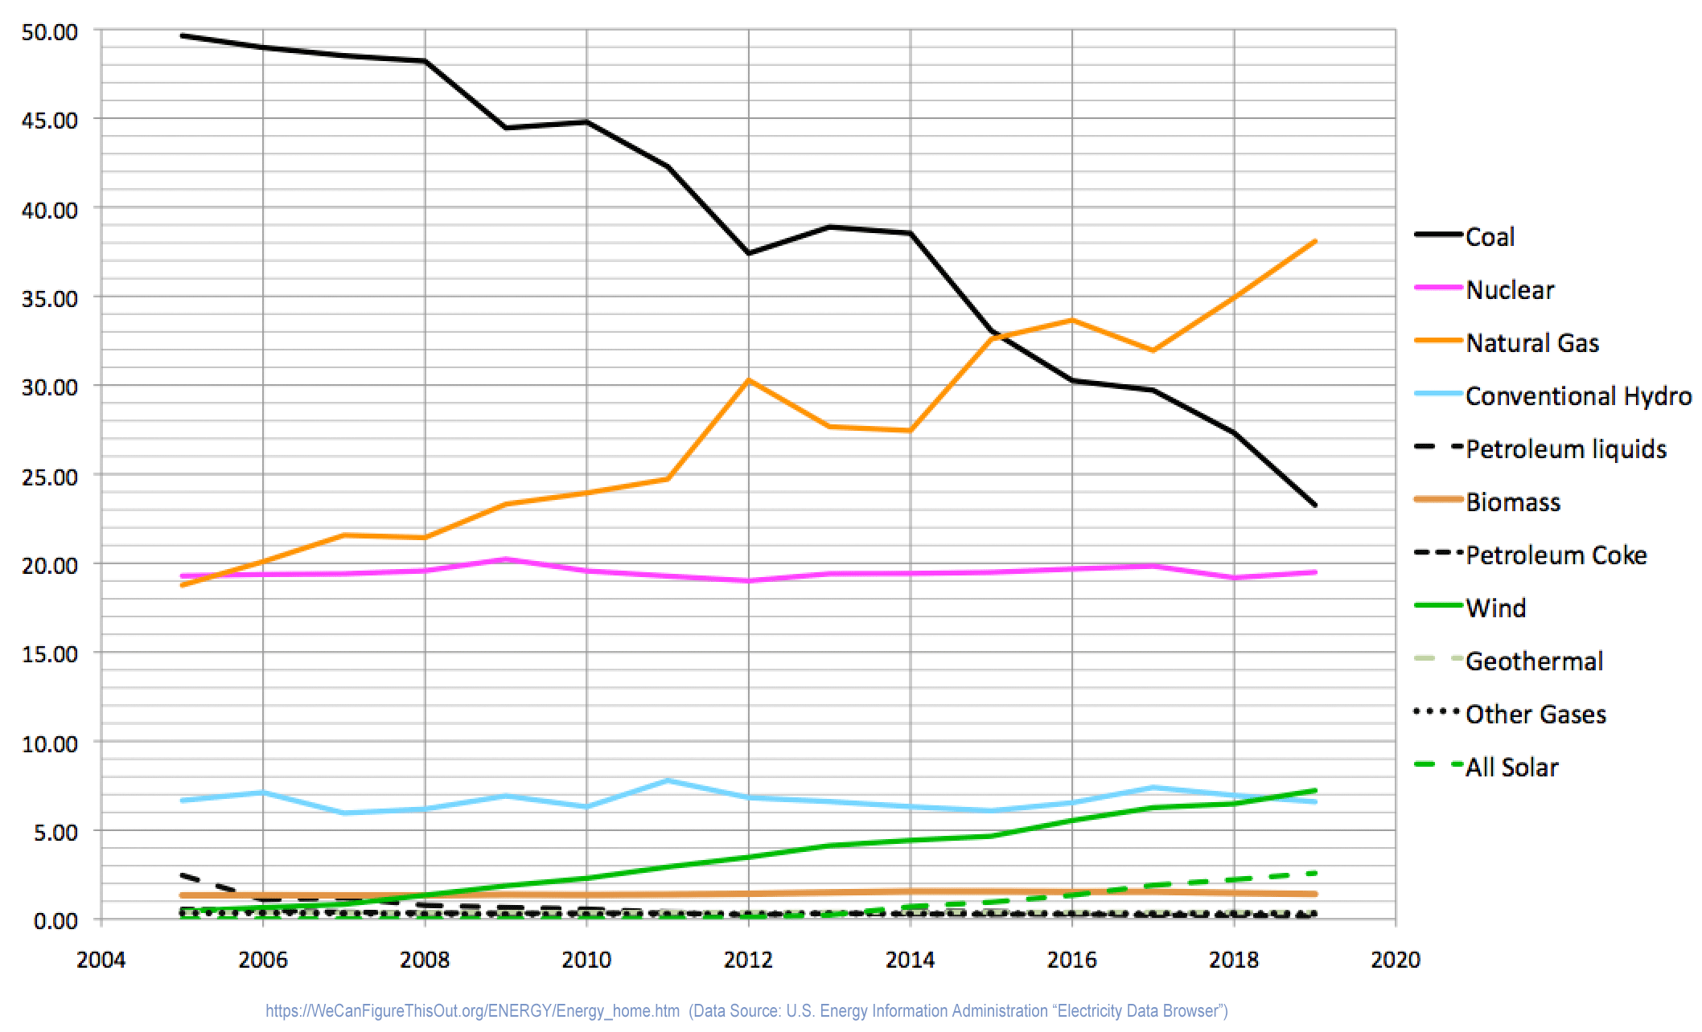
How dirty is today's Electric Power Grid?
From my note set: U.S. Energy Production and Consumption (pptx / pdf / key):
2019 Sources of U.S.
Electrical Energy:
Natural Gas: 38.1%
Coal: 23.3%
Nuclear: 19.5%
Wind: 7.2%
Hydro: 6.6%
Solar: 2.6%
Biomass: 1.4%
Despite recent dramatic gains by wind & solar power, the U.S. electrical Grid,
along with most other worldwide electrical Grids, is FAR from Green
As seen in my compilation of U.S. Energy Information Administration data above,
over 61% of our power comes from fossil-fueled natural gas & coal power plants
Another 26% comes from nuclear & hydro power plants many consider almost as bad

Slide 10
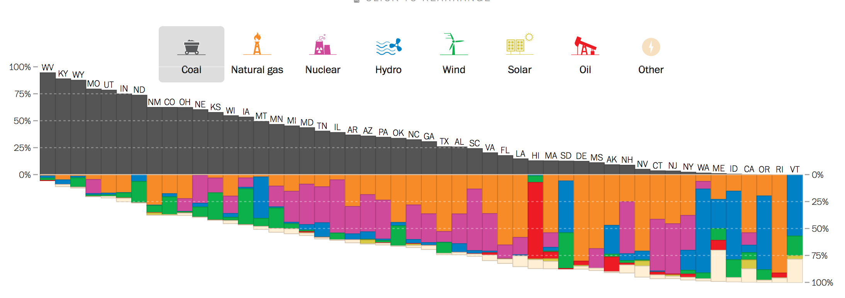
And in many parts of the U.S. electrical power is downright filthy:
This 2017 Washington Post figure depicted state-by-state electrical power sources: ¹
Utah
Ohio
Idaho
West Virginia
Maryland
Virginia
Vermont
Pennsylvania
Washington
Texas
Massachusetts
California
New Hampshire
1) http://www.washingtonpost.com/graphics/national/power-plants/

Slide 11
How much will green / desirable electrical energy sources have to grow?
2019 Sources of U.S.
Electrical Energy:
Natural Gas: 38.1%
Coal: 23.3%
Nuclear: 19.5%
Wind: 7.2%
Hydro: 6.6%
Solar: 2.6%
Biomass: 1.4%
Eliminating fossil-fuel natural gas (38.1%) & coal (23.3%) will require remaining sources
to grow in total capacity by a factor of 100 / (100 - 38.1 - 23.3) => 2.5 X
Eliminating fossil-fuels & nuclear (19.5%) will require remaining sources
to grow in total capacity by a factor of 100 / (100 - 38.1 - 23.3 - 19.5) => 5.2 X
Eliminating fossil fuels & nuclear & hydro (6.6%) will require remaining sources
to grow in total capacity by a factor of 100 / (100 - 38.1 - 23.3 - 19.5 - 6.6) => 8 X

Slide 12

Challenge #2: Increasing the Grid's Capacity
    Today
    Tomorrow

Slide 13
To charge tomorrow's PEVs, how much will the Grid have to grow?
Today Cars & Trucks are almost 100% fossil-fueled, with that chemical energy
being converted to kinetic (motion) energy by Internal Combustion Engine (ICEs)
With that kinetic energy then transmitted to the vehicle's wheels via a "Drivetrain"
generally consisting of at least one transmission, driveshaft and differential
Assume (for a few slides) that energy conversion & transfer
is comparably efficient for today's ICEs and tomorrow's PEVs:
The PEVs completely replacing those fossil-fueled Cars & Trucks would then require
ADDED Grid electrical energy equaling the former fossil-fuel vehicle energy
which, from nine slides ago, we identified as 22,890 TW-h
But, from ten slides ago, the world's electrical Grids now produce 21,357 TW-h
Added PEV-charging energy would thus exceed Today's TOTAL Grid energy
Suggesting that electric Grid capacity would have to more than DOUBLE

Slide 14
But are ICE & electric vehicle efficiencies ACTUALLY comparable?
MIT's Dan Lauber generated this analysis of energy flow in a 2005 ICE Toyota Camry
For stop and go city driving (PgDn to animate):
POWERTRAIN
VEHICLE-Related
Idling
8%
Aero
3%
16%
13%
Engine
Drivetrain
Fuel Tank
100%
Rolling
4%
Engine Loss
76%
Braking
6%
Drivetrain
Losses
3%
Fossil fuel chemical energy ultimately transferred to the wheels: 13%
Dominant loss: 76% of energy going into heating the ICE & its exhaust gases
http://www.slidefinder.net/e/electric_vehicles_101_introduction_dan/evs101-11-13-09%28web%29/10697203

Slide 15
Compared to the same ICE vehicle in steadily moving highway driving:
(PgDn to animate):
POWERTRAIN
VEHICLE-Related
Idling
0%
Aero
10%
23%
19%
Rolling
7%
Engine
Drivetrain
Fuel Tank
100%
Braking
2%
Engine Loss
77%
Driveline
Losses
4%
Fossil fuel chemical energy ultimately transferred to the wheels: 19%
Dominant loss: 77% of energy going into heating the ICE & its exhaust gases
http://www.slidefinder.net/e/electric_vehicles_101_introduction_dan/evs101-11-13-09%28web%29/10697203

Slide 16
Compared to a Plug-in Electric Vehicle in steadily moving highway driving:
(PgDn to animate):
POWERTRAIN
VEHICLE-Related
90%
Aero
29%
76%
Batteries
100%
Motor
Drivetrain
Rolling
35%
Motor Loss
10%
Braking
11%
Drivetrain
Losses
14%
Battery chemical energy ultimately transferred to the wheels: 76%
Minor losses: Electric Motor & Drivetrain
http://www.slidefinder.net/e/electric_vehicles_101_introduction_dan/evs101-11-13-09%28web%29/10697203

Slide 17
But those 2009 PEV numbers are in need of revision:
For one, the battery should not be labeled as the beginning 100% PEV energy source
A PEV's energy source is in fact Grid electrical energy (via its power plug)
But then, even good batteries loose ~ 10% of electrical energy put into them
Second, an added Power Control System must direct electricity within the vehicle
Power FROM the battery must varied to change the PEV's speed
Power INTO the battery must be carefully controlled to avoid recharging damage
Power FROM motors can be recaptured when stopping, but only if it's routed thru
  a rapid storage device (e.g., a capacitor) before trickling back into the battery
But power controllers also loose ~ 10% of the passing electricity (as heat)
Finally, even electric motors loose ~ 10% of their input energy (again, as heat)
Giving a cumulative PEV efficiency of about (~ 0.9)(~ 0.9)(~ 0.9) ~ 70-75%
At least if the large mechanical "drivetrain" losses could be eliminated
And in PEVs they CAN be, by just eliminating most of the drivetrain:

Slide 18
Properly identifying the Grid (not battery) as the energy source:
Here instead is my PEV ADDING necessary (but energy-consuming) Power Control,
but ELIMINATING most of the energy-consuming Drivetrain
by connecting that Power Control to motors DIRECTLY driving each wheel
For steadily moving highway driving (PgDn):
~35%
~90%
Electric
Motor
Grid
100%
Battery
Power
Control
~80%
Electric
Motor
Battery Loss
5-10%
Controller
Loss 5-10%
~35%
Grid electrical energy ultimately transferred to the wheels: ~ 70-75%

Slide 19
Revising our estimate of added Grid capacity required for new PEVs:
For much better accuracy, we will later delve into "Well-to-Wheel" vehicle efficiency studies
But for now let's base our revision upon the above quick comparison of ICE's & PEVS:
In the earlier slides we found that annually:
Today's electrical Grids have a total capacity of 21,357 TW-h
Today's ICE Cars & Trucks consume 22,890 TW-h of fossil-fuel energy
The latter amount would have to be ADDED to the former if future Grids were to power
PEVs with energy conversion efficiencies comparable to today's ICE vehicles
Corresponding to a (22,289 + 21,357) / 21,357 => 2X Grid expansion
But we've now seen that PEVs might be ~ 4X as efficient (~75% vs. ICE's 13-19 => ~ 16%)
Which reduces the necessary increase in Grid capacity to ~ 22,980 / 4 ~ 5,700 TW-h
Corresponding to a (5,700 + 21,357) / 21,357 => ~ 1.3 X Grid expansion
Which WILL be a heck of a lot easier
But which must still be compounded with the need to CLEAN UP those Grids:

Slide 20
Because a truly Green PEV must be powered by a similarly Green Grid
To green the U.S. Grid, we considered three different Green Grid scenarios:
1) Close fossil-fuel power plants => Other plants must expand by 2.5 X
2) Close fossil-fuel & nuclear power plants => Other plants must expand by 5.2 X
3) Close fossil-fuel & nuclear & hydro plants => Other plants must expand by 8 X
Compounding those with a 1.3 X expansion needed to replace ICEs with PEVs:
1) No fossil fuels => 1.3 x 2.5 = 3.3 X expansion of remaining power sources
2) No fossil fuels or nukes => 1.3 x 5.2 = 6.8 X expansion of remaining sources
3) No fossil, nukes or hydro => 1.3 x 8 = 10.4 X expansion of remaining sources
Given the recent & surprisingly rapid decline in coal, and rise of wind & solar power,
over the span of a couple of decades completing scenario #1 seems possible
But (at least to me) also completing the no-nuke scenario #2 seems unlikely
And completing the no-nuke & no-hydro scenario #3 seems very unlikely

Slide 21
Electric Cars & Trucks alone are thus nowhere near a complete solution
PEVs are the easy part in that we already have most of the necessary technology,
and (with enough willpower) could fully implement it within just a handful of years
But even if the necessary PEV-charging infrastructure could be added just as quickly,
such a rapid PEV conversion could have limited positive, or even negative impact
Negative impact if the local Grid (still ~ today's Grid) lacked the necessary capacity,
or if that capacity produced energy dirtier that that of the ICE vehicles displaced
The more complete & environmentally sound solution may thus be to:
- Emphasize the likely long & difficult process of expanding our green Grid energy
- Continue PEV development & deployment, but at a pace consistent with our
ongoing expansion of green Grid energy AND vehicle-charging infrastructure
- In that interim, implement technologies mitigating the impact of remaining ICEs
An Introduction to Sustainable Energy Systems: WeCanFigureThisOut.org/ENERGY/Energy_home.htm

Slide 22
Which motivates the two major remaining sections of this note set:
Greener Cars & Trucks: That mitigate the impact of remaining ICE vehicles by:
Using ICE's with increased efficiency & reduced emissions
Operating ICE's only as they are most efficient & clean by combining them
with better transmissions OR electric motors (=> Hybrid Electric Vehicles)
Recovering and reusing energy now wasted as heat during vehicle braking
Green Cars & Trucks: PEVs that, as noted above, are themselves straightforward
But for which effective integration with a still-greening Grid
will require often complex decisions about timing and location
That integration will also require development of a massive charging infrastructure
including both daytime commercial plus nighttime home-charging stations,
with the latter actually offering a way to accelerate greening of the Grid
All of which may not be free of unintended consequences, such as the
negative environmental impacts of at least today's PEV batteries

Slide 23
Energy / Power Consumption of IDEAL Cars & Trucks
An Introduction to Sustainable Energy Systems: WeCanFigureThisOut.org/ENERGY/Energy_home.htm

Slide 24
Before moving on, we need one more bit of useful background:
We discussed how much energy today's Cars & Trucks STORE onboard,
and what fraction of that energy ultimately makes it to those vehicles' wheels
But we never figured how much energy a vehicle of a certain size, shape & mass
NEEDS at its wheels to move in a certain way (slow vs. fast, steady vs. stop & go)
That information will strongly affect the design and use of future vehicles
Accurate answers are a lot of work, but approximate answers are surprisingly easy
All we've got to do is resurrect a bit high school science
Specifically: Sir Isaac Newton's laws of motion
Easy, at least, if we cheat a little by considering only the biggest moving things:
the car (as a single unit) and the air (as uniformly moving volumes)
By neglecting smaller moving things (e.g., atoms or gas molecules) we ignore heating
But the resulting predictions are still accurate enough to be very, very useful

Slide 25
Physics MODEL 1: Stop-and-Go Vehicle ¹
Assume vehicle moves a distance L, at velocity v_{max}, stops, then repeats this cycle
At the start of each cycle, fuel energy is transformed into vehicle kinetic energy of:
E_{vehicle_kinetic} = ½ M_{vehicle} v_{max} ²
As in all of these models, energy put into air heating is neglected
But if vehicle never goes very fast, energy put into moving blocks of air is also small
Leaving the above vehicle kinetic energy as the major expenditure of energy
That energy (almost alone) carries the vehicle a distance L, yielding:
Energy per distance stop_go = M_{vehicle} v_{max} ² / 2 L
OR, the rate of energy consumption while the vehicle is moving = Δ E / Δtime = Power
Over moving part of cycle: Δ E = ½ M_{vehicle} v_{max}² Δtime = L / vmax yielding:
Power_{stop_go} = M_{vehicle} vmax³ / 2 L
This model approximates Car & Truck city driving
1) This and models that follow build upon David J.C. McKay's chapters "Cars II" (link) & "Planes II" (link),

Slide 26

Physics MODEL 2: Steadily Moving Vehicle
Which is mostly what is going on during long trips:
Then, the interval between accelerations is vastly stretched out
  Diluting the kinetic energy investment during acceleration described by MODEL 1
The dominant energy loss then becomes the loss due to the "drag" of air
That is, the vehicle accelerates & drags along a volume of air at almost its own speed
That moving air thereby acquires its own kinetic energy (and gradually spreads out)
But while the energy going into moving those blocks of air is now accounted for,
  energy going into air friction / heating is still neglected
  which is again a better approximation for lower speeds of travel
This model will approximate Car & Truck highway driving
Car image from: www.clipartlord.com/category/transportation-clip-art/

Slide 27
The analysis:
Consider a cylinder of air that WAS stationary in front of the vehicle
but is now being dragged along behind it at a nearly the vehicle's speed
The cross-section of that air cylinder will depend upon the car's streamlining
Better streamlining => Less air accelerated => Smaller cylinder cross-section (A):
Area_{air} = c_{drag} Area_{vehicle}
That is, the air's cross section = c_{drag} x (vehicle's frontal cross-section area)
With c_{drag} likely being < 1 and decreasing with better and better streamlining
Then, over a time interval t, the volume of accelerated air = A_{air} x (v_{steady} x t)
with that accelerated volume now moving at ~ vehicle's velocity = vsteady

Slide 28
Energy gained by the trailing cylinder of air:
For air of mass density ρ_{air}, we can then calculate its gained kinetic energy:
E_{air_kinetic} = E_{drag} = ½ Mair v_{steady}² = ½ ( ρ_{air} x volume of air ) v_{steady}²
But from above, volume of air = A_{air} x (v_{steady} x t) = cdrag Avehicle vsteady t and thus:
E_{drag} = ½ ρ_{air} (A_{air} v_{steady} t ) v_{steady} ² => ½ ρ_{air} c_{drag} A_{car} t v_{steady}³
Dividing that by distance (vsteady x t) gives the energy expended per distance:
Energy per distance steady = ½ ρ_{air} c_{drag} A_{vehicle} v_{steady}²
Or dividing it by time gives the power used while moving:
Power_{steady} = ½ ρ_{air} c_{drag} A_{vehicle} v_{steady} ³

Slide 29
Takeaways from those Physics Models:
Common to both stop & go and steadily-moving vehicle models:
Energy per distance traveled is proportional to vehicle speed squared
Power (energy per time) is proportional to vehicle speed cubed
Particular to lower speed stop & go city travel:
Energy / Power use is mostly due kinetic energy put into the vehicle's motion,
which is then thrown away (heating the brakes) every time the vehicle stops
That Energy / Power is proportional to the vehicle's mass
But that Energy / Power is unaffected by the vehicle's size and shape
Particular to higher speed steadily moving highway travel:
Energy / Power use is mostly due to kinetic energy put into a trailing volume of air
That Energy / Power is proportional to that air's mass, and thus to the air's volume,
which is strongly affected by the vehicle's frontal area and shape
But that Energy / Power is unaffected by the vehicle's mass and length

Slide 30
Part I:
GREENer Cars & Trucks
An Introduction to Sustainable Energy Systems: WeCanFigureThisOut.org/ENERGY/Energy_home.htm

Slide 31
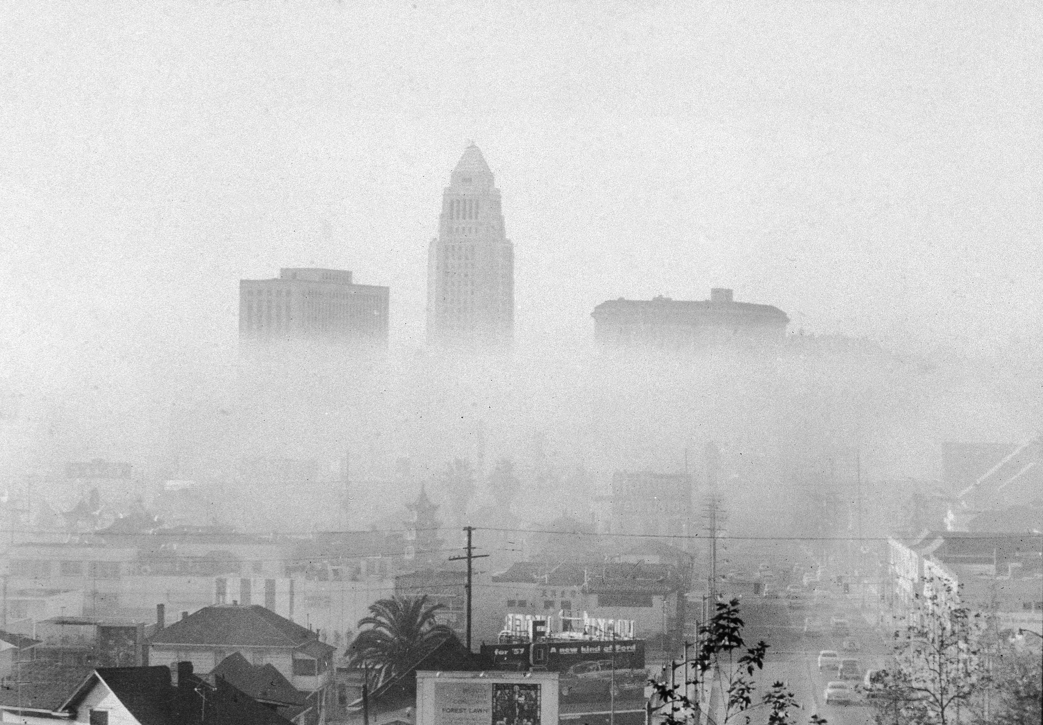


For more than 50 years we've been trying to clean up ICE's
As motivated by news about auto-pollution, illustrated by pictures such as those below
But the highlighted cities have changed, from LA in the 1950-70's,
to Beijing early in this century, to Dehli in the last couple of years
Lack of recent focus on LA suggests its ICE vehicles are now much less polluting
While new reporting about Beijing and Dehli could be explained by either:
Recent vast increases in the number of ICE vehicles being used and/or
ICE vehicles that are still using older, far from state-of-the-art, technology
In different parts of the world, ALL THREE explanations turn out to be correct
Los Angelas - 1954
Beijing - 2015
Dehli - 2019
https://timeline.com/la-smog-pollution-4ca4bc0cc95d
https://www.chinadaily.com.cn/china/2015-04/01/content_19973373.htm
https://www.dw.com/en/new-delhi-schools-closed-as-air-pollution-worsens/a-51235841

Slide 32
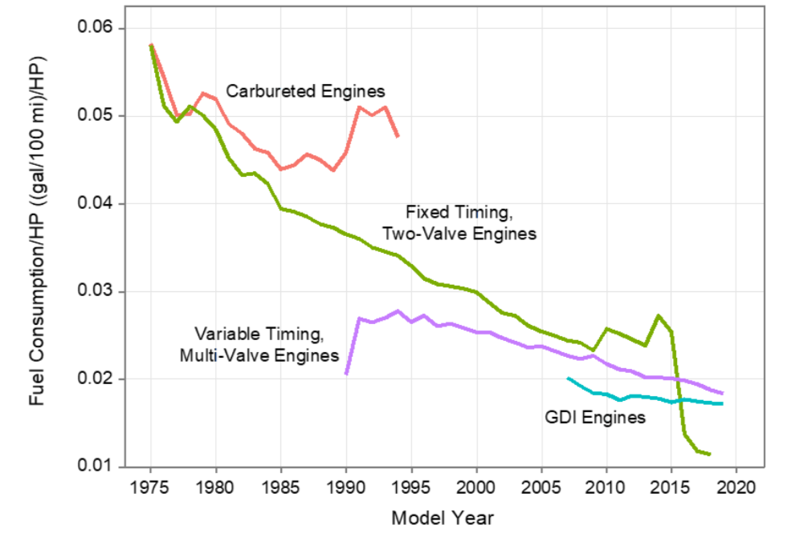
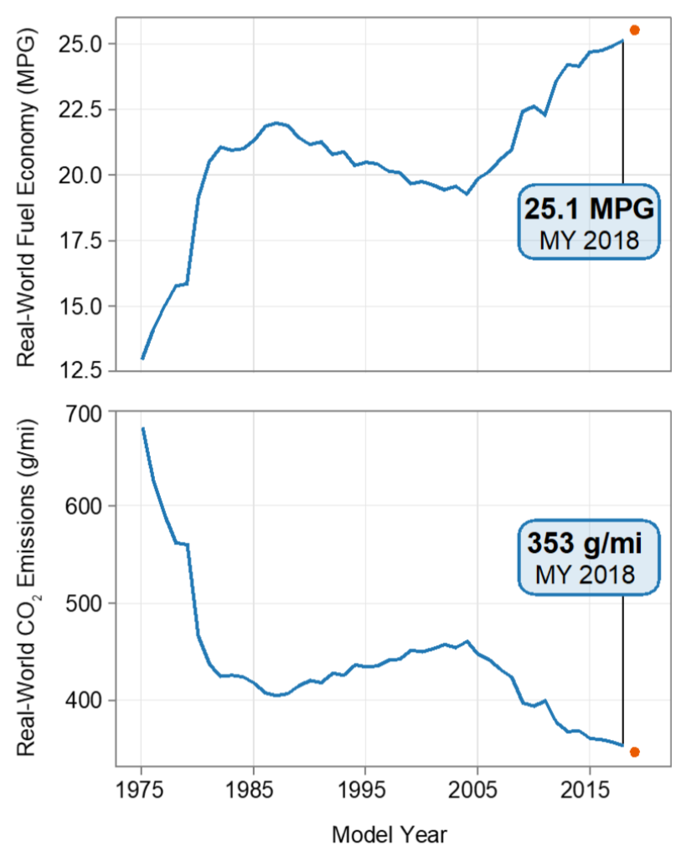
Improvements in state-of-the-art ICE technology are evident in these figures:
From the U.S. Environmental Protection Agency's "2019 Automotive Trends Report" ¹
ICE Fuel Consumption per Horsepower:
Leading to these trends in U.S. ICE auto mileage and emissions:
WHEN we mandated improvement (gas crises of 70/80's + prior U.S. administration)
there WAS phenomenal growth in ICE fuel economy and decline in emissions
1) Pages 46 & 5 in: https://nepis.epa.gov/Exe/ZyPDF.cgi?Dockey=P100YVFS.pdf

Slide 33
But has ICE technology now reached its limit? Experts say no:
Government experts: Including those who developed new fuel mileage standards
mandating a further doubling of U.S. vehicle mileage (to as much as 54.5 mpg) ¹
Auto industry experts: Who'd bitterly labeled 1970-90's standards as "unachievable,"
but who now see opportunity in mandates applied fairly to all competitors, and thus
stood smiling behind the President as he signed new 2012 standards into law ²
Emissions-driven ICE innovation will thus likely continue into a 6th or 7th decade
But laboratory innovation and real-world implementation are very different things:
The developed world is still implementing ICE technologies invented 1990-2000
While the developing world is adopting technologies invented 1970-1980
And the undeveloped is still using technology virtually unchanged since 1950-1970
Technologies developed 1970 onward are thus STILL leading-edge . . . somewhere
Which is WHY I will shortly try to describe that full span of ICE technology
1) https://www.ucsusa.org/resources/brief-history-us-fuel-efficiency
2) https://obamawhitehouse.archives.gov/the-press-office/2012/08/28/obama-administration-finalizes-historic-545-MPG-fuel-efficiency-standard

Slide 34
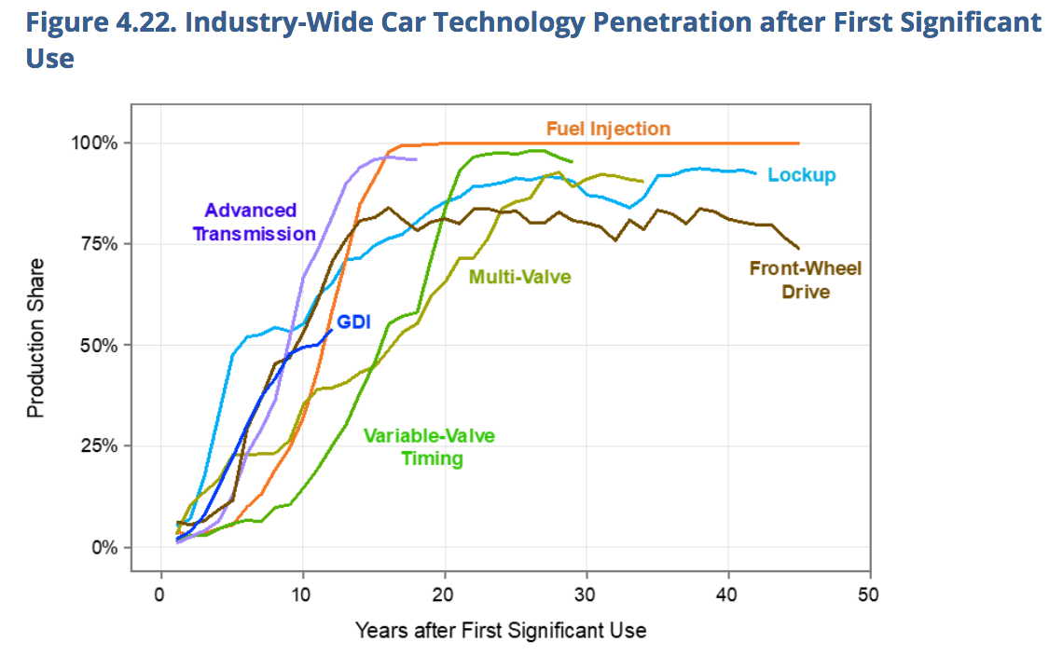
This EPA figure documents the slow rate of U.S. ICE technology introduction: ¹
Page 66 in: https://nepis.epa.gov/Exe/ZyPDF.cgi?Dockey=P100YVFS.pdf

Slide 35
How might ICE vehicles now evolve (over their likely final decades)?
This note set's Resources webpage identifies 100+ sources discussing ICE innovations
But most cover only a single would-be technology innovation, and many were
obviously strongly influenced by that technology's developer or manufacturer
A search on the broader question asked in this slide's title was far less productive
Yielding only a handful of media articles (NPR ¹ and two Scientific American ^{2, 3})
And a pair of government-backed studies (EPA ⁴ & U.S. National Academies ⁵)
The government-backed studies were much longer and much, much more detailed
But, confirming its "Automotive Trends" title, the EPA report looked mostly backward
It did, however, provide the figures used in the last three slides
It also provided the following figure about technologies under investigation,
and the subsequent figure about introduction dates for some of those technologies:
1) https://www.npr.org/transcripts/104315952 2) https://www.scientificamerican.com/article/how-automakers-can-meet-new-fuel/
3) https://www.scientificamerican.com/article/why-automakers-keep-beating-government-standards/
4) https://nepis.epa.gov/Exe/ZyPDF.cgi?Dockey=P100YVFS.pdf
5) https://www.nap.edu/catalog/21744/cost-effectiveness-and-deployment-of-fuel-economy-technologies-for-light-duty-vehicles

Slide 36
List of 2019 "emerging technologies" used by by various manufacturers:
From the U.S. EPA's 2019 Automotive Trends Report ¹
"Engine technologies such as turbocharged engines (Turbo) and gasoline direct injection (GDI) allow for more efficient engine design and operation. Cylinder deactivation (CD) allows for only using part of the engine when less power is needed, and stop/start can turn off the engine entirely when the vehicle is stopped to save fuel. Hybrid vehicles use a larger battery to recapture braking energy and provide power when necessary, allowing for a smaller, more efficiently-operated engine. Transmissions that have seven or more speeds (gears), and continuously variable transmissions (CVTs), allow the engine to more frequently operate near its peak efficiency, providing more efficient average engine operation and a reduction in fuel usage."
1) Page 38 in: https://nepis.epa.gov/Exe/ZyPDF.cgi?Dockey=P100YVFS.pdf

Slide 37
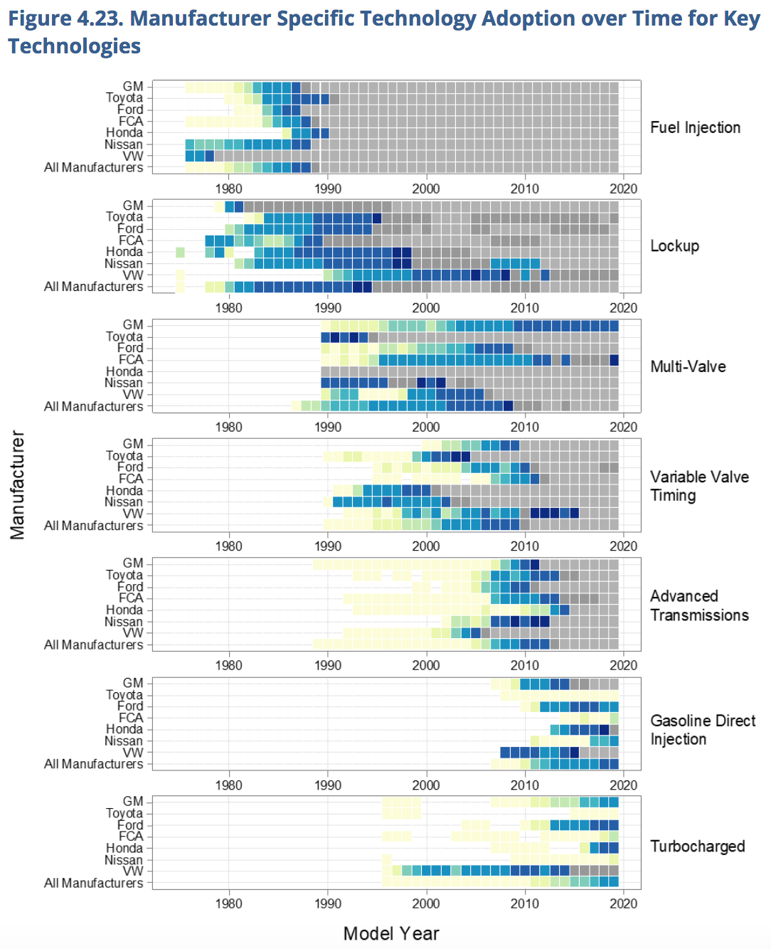
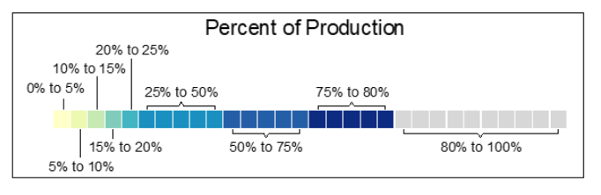
Chronology of technology adoption by various manufacturers: ¹
But this table is a bit misleading:
Most of its "technologies" are actually a whole class of technology, which encompasses many different forms and generations, each of distinctly different effectiveness.
For instance: In the U.S. only the most primitive form of fuel injection was widely introduced by 1990 (as indicated by this figure).
But in fact, introduction of more sophisticated and more effective forms of fuel injection continues right up to the present day.
2
1) Page 68 in: https://nepis.epa.gov/Exe/ZyPDF.cgi?Dockey=P100YVFS.pdf
2) LOCKUP = holding an automatic transmission in a certain gear to reduce fuel consumption

Slide 38
The other government-backed report was from the National Academies ¹
It was entitled:
"Cost, Effectiveness, and Deployment of Fuel EconomyTechnologies for Light-Duty Vehicles"
Running to 479 pages, that report was not only exhaustive but exhausting
Particularly frustrating was its obsession with detail at the expense of perspective:
For instance, in chapter 2, its analysis of fuel consumption extended to the
minor roles played by oils, water pumps, cooling fans & alternators (p. 47)
And in cost-analyzing one technology, it got down to the $1.00 cost of "oil-drillings" (?),
the $1.79 cost of wires & wire connectors, and the $1.80 cost of a larger fuel pump (p. 50)
And when the report did finally get to the point of presenting its summary of:
"Estimated Fuel Consumption Reduction Effectiveness of SI Engine Technologies"
That summary spanned seven pages of single-spaced text tables (pp. 90-96), making
identification of the most promising & rapidly impactful technologies very difficult
1) https://www.nap.edu/catalog/21744/cost-effectiveness-and-deployment-of-fuel-economy-technologies-for-light-duty-vehicles

Slide 39
Finally, returning the media's answer to "How might ICE vehicles now evolve?"
Those answers came from three overview articles, from NPR ¹ & Scientific American ^{2, 3}
I decided to tally the number of times they mentioned any technology
Those mentions were (as indicated by the references):
More efficient ICE engines (via a variety of possible sub-technologies) ^{1, 2, 3}
Lighter vehicles ^{1, 2, 3}
Gas engine + electric motor vehicles (a.k.a. Hybrid Electric Vehicles) ^{1, 2, 3}
More efficient transmissions ^{1, 3}
More aerodynamically vehicles ¹
Smaller vehicles ²
Diesel powered cars ¹
More efficient climate control systems ³
1) https://www.npr.org/transcripts/104315952 2) https://www.scientificamerican.com/article/how-automakers-can-meet-new-fuel/
3) https://www.scientificamerican.com/article/why-automakers-keep-beating-government-standards/

Slide 40
By merging together the answers from all of those sources
Then adding impressions gained from those 100+ Resources webpage sources
It appears that the most promising paths towards Greener Cars & Trucks are:
At the top of the list: Improved Internal Combustion Engines (ICEs)
This note set's next section thus focuses on the many forms that may take
Closely related, and thus next down the list: More effective USE of ICEs
Leading to a section about alternate transmissions and Hybrid Electric Vehicles
Also closely related is the possibility of Diesel powered cars, which will be discussed
in an introductory section about ICEs and a later section about Diesel emissions
Finally, the preceding section about Physics modeling of vehicle motion energy
prompts a group of options receiving both direct & indirect attention:
lighter, smaller, and more aerodynamic vehicles
1) https://www.npr.org/transcripts/104315952 2) https://www.scientificamerican.com/article/how-automakers-can-meet-new-fuel/
3) https://www.scientificamerican.com/article/why-automakers-keep-beating-government-standards/

Slide 41
But responses to those final options are controversial (especially in the U.S.)
For stop & go vehicle travel our Physics-based model concluded:
Energy / Power use is mostly due kinetic energy put into the vehicle's motion
which is then lost (heating the brakes) every time the vehicle stops
That Energy / Power is proportional to the vehicle's mass
Vehicle weight reduction has thus been, and is still being, aggressively pursued
To date: By replacing much of the vehicle body & engine steel with aluminum
In the future (inspired by aircraft): By replacing metals with fiber composites
But weight reduction affects strength, ultimately compromising crash survivability
Hence the approach of reducing vehicle weight by reducing vehicle size
Which runs absolutely contrary to mainstream buying preferences of U.S. consumers
Leading to the alternative of developing Kinetic Energy Recovery Systems
Which are thus covered in another upcoming section of this note set
1) https://www.npr.org/transcripts/104315952 2) https://www.scientificamerican.com/article/how-automakers-can-meet-new-fuel/
3) https://www.scientificamerican.com/article/why-automakers-keep-beating-government-standards/

Slide 42
Our other Physics model prompted the remaining option of streamlining:
For higher speed steadily-moving highway travel that Physics model concluded:
Energy / Power goes mostly into the kinetic energy of a trailing volume of air
That Energy / Power is proportional to that air's mass, and thus to the air's volume,
which is strongly affected by the vehicle's frontal area and shape
Specifically: Energy per distance steady = ½ ρ_{air} c_{drag} A_{vehicle} v_{steady}²
Power_{steady} = ½ ρ_{air} c_{drag} A_{vehicle} v_{steady} ³
One option is thus to shrink the vehicle's frontal area (A_{vehicle})
  But (again especially in the U.S.) larger, not smaller, vehicles are strongly favored
A second option (opposed pretty much worldwide) is reducing vehicle speed (v_{steady})
A third option is reducing air density (ρ_{air}), as inside Elon Musk's proposed Hyperloop
Leaving only the option of shrinking the vehicle's drag coefficient (c_{drag}) via streamlining
1) https://www.npr.org/transcripts/104315952 2) https://www.scientificamerican.com/article/how-automakers-can-meet-new-fuel/
3) https://www.scientificamerican.com/article/why-automakers-keep-beating-government-standards/

Slide 43
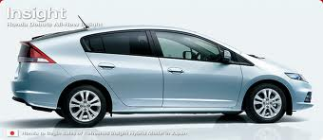

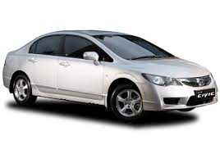
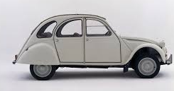
But we've already approached the practical limits of streamlining:
        cdrag:
Honda Insight 0.25
Prius 0.26
Renault 25 0.28
Honda Civic 0.31
Volkswagen Polo 0.32
Peugeot 206 0.33
Ford Siesta 0.34
Audi TT 0.35
Honda Civic 0.36
Citroen 2CV 0.51
For modern cars (unlike the Citroen 2CV):
Streamlining => diminishing returns
Somewhat boxy Polo: c_{drag} = 0.32
Teardrop shaped Insight: c_{drag} = 0.25
Total reduction is only ~ 20%
Stronger improvement would require:
Much longer (and hence heavier) cars
Or much lower cars (as used in racing)
With more difficult entry & exit AND
Much less passenger / cargo space
Thus moving onward to a discussion of:

Slide 44
GREENer Cars & Trucks:
Improving Internal Combustion Engines
(ICE Basics / Diesel vs. Gas / Fuel-Air Mix / Timing / Turbocharged Small ICEs)
An Introduction to Sustainable Energy Systems: WeCanFigureThisOut.org/ENERGY/Energy_home.htm

Slide 45
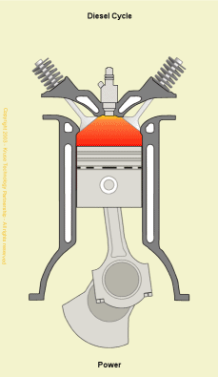
ICE Basics: The classic "4-stroke" Engine
Piston within cylinder is tied by connecting rod to rotating (wheel-driving) crankshaft
Crankshaft is connected via a timing belt to one or two camshaft(s) (not shown)
Cams (bumps) on camshaft(s) open one of two types of valve in the cylinder roof
Stroke 1: Piston falls, cam opens left valve(s), air OR fuel + air mixture is drawn inward
Stroke 2: Valve closes, rising piston compresses and heats air or fuel + air mixture
End of Stroke 2: If not already added, fuel is then injected
Compressed fuel + air mixture is then ignited
vastly increasing its temperature & pressure
Stroke 3: High pressure drives piston back downward
Stroke 4: Piston rises as cam on camshaft opens right valve(s)
allowing hot high-pressure exhaust gases to exit
Near top of piston's stroke, the exhaust valve(s) closes
Back to Cycle #1, repeat as wanted or until fuel is gone
(PgDn to animate)
Animated gif: http://www.kruse-ltc.com/Diesel/diesel_animation.html

Slide 46
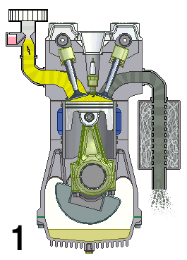
Labeled parts of a gasoline Spark Ignition Internal Combustion Engine (SI-ICE):
(PgDn to animate)
Intake Valve (1 or 2)
driven up & down by one cam
Exhaust Valve (1 or 2)
driven up & down by other cam
Spark
Plug
Carburetor
mixing fuel with air
Exhaust Pipe
Piston
Connecting Rod
Engine Crankshaft
Exhaust Muffler
Stroke # =
https://commons.wikimedia.org/wiki/File:4-Stroke-Engine-with-airflows_numbers.gif

Slide 47
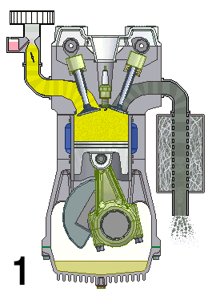
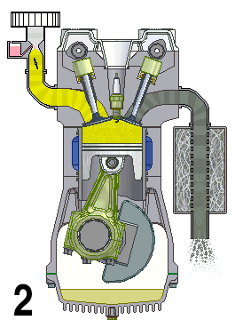
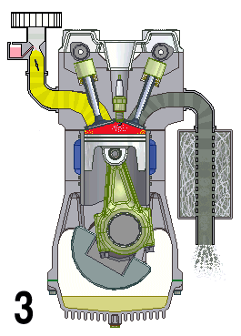
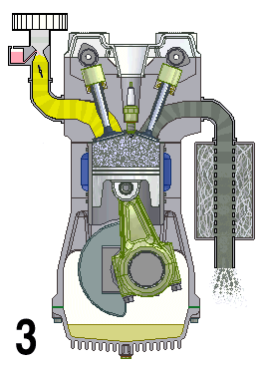
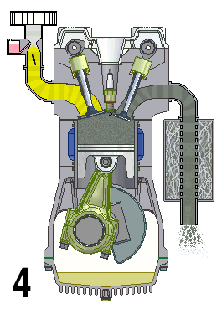
From: https://commons.wikimedia.org/wiki/File:4-Stroke-Engine-with-airflows_numbers.gif
In stop action:
Downstroke:
Fuel + Air Intake
via open left valve(s)
Upstroke:
Fuel + Air Compression
Fuel + Air Ignition
caused by spark plug
Downstroke:
Combustion Gas Expansion
Upstroke:
Combustion Gas Exhausting
via open right valve(s)
All valves closed

Slide 48
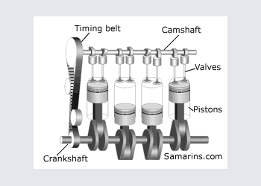
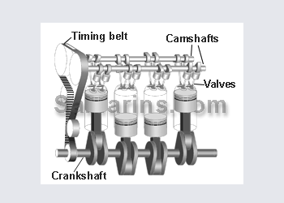
Finally, paying attention to the valves and what is driving them:
They're opened & closed by cams (bumps) on one or two camshafts atop the engine
Which are rotated by a timing belt connected to the crankshaft low in the engine
(PgDn repeatedly to start animations)
Intake Valve(s)
driven up & down by camshaft
Exhaust Valve(s)
driven up & down by camshaft
X-ray side view of entire
Over Head Valve (OHV) Engine with
Single Over Head Camshaft (SOHC)
(two valves per cylinder)
X-ray side view of entire
Over Head Valve (OHV) Engine with
Dual Over Head Camshaft (DOHC)
(four valves per cylinder)
Top: https://commons.wikimedia.org/wiki/File:4-Stroke-Engine-with-airflows_numbers.gif
Bottom: https://www.samarins.com/glossary/dohc.html

Slide 49
Diesel vs. Gas: Where and when fuel is added:
Classic Gasoline SI-ICEs:
Outside of the cylinder, gasoline mist / vapor is first mixed with air,
that mixture is then drawn into the cylinder (during stroke 1)
Engine speed is varied by changing the mixture's fuel / air ratio
AND by varying exactly when that fuel + air mixture is spark-ignited
Diesel ICEs:
After air is drawn in and compressed by the rising piston (end of stroke 2),
pure diesel fuel is injected into that compressed / heated air within the cylinder
Engine speed is varied by changing only the amount of fuel injected
An Introduction to Sustainable Energy Systems: WeCanFigureThisOut.org/ENERGY/Energy_home.htm

Slide 50
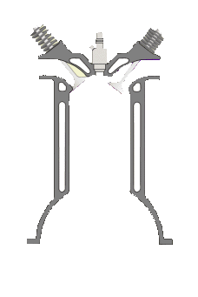

Diesel vs. Gas: How fuel is ignited:
Diesels change the rotating point where the connecting rod attaches to the camshaft
Large circle => Long piston stroke: Small circle => Short piston stroke:
Fuel
Injector
Fuel
Injector
Piston Stroke
Crankshaft Turning Circle
Long => high compression ratio (max / min volume) => Much more air compression
Diesel engines thus compress air by 14-25 times (vs. ~10 times in gasoline ICEs) ^{1, 2}
More air compression => More heating => Air temperatures at or above 500ºC ¹
Hot enough that many injected fuels almost immediately auto-ignite, including
less-refined fuels such as standard diesel, biofuels & used cooking oil
1) https://www.explainthatstuff.com/diesel-engines.html 2) https://en.wikipedia.org/wiki/Diesel_engine

Slide 51
But both types of ICE are still "Thermal Engines"
So called because when input energy creates temperatures differences within them,
those differences can be used to induce motion (thermal energy => kinetic energy)
Thermal Engine conversion efficiencies are modeled by the Carnot Cycle ¹
Which predicts energy conversion efficiencies of: (Tmax - Tmin) / Tmax
  Where Tmax & Tmin are highest and lowest temperatures within the engine
For all ICEs, Tmin ~ Tincoming air ~ Tambient air (in the absence of added technologies) ²
But the higher compression within Diesel engines drives up Tmax in a number of ways:
Stronger compression heats the pre-combustion air to much higher temperatures
Stronger compression increases the O2 available, thereby intensifying combustion
Leading the Carnot formula to correctly predict much more efficient Diesel operation:
Diesel efficiencies = 40-45% vs. Gasoline Si-ICEs efficiencies ≤ 20%
Doubling Diesel fuel mileage . . . possibly halving GHG output? (more about that later)
1) For further discussion about the Carnot Cycle, see my note set: Fossil Fuels (pptx / pdf / key)
2) Such as: TURBOCHARGING (which heats incoming air) or INTERCOOLING (which then tries to cool it back down)

Slide 52
Apparent bottom lines: Diesels are FAR more efficient and FAR simpler:
To control their speed (power and GHG emissions) gasoline SI-ICEs must:
- Vary the fuel to air ratio of the mixture drawn into the cylinder
Which was once done by finicky but cheap mechanical "carburetors"
but is now increasingly done by injection devices
controlled by less finicky but expensive & complex control electronics
- Vary the exact timing and intensity of the electronic pulse sent to the spark plug
    As once done by finicky but cheap mechanical "distributors & ignition coils"
    but now done by less finicky but expensive & complex electronic ignitions
To control their speed Diesels must instead:
- Vary the amount of fuel injected into the already compressed cylinder air
PERIOD
Diesels' greater simplicity => Enhanced reliability => Lower operating costs

Slide 53
But then along came Dieselgate:
Which was a scandal revealing massive fraud in emissions testing of Diesel engines ¹
During emission tests, cars were typically operated in non-real-life modes,
such as at constant speed, or in one particular stop & go cycle
Which simplified testing, making it both more reproducible & automatable
But like all of today's cars, diesel cars have considerable onboard computer power
and a Volkswagen cabal recognized that those computers could be
programmed to recognize when the vehicle was being emissions tested
And further programmed to then temporarily reduce the vehicle's emissions,
by altering fuel use in ways which would degrade real-world driving performance,
  but likely remain undetected by automated emissions-testing equipment
Convicted in both German and U.S. courts, Volkswagen / Audi has since paid:
"$33.3 billion in fines, penalties, financial settlements and (diesel) buyback costs" ¹
Testing by Volvo, Renault, Jeep, Hyundai, Citroen & Fiat has also been questioned
1) https://en.wikipedia.org/wiki/Volkswagen_emissions_scandal

Slide 54
So what IS the truth about Diesel engines' environmental friendliness?
Industry sources (now considerably lacking in credibility) claim that use of Diesels
has massively reduced worldwide vehicle CO2 emissions ¹
The basic science suggests this should be possible for at least an idealized Diesel:
From my note set about Fossil Fuels (pptx / pdf / key):
Diesel's molecules are 8-21 C atoms long, gasoline's 4-12 C atoms long
Meaning that, per molecule, diesel packs ~ twice the C of gasoline
But tighter molecular packing ultimately gives diesel up to 20% higher mass density ²
Suggesting ~ 20% more C per volume of diesel fuel => Estimate of CO2 output:
(1.2 x higher C / vol) (0.5 vol burned /distance) => 0.6 CO2 produced per distance
But back out in the real world, non-industry sources report much poorer results
From the International Council on Clean Transportation's lab + on-road study: ³
"gasoline vehicle(s) can have the same or lower CO2 emissions than a comparable diesel"
1) https://www.smmt.co.uk/2015/03/smmt-puts-record-straight-on-diesel-cars-with-new-nationwide-consumer-campaign/
2) https://www.engineeringtoolbox.com/fuels-densities-specific-volumes-d_166.html
3) https://theicct.org/publications/fact-sheet-gasoline-vs-diesel-car-co2-emission

Slide 55
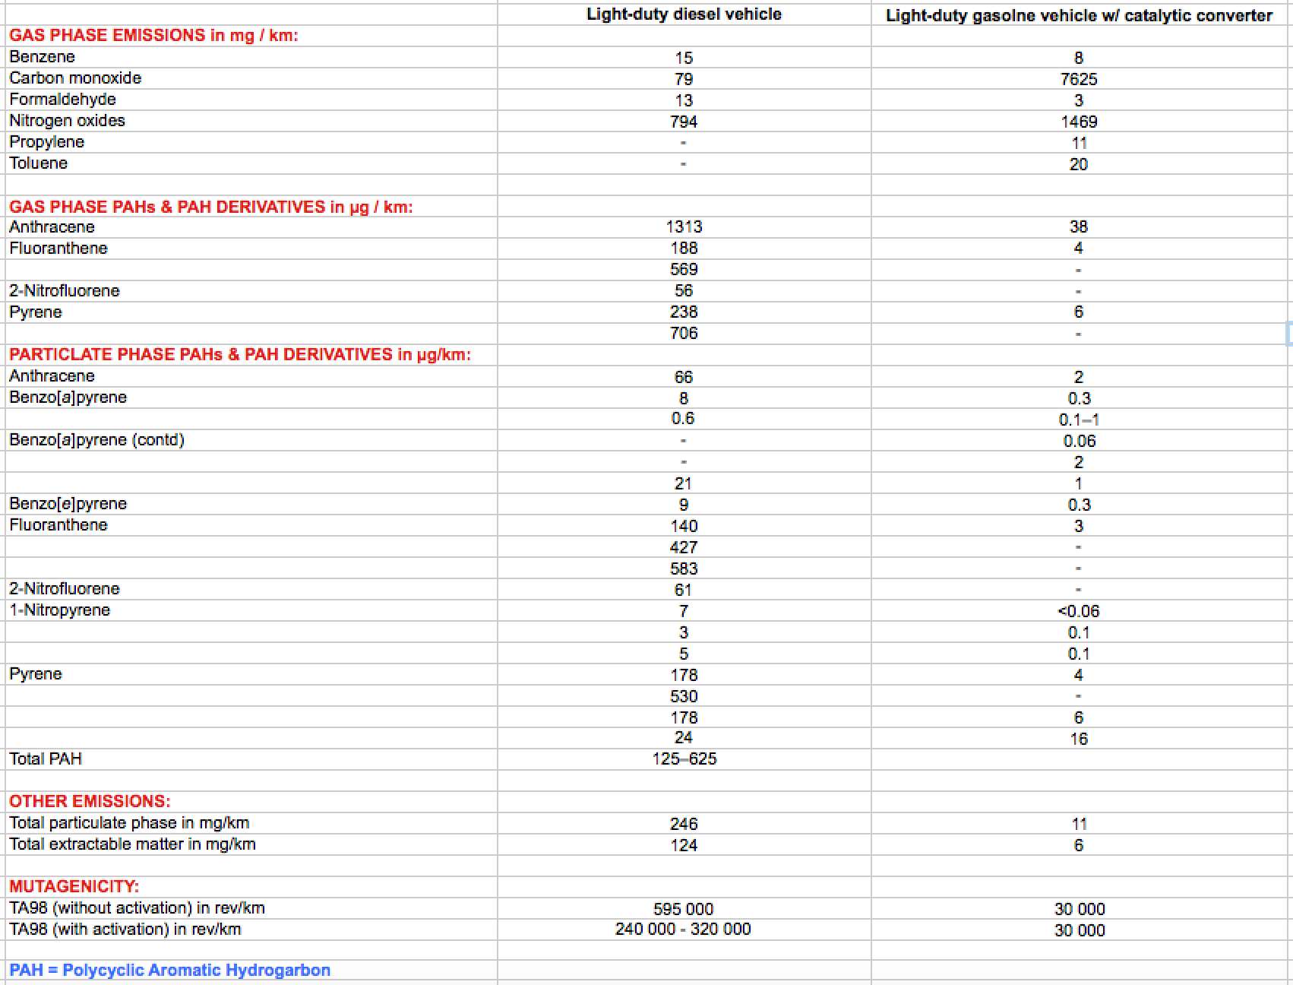
Further, Diesels emit more particulates & organics, including mutagens:
From a study posted on the U.S. National Institutes of Health website: ¹
Reasons why Diesel exhaust is SO much richer in unhealthful particulates & organics?
Greater complexity of diesel fuel molecules + ultra-fast & thus incomplete combustion
1) My Excel table above is abstracted from Table III in the study: Diesel and Gasoline Exhausts . . .
As downloaded from the U.S. National Institutes of Health website at: https://www.ncbi.nlm.nih.gov/books/NBK531294/

Slide 56
Others echo this concern about the unique character of Diesel emissions
For instance, in the European Environmental Agency's report: "Air Quality in Europe" ¹
Putting this all together, my takeaway is that:
Higher conversion efficiency means simple diesel engines can use less fuel,
reducing their output of the primary hydrocarbon combustion products CO2 & H2O
But reductions have been effectively matched in complex modern gasoline engines,
which exploit their more numerous ways of fine-tuning combustion
Diesels have thus lost their strong theoretical advantage in primary GHG emissions,
and attention has turned to their secondary emissions which,
while they may have a lower long term global warming impact,
could well have a more immediate human health (and biosphere) impact
I will thus now focus on the possible improvement of ONLY gasoline ICEs
1) See, for instance pages 15, 18 & 84 in: https://www.eea.europa.eu/publications/air-quality-in-europe-2016

Slide 57
How might SI-ICEs be markedly improved . . . within just 5-10 years?
This earlier "EPA Automotive Trends Report" figure provides some cryptic hints: ¹
1) Page 46 in: https://nepis.epa.gov/Exe/ZyPDF.cgi?Dockey=P100YVFS.pdf
Improvements suggested by that figure involve either:
Better control of HOW & WHERE fuel and air get mixed
Better control of WHEN the fuel air mix enters the cylinder
OR of WHEN air, then fuel, separately enter the chamber
OR of WHEN, however it got into there, the resulting mix is ignited
An Introduction to Sustainable Energy Systems: WeCanFigureThisOut.org/ENERGY/Energy_home.htm

Slide 58
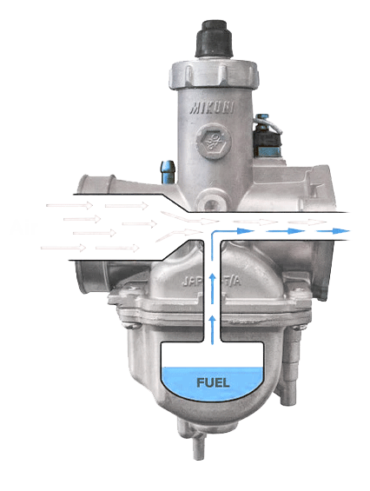
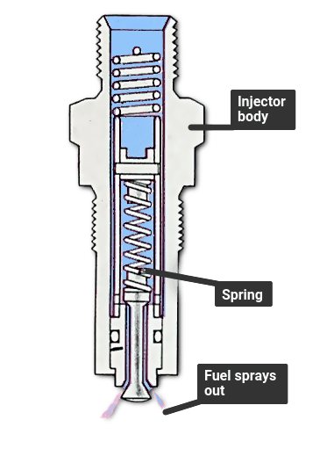
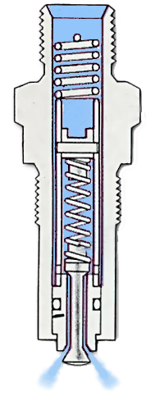
Fuel-Air Mix: What IS a fuel injector & how is it used?
Fuel Injectors are all about creating a fast & cleanly burning fuel + air mixture:
This was originally done by Carburetors inside of which (via the Venturi effect) passing air sucked gasoline out of a reservoir forming a stream of droplets
Which was a fuel + air mixture, but a
crude one that did not facilitate rapid and
complete combustion of that gasoline
Fuel pumps instead supply Fuel Injectors with high-pressure gasoline
That pressurized fuel then sprays out of the Injector via a carefully designed "atomizing" nozzle. The result is a very fine mist of fuel in air, which can burn much more quickly and completely
Derived from: https://www.revzilla.com/common-tread/how-does-a-carburetor-work
Derived from: https://www.howacarworks.com/basics/how-a-fuel-injection-system-works

Slide 59
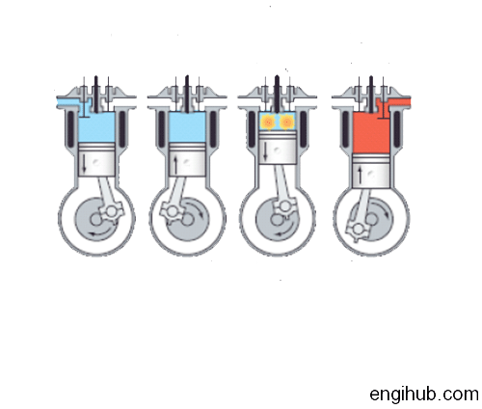
But Fuel Injectors have been used in all sorts of different ways:
Classic gasoline ICEs had a single Carburetor mixing together fuel and air,
which was then drawn by opening intake valves into one cylinder after another
1980's vintage cars simply replaced that single Carburetor with a single Fuel Injector:
Parts of figure derived from: https://engihub.com/diesel-engine-working/

Slide 60
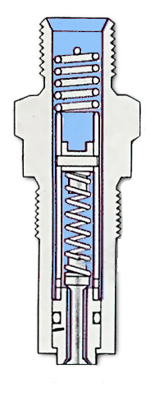
But as they pass down pipes, ultra-fine fuel droplets tend to coalesce
Forming fewer larger droplets, undercutting the advantage of Fuel Injectors,
which is to create a more quickly and completely burning fuel + air mixture
Later cars thus incorporated one Fuel Injector per ICE engine cylinder,
with that injector injecting fuel into the air pipe just outside of the cylinder
(with the subsequent intake valve(s) still controlling admission of the fuel + air)
While in the most recent cars, injectors shoot directly into each cylinder, giving them
FULL control of the fuel's injection (with the intake valves then controlling only air)
This is the Gasoline Direct Injection (GDI) referred to in earlier figures

Slide 61
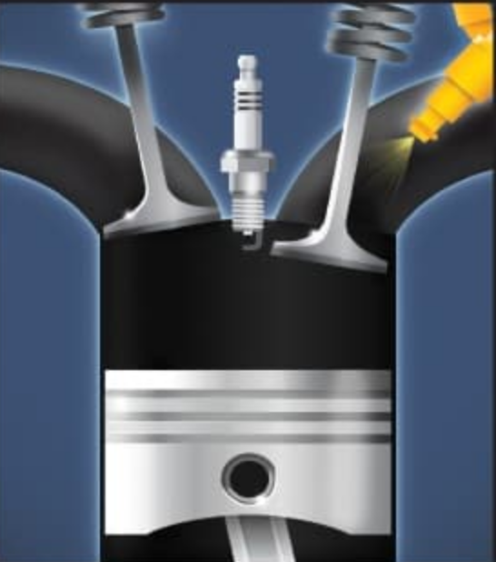
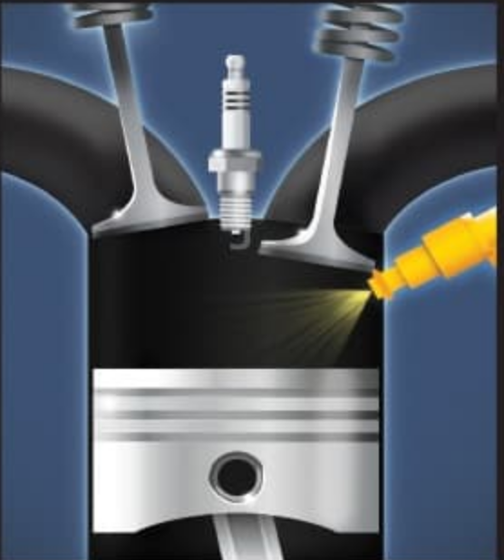
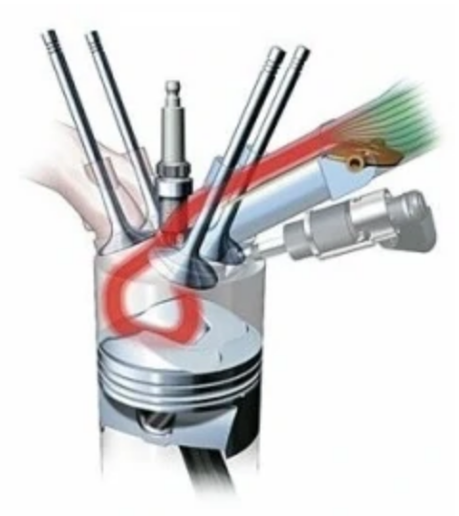
The full alphabet soup of Fuel Injection gets even more confusing:
MPFi = Multi Port Fuel Ignition
also called just: =
PFI = Port Fuel Injection
=
GDI = Gasoline Direct Injection
also called: =
SIDI = Spark Ignited Direct Injection
=
FSI = Fuel Stratified Injection = CGI = Charged Gasoline Injection
Injector & intake valve(s) are designed such that near the spark
plug fuel air mix is "richer" in fuel (and thus more readily ignited)
But such that fuel mix lower down is "leaner" (i.e., having an excess of air / oxygen) promoting more complete & cleaner combustion
Figures:
Right top/middle: https://autoportal.com/articles/what-is-gdi-fsi-cgi-sidi-direct-injection-6965.html
Right bottom: https://automobile.fandom.com/wiki/Fuel_Stratified_Injection

Slide 62
But the important takeaways about Fuel Injection are that:
In the most advanced SI-ICEs, gasoline is now injected directly into the cylinder,
just as diesel fuel is injected directly into the cylinders of Diesel Engines
But Fuel Injected gasoline SI-ICE's still require the use of spark plug ignition
While Diesel engines instead rely upon auto-ignition,
as enabled by their cylinder's greater compression and thus higher air heating which,
for their more combustible diesel fuels, enables auto-ignition
But in gasoline SI-ICEs, Fuel Injection DOEs enhance fuel vaporization,
especially when that injection is directly into the cylinders,
which also allows for sophisticated fuel-saving / pollution-reduction strategies
such as non-uniform "stratified" fuel-air mixtures
However:
This improved control of HOW & WHERE is only half of what's really needed
The other half is better control of WHEN:

Slide 63
Timing: Essential for proper ICE operation, especially in gasoline ICE's:
Viewed in slow motion, ICE timing seems easy (PgDn):
During full downward Stroke 1: Keep the inlet valve(s) open
Allowing fuel + air mix to enter
During full upward Stroke 2: Keep all valves closed
Compressing fuel + air mix
At Top of Piston Travel: Fire Spark Plug
Igniting fully compressed fuel + air mix
During full downward Stroke 3: Keep all valves closed
While hot combustion gases expand
During full upward Stroke 4: Open exhaust valve(s)
Expelling combustion gases
But as we drive, our gasoline ICE's speed can range from about 700 to 7,000 RPM
Meaning that one engine rotation lasts only 85 to 8.5 milliseconds
And that the full two-rotation 4-Stroke cycle lasts only 170 to 17 milliseconds
https://commons.wikimedia.org/wiki/File:4-Stroke-Engine-with-airflows_numbers.gif

Slide 64
On millisecond time scales, critical things occur slowly within an ICE:
During Stroke 1, starting & stopping inward air + gas flow takes milliseconds
Gas molecules travel at a finite speeds, meaning they have finite momentum
But, barring infinite force, Newton says neither can change instantaneously
Between Strokes 2 & 3, fully igniting the compressed air + gas takes milliseconds
Because the spark plug's spark can only excite nearby fuel and O2 molecules
and that excitation must then be passed molecule-to-molecule outward
During Stroke 4, starting & stopping outward exhaust gas flow takes milliseconds
For same reason Stroke 1 air + gas molecules couldn't respond instantaneously
All three of those processes thus need to be given a HEAD START
Getting head starts right STRONGLY AFFECTS ICE EFFICIENCY & EMISSIONS
An Introduction to Sustainable Energy Systems: WeCanFigureThisOut.org/ENERGY/Energy_home.htm

Slide 65
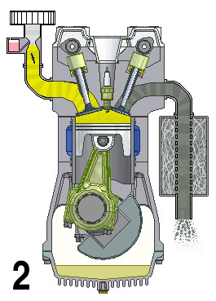
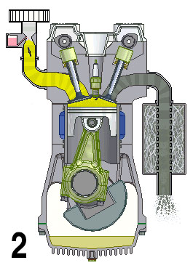

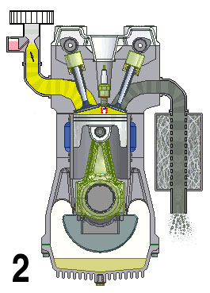
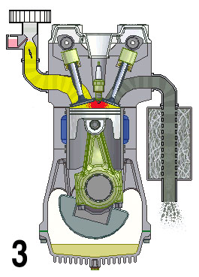

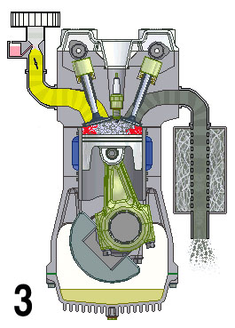
The earlier ICE animation portrayed one of those HEAD STARTS:
Here are its seven animation frames, from late in Stroke 2 to early in Stroke 3 (PgDn):
- 45º : Piston rising, fuel + air compressing
- 30º : Piston rising, fuel + air compressing
- 15º : Spark plug fires
0º : Small local pocket of combustion
15º : Spreading pocket of combustion
30º : Nearly complete central combustion
45º : Final outer edge combustion
-45º
-30º
-15º
0º
15º
30º
45º
Stroke 2: Fuel + Air Compressing
Stroke 2: Fuel + Air Compressing
Stroke 2: Spark Plug Fires
"Top Dead Center"
Stroke 3: Partial Combustion
Stroke 3: Full Combustion
Stroke 3: End of Combustion
https://commons.wikimedia.org/wiki/File:4-Stroke-Engine-with-airflows_numbers.gif

Slide 66
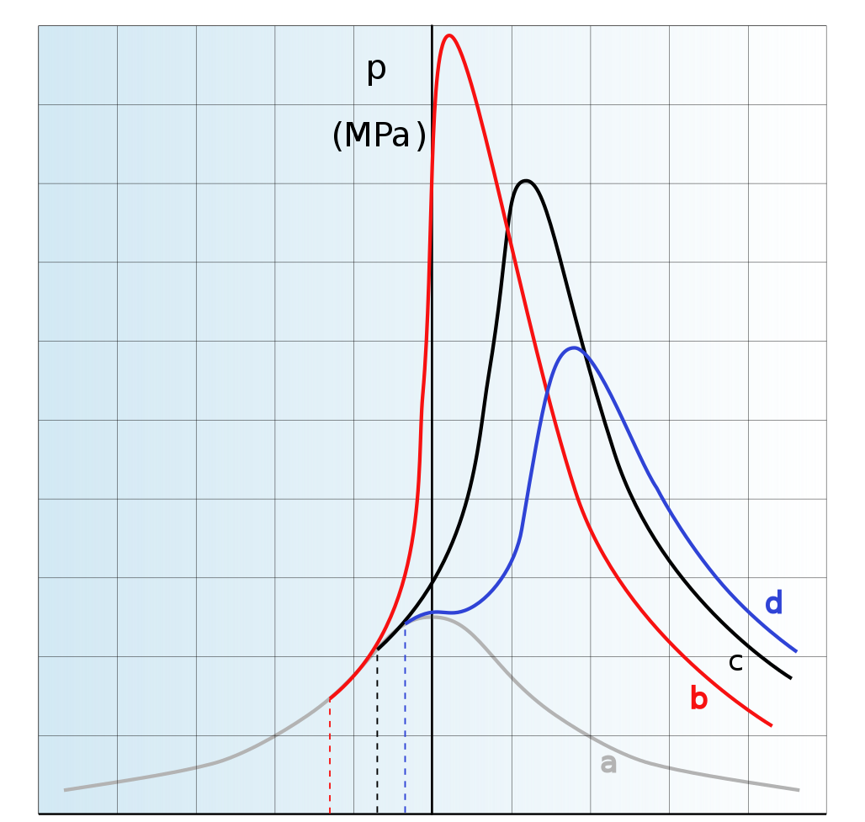
Real life fuel + air combustion takes about 3 milliseconds ¹
As determined by the chemistry & physics governing hydrocarbon + O2 ignition,
followed by that of heat spreading outward through a highly compressed gas
During those ~ 3 milliseconds, pressure inside the cylinder rises and falls,
as depicted in these curves which differ in the amount of spark plug Head Start ²
Of these curves, "c" is optimum in that it maximizes the product of pressure x duration
and that combustion cycle thus drives the piston downward most strongly
That curve's dashed beginning marks where in time the spark plug should be sparked
One Head Start problem seemingly solved! Not quite:
Because in classic ICEs timing is not based on time
Timing is instead based on the engine rotation angle:
(PgDn twice)
1) See the excellent video at: https://carbiketech.com/ignition-timing/ 2) https://en.wikipedia.org/wiki/Ignition_timing

Slide 67
Well, just convert timing to rotation angle via the engine's speed!
For instance, at 6000 RPM ICEs rotate 360º in 1/100 Second => 36º per mS
Thus, if the spark plug needs to fire ~ 1 mS before the piston reaches cylinder top,
its firing should be advanced to about 36º before top dead center (BTDC)
But that was not what the animation depicted - it showed 15º before top dead center
Yes, because ICEs turn at anywhere from about 700 to 7,000 RPM
Making the animation's spark firing at 15º before top dead center
consistent with a ~ 1 mS advance for an engine turning at 2,500 RPM
MY POINT: While rotational mechanics was indeed used to set ICE timing,
that timing was then BUILT-IN to the ICE's gears, belts, camshafts & cams
Those were chosen to OPTIMIZE efficiency & emissions at ONE SPEED
But diverging from that speed, operation became increasingly SUB-OPTIMAL ¹
1) An historical exception: As ICE's speed up, the suction of air into their cylinders increases, and that increasing partial vacuum was used to slightly advance the sparking charge sent from a mechanical "ignition distributor"

Slide 68
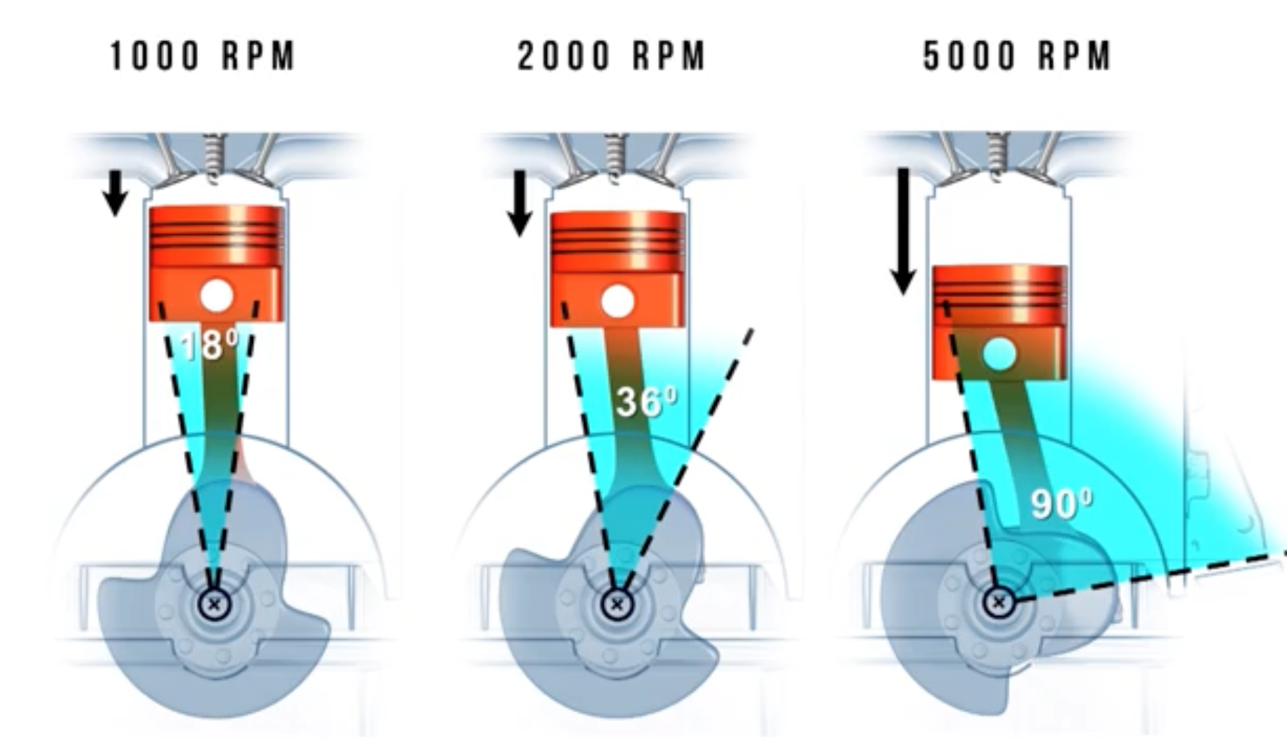
It's easy to see why timing of the spark is hyper-critical:
Spark too early and combustion will fight against the upward piston motion of Stroke 2
Spark too late and combustion might continue past the end of downward Stroke 3
allowing still expanding gas to escapes though Stroke 4's open exhaust valve(s)
But the timing of the intake & exhaust valves is similarly hyper-critical
Depending on the speed at which the ICE is rotating,
look how far it rotates while completing 3 mS of fuel-air combustion:
From the video at: https://carbiketech.com/ignition-timing/
Radical changes in ignition span call for similarly aggressive changes in valve timing

Slide 69
But to this day, valve timing is STILL controlled mechanically
Making it one of few ICE features that has hardly changed in fifty years:
An ICE's crankshaft turns timing belt turning camshaft(s) opening valves (PgDn):
Emissions could be reduced by what's labeled Variable Valve Timing (VVT)
Which has thus far been pursued by making the mechanics even more complex
The reviews I found on VVT development had virtually no explanatory illustrations ^{1, 2}
Leading me to instead gather figures from throughout the Internet =>
1) https://en.wikipedia.org/wiki/Variable_valve_timing 2) https://en.wikipedia.org/wiki/Camless_piston_engine

Slide 70
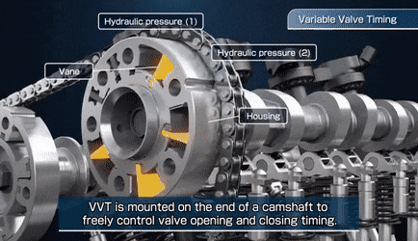
One VVT goal is to adjust the "phasing" of the camshafts: ¹
That is the equivalent of somehow removing and then reinstalling the timing belt
such that it engages the gear on the camshaft a few teeth earlier or later
That effect can be produced by redesigning that gear, so that when oil is driven into it
an internal vane attached to the camshaft slightly shifts its rotation (PgDn):
The obvious challenge of this approach is getting the controlling hydraulic oil
reliably in and out of that rapidly rotating assembly (i.e., w/o it leaking away)
1) Without source attribution, this animated gif is widely posted. I identify it as being derived from a
YouTube video from Japan's Aisin Group about their VVT technology: https://www.youtube.com/watch?v=0EzBGIO8Y2U)

Slide 71
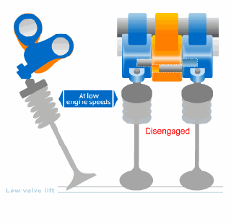
Instead, sliding pins might select between alternate secondary cams ¹
Which, because of their different shapes, would open & close valves differently,
changing how long they are open and/or how widely they are open (PgDn):
Rotating camshaft
with primary cams
Rocking secondary cams
Elegantly, here while the camshaft and its cams are still a rapidly rotating assembly,
secondary cams are not part of that assembly, with pivot points fixed to the engine
Their simple rocking makes sliding the controlling pins hugely simpler (PgDn again)
1) Again without source attribution, this animated gif is widely posted. I could not identify its source, but it depicts Honda's "VTEC"
version of VVT technology as described & depicted at: https://global.honda/heritage/episodes/1989vtecengine.html

Slide 72
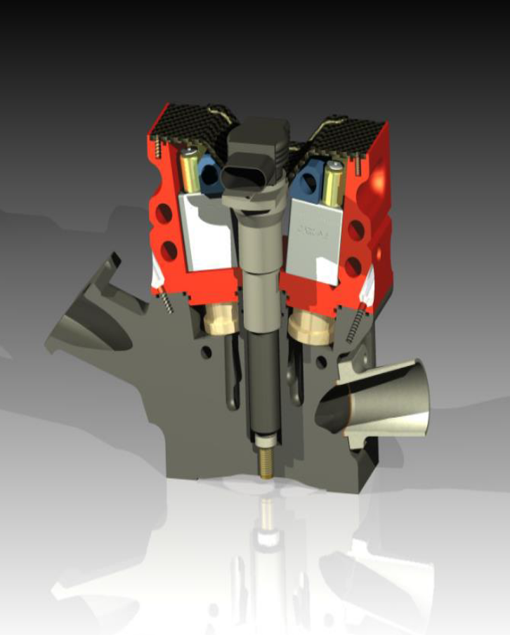
The obvious (but perhaps still too expensive?) alternative:
Completely eliminating the timing belt, camshaft and cams,
putting in their place cylinder-by-cylinder,
completely fixed-in-position,
pneumatically or electronically-actuated valves
This has been proposed by a company variously called "FreeValve" or "Cargine" ¹
Which at one point posted a PowerPoint presentation depicting their valve:
This (or an equivalent technology) would be as revolutionary
as the earlier replacement of Carburetors by GDI Fuel Injection
in that, under complete electronic control, valve timing and
duration of opening could be arbitrarily and immediately varied
to accommodate the ICE's current operating speed / mode
1) https://www.freevalve.com/

Slide 73
Finally: ICE's can steal technology from gas-guzzling / GHG-spewing supercars
Specifically, a technology applied to the incoming air: Turbocharging + Intercooling
These were developed to enhance large engine performance (GHGs be damned!):
Turbocharger = Air Compressor Intercooler = Heat Exchanger
THE IDEA: If the air ENTERING the engine were denser,
after heating it by combustion it would try to expand more
pushing the pistons downward more strongly => More ICE power per fuel consumed
ITS IMPLEMENTATION: Incoming air is densified by compressing it = Turbocharger's job
But compressing that air also heats it, inhibiting its fuller compression
That's corrected by cooling the hot air leaving the Turbocharger = Intercooler's job
Figure: https://en.wikipedia.org/wiki/Turbocharger
Figure https://burnsstainless.com/blogs/articles-1/air-to-water-intercooler-tech-101-what-it-does-and-what-you-need

Slide 74
Turbocharger = Air Compressor
Air can be compressed by pistons (as inside bicycle pumps)
Air can also be compressed by spinning "turbine" blades (as inside jet engines)
To achieve required speed, electric motors most often drive turbine compressors
But hot ICE engine compartments are neither electric motor or generator friendly
Turbochargers thus consist of two interconnected turbines (but no electric motor):
High pressure gas is piped into the red turbine, spinning it, then exiting to the right
  A connecting shaft makes the blue turbine spin, drawing air in from the left
  The blue turbine compresses that air, expelling it from the top/left port
Source of high pressure gas driving the red turbine? The ICE's own exhaust!

Slide 75
Intercooler = Heat exchanger
A heat exchanger forces a gas or fluid at temperature Thot
into intimate contact with another gas or fluid at Tcold
By "intimate contact" I mean that, while they are not allowed to mix,
they are separated by only very thin metal walls that easily conduct heat
Further, that wall area is maximized via a zigzagging / interleaved flow pattern
An example? Your car's radiator in which air flows past zigzagging water pipes
The result? The hot gas/fluid gets cooler and the cold gas/fluid gets warmer
The Intercooler's hot gas is the partially compressed air exiting the Turbocharger
Its cold gas / fluid is either ambient air OR water coming from the car's radiator
(but using ambient air, Intercoolers must be larger, sometimes too large for smaller cars)

Slide 76
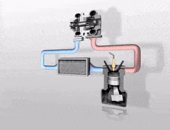
Putting those together, you get this:
As carefully labeled in the left static figure, or fuzzily animated on the right (PgDn): ¹
INTERCOOLER
Figure derived from: https://thecraftychemist.tumblr.com/post/60928536051/how-a-turbo-system-works-engine-power-is
Figure https://makeagif.com/gif/how-a-turbo-works-6sQhnA
Via Turbocharging + Intercooling:
Small / underpowered, but fuel-efficient & low emission ICEs can acquire
enough power to be used, while retaining most of their economy & cleanliness
"Most" because, contrary to many accounts, Turbocharging has an energy cost:
It impedes Stroke 4 exhaust & needs bigger water pump (w/ water-cooled intercooler)
1) On the right is yet another widely posted but unattributed animated gif. I identified it as the conversion of a short clip from a product video posted by BTNturbo.com at: https://www.btnturbo.com/turbotech/turboworks.aspx

Slide 77
Best known example of such a Petroleum Turbocharged Direct Injection (PTDI)?
Ford's EcoBoost Engine
According to a Ford corporate webpage, that engine is now used in models including: ¹
Fiesta Fusion Mustang Escape Edge
Flex Explorer F-150 EcoSport Expedition
Wikipedia reports that: ²
"(EcoBoost achieves) 30% better fuel economy and 50% lower GHG emissions"
"(Ford) sees the EcoBoost technology as less costly and more versatile than
further developing or expanding the use of hybrid and diesel engine technologies"
Popular Mechanics ran ran appreciative story entitled: ³
"Why the 3.5 EcoBoost Is the Best Ford F-150 Engine"
But reliability issues were noted in an advisory from a used car marketing company: ⁴
"Everything You Need to Know About Ford EcoBoost Engine Problems" ⁴
Has new technology become so complex that it's now degrading ICE reliability?
1) https://www.ford.com/powertrains/ecoboost/ 2) https://en.wikipedia.org/wiki/Ford_EcoBoost_engine
3) https://www.popularmechanics.com/cars/trucks/a29149378/2019-ford-f-150-review/
4) https://www.cashcarsbuyer.com/ford-ecoboost-engine-problems/

Slide 78

A final untended consequence of Ford's use of smaller turbocharged engines:
As reported in the 21 January 2015 business section of the Washington Post ¹
“America’s best-selling cars and trucks are built on lies:
The rise of fake engine noise”
“Stomp on the gas of a new Ford Mustang or F-150 an you’ll hear a throaty rumble – the same style of roar that Americans have associated with auto power and performance for decades. It’s a sham.”
YES: Fearing customers might shun more efficient (and thus quieter) vehicles,
Ford has now created artificial engine noises and is secretly
piping them in through the vehicle’s hi-fi speakers!
1) http://www.washingtonpost.com/business/economy/americas-best-selling-cars-and-trucks-are-built-on-lies-the-rise-of-fake-engine-noise/2015/01/21/6db09a10-a0ba-11e4-b146-577832eafcb4_story.html

Slide 79
GREENer Cars & Trucks:
Using ICEs More Effectively
(Power Bands / Transmissions / Hybrid Electric Vehicles)
An Introduction to Sustainable Energy Systems: WeCanFigureThisOut.org/ENERGY/Energy_home.htm

Slide 80
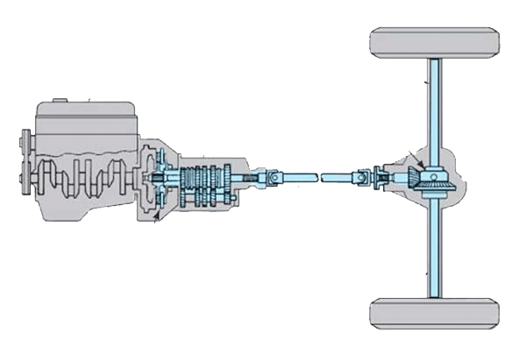
Using Internal Combustion Engines more effectively:
The previous section was about making cleaner and more efficient ICE's:
The section is instead about using an ICE to power a vehicle in the cleanest and most efficient manner:
Engine
Engine
Rear axle shaft
Rear axle
Housing
Differential
Driveshaft
Clutch
Transmission
There's a LOT OF COMPLEXITY separating an ICE from the wheels it drives
That includes a Clutch, Transmission, Driveshaft and Differential
Which, together, are called a Drivetrain or Driveline ¹
That complexity can come at a steep cost, in both money and energy
1) POWERTRAIN = ENGINE + DRIVETRAIN / DRIVELINE
Figure adapted from: https://www.drivespark.com/off-beat/car-drivetrain-systems-explained-022723.html

Slide 81


The Differential performs an essential function, but in a simple / clever way:
As explained by the static figure on the left:
The engine's green driveshaft turns a yellow crown gear that is attached to a red cage
In the sides of that cage are two small opposing green gears
Through the cage's ends come two blue gears attached via blue shafts to the wheels
Driving straight, the green gears don't turn, while the blue gears just rotate with the cage
But while the vehicle turns, the outer wheel tries to turn faster than the inner wheel
That's allowed because the outer wheel's shaft starts turning faster than the cage
which, via the green gears, turns the other wheel's shaft slower than the cage
(PgDn to play the differently colored animation at right)
http://www.mrclutchnw.com/services/differential-rebuilding/
https://makeagif.com/i/nhTd99

Slide 82


But Clutches and Transmissions are anything BUT simple
Clutches disconnect engines, allowing Transmissions to transform themselves
<= Gearbox
Clutch & Transmission =>
Gearboxes are collections of meshed gears, with input and output shafts
Their input shaft speed / output shaft speed = a fixed ratio, determined by the gears
This is also called a "1-speed gearbox," despite all sorts of speeds being possible
It is only the ratio of those shaft rotational speeds that has a single fixed value
Transmissions = multiple choice Gearboxes with added gears that can be moved
such that a subset meshes to produce alternate ratios of input-speed / output-speed
But each ratio is (again) confusingly labeled as a possible transmission "speed"
ICE vehicle transmissions have 3, 4, 5, 7 or more "speeds" (i.e., input / output ratios)

Slide 83

Why do ICE vehicles require transmissions with so many alternate "speeds?"
Especially given that:
A typical Clutch might have dozens of moving parts
While a typical Transmission has hundreds & hundreds of moving parts
Vs. a simple pair of gears (i.e., a simple gearbox) which serves TOY cars so very well:
Moving them effectively and efficiently over their entire range of speeds
Engine
Rear axle shaft
Rear axle
Housing
Differential
VS.
Driveshaft
Clutch
Transmission
Simple gearboxes ALSO allow full-sized Plug-in Electric Vehicles (PEVs)
to move effectively and efficiently over their entire range of speeds,
BECAUSE of the unique power & torque characteristics of electric motors:
Photo from: https://www.pinterest.com/pin/275704808415430219/

Slide 84

Motor & Engine Torque and Power Curves:
These, also called Torque Bands & Power Bands, describe the
Maximum Torque & Maximum Power that can be delivered at a specific RPM
A lightly loaded electric motor transfers from its battery far less than Powermax
But as the load increases, more power is transferred, and the motor maintains speed
Only as it approaches Powermax does the motor begin to bog down, loosing speed
https://theconversation.com/heres-why-electric-cars-have-plenty-of-grunt-oomph-and-torque-115356
But the most remarkable thing about electric motors?
Electric motors deliver high torque starting at even low speeds
And with a fixed gearbox can push toy cars & PEVs over their FULL SPEED RANGE

Slide 85

But Internal Combustion Engines behave very differently:
Their Torque limits fall off sharply at both LOW and HIGH rotational speeds:
https://theconversation.com/heres-why-electric-cars-have-plenty-of-grunt-oomph-and-torque-115356
Thus, to produce high torque (which is essential for strong acceleration)
this particular ICE would have to be turning at ~ 1750-5000 RPM
The car would hardly accelerate (or stall out) if you tried starting well below 1750 RPM
Which is why you instead first "rev" an ICE before manually engaging 1st gear
And in any gear, if you "over-revved" (to over 5000 RPM) acceleration would fall off
That's a VERY narrow effective speed range: spanning a ratio of only ~ 3 to 1
Figure derived from: https://theconversation.com/heres-why-electric-cars-have-plenty-of-grunt-oomph-and-torque-115356

Slide 86
WHY are ICE's so very poor at low & high speeds?
An electric motor rotating at very low speeds maintains Torque
by just sucking more Power from its battery (i.e., by drawing more current)
But at low speeds the bursts of combustion inside an ICE are fewer and farther apart,
being mechanically limited to one combustion per two now very slow revolutions
And power can only be mildly increased by adding more fuel per combustion,
because combustion intensity is soon limited by the O2 available within the cylinder
Whereas at very high speeds an ICE effectively begins to "trip over its own feet"
Because engine strokes then occur so quickly that
a diminishing amount of air flows into the cylinder during Stroke 1
and combustion can continue through Stroke 3 and right on into Stroke 4
allowing its late power to blow straight out of open exhaust valve(s)
An Introduction to Sustainable Energy Systems: WeCanFigureThisOut.org/ENERGY/Energy_home.htm

Slide 87

What are the consequences?
Well, we expect our ICE to power our vehicle from about 1 mph to at least 75 mph
Which is to say, for at least a 75X range in vehicle speed
But the ICE has strong power and torque over a rotational speed range of only ~ 3X
Let's see: 3 x 3 x 3 x 3 = 81, which is just a bit above 75
So to accelerate through our desired 1 to 75 mph vehicle speed range,
while keeping the ICE within its most effective 1 to 3 rotational speed range,
our ICE vehicle is going to need to switch between four different gear ratios
Or, for better performance (keeping the ICE very near peak operation), 5 gear ratios
Leading to the common
ICE Manual Transmission
("i" = net gear ratio):
(PgDn to animate)
https://imgur.com/r/gifs/GWNN3D3

Slide 88
But how might we now use ICEs even more effectively?
By using the ICE over an even narrower range of speed!
Speeds that, based on the peaks of its Torque, Power & Fuel Efficiency curves
allow for the most efficient yet customer-acceptable vehicle operation
Which could be done in a number of different ways:
Solution #1) ADD GEARS => more gear ratios => more transmission "speeds"
That is, make at least the Transmission even MORE complex
Engine
Rear axle shaft
Rear axle
Housing
Differential
Driveshaft
Clutch
Transmission
But while big rig drivers may (grudgingly?) endure "ten speed" manual transmissions
To achieve car-like acceleration, frantic repeated shifting would be required

Slide 89
Automatic transmissions would relieve the stress . . . but operate slowly
Shifting between too many gear combinations can thus become unacceptable slow
Leading to Solution #2: Dual Clutch Automatic Transmissions ¹⁻³
Which have been described in words as acting like two different transmissions
One with, perhaps, 5 possible gear ratios
One with 5 different gear ratios falling between those of the other transmission
The Dual Clutch Transmission would alternate between those two transmissions
inserting one into the drivetrain, while the idle one changed to its next gear ratio
and so on and so on, moving through all ten of the possible gear ratios
Which would be an absurd suggestion if the transmissions were indeed separate
In fact, they are very cleverly merged into one very complex transmission
So clever that I've yet to find a really good detailed description
But I have found a supposedly accurate (if simplified) animation:
1) https://www.matfoundrygroup.com/News%20and%20Blog/Whats_a_Dual_Clutch_Transmission_and_How_Does_it_Work
2) https://www.carfax.com/blog/what-is-a-dual-clutch-transmission
3) https://www.faistgroup.com/news/how-dual-clutch-transmissions-work/

Slide 90

Animation of the inside of a Dual Clutch Automatic Transmission:
At left, two clutches, alternately engaging two driveshafts (a rod & its surrounding tube)
(PgDn to animate)
My slowed down and non-repeating version of:
https://imgur.com/lONRlUE
My corresponding incomplete attempt at figuring out how those thin disks alternately
tie different gearshafts together, or different segments of the same shaft together:

Slide 91

Solution #3: A Continuously Variable Transmission (CVT)
Which, instead of having lots of immutable multi-tooth gears,
uses a belt linking together what amounts to two strangely variable pulleys
Because here each pulley consists of two opposing cones, with a variable separation
A stiff belt rides between those cones at a diameter that accommodates its width
Then, as one set of cones increases separation, the other decreases separation
The effect is that of meshing two gears of variable diameters,
allowing the simple CVT to effectively mimic ALL gear ratios within its range
The ICE can thus rotate at a near single optimum speed for ALL vehicle speeds
5:1 Ratio 1:1 Ratio
Gear equivalents at bottom
http://nissanaltimaaustin.com/altimas-cvt-keeps-moving/

Slide 92






Solution #4: Hybrid Electric Vehicles (HEVs)
We tend to think of HEVs as being a new idea, and one that's applied to only cars
But HEVs are far from new, as seen in these early 1900's photos:
https://www.wikiwand.com/en/Hybrid_electric_vehicle
http://www.columbusrailroads.com/orm%20pc%20set%202.htm/
And HEVs come in ever increasing varieties, as seen in these modern examples:
https://www.leonardodrs.com/news/electric-and-hybrid-marine-world-expo/
https://www.wisegeek.com/what-is-a-diesel-electric-locomotive.htm
https://www.wartsila.com/marine/build/power-systems/electric-propulsion/electric-propulsion-systems
https://www.maritime-executive.com/editorials/a-future-for-hybrid-and-battery-electric-wing-ships

Slide 93
Why are HEVs such an old idea? Why are there so many kinds of HEV?
ICE FACTOIDS:
Super-energy-packed fossil-fuels allow ICEs to run seemingly for ever
But their low-speed performance is lousy!
ELECTRIC MOTOR FACTOIDS:
Electric motors work well & super-efficiently at all sorts of speeds
But when powered by batteries they stop running way too soon!
Which, respectively, have long inspired these HEV solutions:
Solution #1: Supplement ICEs with e-Motors to help them out at low speeds
Solution #2: Keep e-Motors running w/ electricity from ICE-driven Generators
An Introduction to Sustainable Energy Systems: WeCanFigureThisOut.org/ENERGY/Energy_home.htm

Slide 94

For #1 (e-Motor helping out ICE) a Parallel Hybrid configuration is used: ¹
TOP battery-powered electric motor/generator ² system is active during:
STARTING: Electric motor helping out the ICE which is weak a low speeds
STOPPING: Power from wheels => generator => capacitor => battery ³
e-Motor /
Generator ²
Gas
Tank
Gas
ICE
Multi-speed
Transmission
BOTTOM gasoline-powered ICE is active during:
STARTING: Per above, working WITH the electric motor
CRUISING: Working ALONE to drive wheels because it's efficient at higher speeds
AND driving e-motor (now acting as a generator) ² to recharge battery
!) This is my modified version of a figure at: https://en.m.wikipedia.org/wiki/Hybrid_vehicle_drivetrain
2) More about this electric motor <=> electric generator duality in a few slides
3) More about this "Regenerative Braking" in just a few slides

Slide 95

For #2 (ICE extending e-Motor range) a Series Hybrid configuration is used: ¹
Gas ICE drives a generator, charging a battery, feeding an e-Motor, turning the wheels:
CENTER
Energy stored or released
Gas
Tank
Gas
Engine
1-Speed Gearbox
e-Motor /
Generator ²
Flywheel
or
Capacitor ³
LEFT
Gas ICE driving 1-speed gearbox driving generator sending energy (to center)
RIGHT
Electric motor/generator ² using
energy (from center) to drive wheels
OR
During deceleration using wheels to turn
motor/generator sending energy (to center)
1) This is my modified version of a figure at: https://en.m.wikipedia.org/wiki/Hybrid_vehicle_drivetrain
2) More about this electric motor <=> electric generator duality in a few slides
3) More about how Flywheels & Capacitors are used in Regenerative Braking in just a few slides

Slide 96
Or for really BIG vehicles, omit the batteries:
Yielding what's simply called a Diesel-Electric or Gas-Electric or Turbine-Electric
Fossil
Fuel
Heater
(Resistor)
Generator
e-Motor /
Generator
ICE or
Turbine
1-Speed Gearbox
Most of the time Ships & Freight Trains move at an nearly constant moderate speed,
allowing ICE to turn at efficient mid-range speed, driving generator, powering e-Motor
During brief gradual accelerations, the ICE is pushed to less efficient higher speeds
During decelerations, ships either disconnect everything or do acceleration in reverse
While trains apply heat-producing & wasting brakes (w/ e-Motor electrically disconnected)
OR w/ e-Motor electrically connected, send its generated power out to heater atop engine

Slide 97




But in supercars to people's cars many more configurations are being tried:
All exploiting the fact that, when turned, e-Motors become electrical Generators
Ferrari LaFerrari: 1 e-Motor placed between 1 ICE / 7-speed transmission & rear wheels
Driven by ICE or wheels, the e-Motor charges batteries
Powered by batteries the e-Motor drives rear wheels
Jaguar C-X75: 2 Diesel gas turbines drive 2 e-Motors charging batteries
Powered by batteries 4 more e-Motors (one per wheel)
directly drive the wheels
BMW i3: 1 ICE drives 1st e-Motor charging batteries
Powered by batteries 2nd e-Motor drives rear wheels
Honda Accord: LOW SPEED: 1 ICE drives 1st e-Motor charging batteries
Powered by batteries 2nd e-Motor drives wheels
HIGH SPEED: ICE drives wheels via 1-speed gearbox
Le Ferrarri: http://auto.ferrari.com/en_EN/sports-cars-models/car-range/laferrari/
Jaguar C-X75: http://en.m.wikipedia.org/wiki/Jaguar_C-X75
BMW i3: http://en.m.wikipedia.org/wiki/BMW_i3
Honda Accord: http://www.greencarreports.com/news/1087518_2014-honda-accord-hybrid-has-no-transmission-how-it-works

Slide 98
GREENer Cars & Trucks:
Storing CURRENT Kinetic Energy for LATER Motion
(Kinetic Energy Recovery Systems / Regenerative Braking)
An Introduction to Sustainable Energy Systems: WeCanFigureThisOut.org/ENERGY/Energy_home.htm

Slide 99
From Physics models: Wheel Energy => Kinetic Energy of some other thing
For steady highway driving that "other thing" was air drawn along by the vehicle
Unfortunately, there's NO WAY to recapture & reuse that air's Kinetic Energy (KE)
But for stop & go city driving that "other thing" was the vehicle itself
And there ARE ways of recapturing & reusing most of the vehicle's Kinetic Energy
Vehicle Kinetic Energy is recaptured by what are called either:
Kinetic Energy Recovery Systems (KERS) or Regenerative Braking Systems
KERS generally (but not always) refers to KE recapture within a mechanical device
Regenerative Braking generally (but not always) to KE recapture in an electronic device

Slide 100

ICE vehicles are largely mechanical devices
Which makes it easier to recapture their KE in other mechanical devices => KERS
The other mechanical device is usually an extremely big, massive & strong flywheel ^{1, 2}
The flywheel has be extremely strong because in a KERS, to slow the vehicle,
rather than just applying the brakes (which throw away vehicle KE as waste heat),
vehicle wheels are decoupled from the ICE's transmission
and recoupled (via a gear box) to spin a flywheel up to ~ 50,000 RPM
When the vehicle wants to restart, the gearing is changed so that the ICE & flywheel
work together (the flywheel slowing as its KE is transferred back to the vehicle)
Figure & 1) https://ricardo.com/news-and-media/news-and-press/breakthrough-in-ricardo-kinergy-%E2%80%98second-generation
2) https://en.wikipedia.org/wiki/Kinetic_energy_recovery_system

Slide 101


You've likely heard about the use of flywheel KERS for diesel city buses
Such as these London city buses where
KERS cut fuel consumption by 20%: ¹
But KERS development was actually driven by the sudden need to increase fuel mileage in vehicles such as this: ²
"Sudden need?" Yes:
Formula 1 Racing was born as a vrroom-vroom macho celebration of powerful ICEs
And partially justified by its claim that racing would further ICE development
But by the early 2000's auto industry sponsors were cultivating Green corporate images,
which were being undermined by continued participation in this gas-guzzling sport
Hence, beginning in 2009, stringent Formula 1 fuel restrictions were introduced ² making
it imperative that cars NOT throw away energy braking into every curve => KERS
1) https://www.wired.com/2014/07/f1-kers-london-buses/ 2) https://en.wikipedia.org/wiki/Kinetic_energy_recovery_system

Slide 102


Leading, over the last decade, to KERS showing up in luxury ICE cars:
Pictured here, for example,
is a flywheel-based KERS system developed for Jaguar's cars:
KERS EXTERIOR VIEW:
Differential / Coupling Gear
KER COMPONENTS:
Axle coupling gear
Existing Differential
Flywheel
Flywheel side clutch
CVT module
Step-up gear
Existing driveshaft
Step-up gear
Axle side clutch
Vacuum pump
(not visible)
Flywheel
Continuously Variable Transmission
Hydraulic supply & control valves for CVT & clutches
But as with the earlier example of Turbocharged + Intercooled ICE's
KERS technology adds a lot of complexity to already very complex ICE vehicles
Stimulating the search for alternate, much simpler, Kinetic Energy capture schemes
My version (captions enlarged) from: https://www.wired.com/2010/10/flywheel-hybrid-system-for-premium-vehicles/

Slide 103



The prime alternative? Dual use of any available Electric Motors
By this I mean exploiting another very unique characteristic of e-Motors:
If supplied with electrical power they produce mechanical power = A Motor
If driven by mechanical power, they produce electrical power = A Generator
The science behind this uniquely reversible behavior is the subject of my note sets:
Electric & Magnetic Fields (pptx / pdf / key) Magnetic Induction (pptx /pdf / key)
And my animated explanation of how e-Motors work is a complete WCFTO Virtual Lab:
AC & DC Electric Motors
An Introduction to Sustainable Energy Systems: WeCanFigureThisOut.org/ENERGY/Energy_home.htm

Slide 104
The idea is to repurpose the e-Motor that had been pushing the car
And instead, when you want to slow or stop, use the car to push the motor which,
then acting as an e-Generator, can be used to recharge your car's Batteries
But, contrary to popular accounts, that alone will not work - because of time scales:
Slowing or stopping cars takes from a few seconds to perhaps half a minute
But even quick-charging a battery takes from a fraction of an hour to hours
Batteries can't move atoms & ions fast enough to accept a slowing car's energy
From my note set Batteries & Fuel Cells (pptx / pdf / key),
the atom-by-atom rearrangement going on within a charging Li-ion battery:
-
-
Anode:
Li absorbing
and deionizing
+
Cathode:
Li dissolving and ionizing
-
+

Slide 105

A temporary energy storage device is needed between e-Generator & Battery
A device that can quickly accept energy generated as a car briefly decelerates or stops
then gradually send that energy onward at a rate that the Battery can accept
Imagine trying to store energy by pumping electrons from one metal plate to another
THIS wouldn't work: Because accumulating net - - charges repel each other fiercely
And + charges left behind suck back that - charge just as fiercely
But THIS COULD if the two plates were ~ as close as the + + and - - charge spacings
Because + + and - - charge repulsions would then be balanced by + - charge attractions
This is a simple Capacitor, which CAN store & expel charge energy VERY quickly
  (even if the amount of charge, and thus charge energy, is very limited)

Slide 106

Capacitor => Supercapacitor if its plates are mere atoms apart
Which, with e-Motor / e-Generator + Battery allows for Regenerative Braking:
When the car is cruising
Capacitor charging of Battery continues
OR (not shown in figure):
the Battery can power the e-Motor
helping the ICE to power the wheels
(= HEV configuration discussed earlier)
When car is slowing or stopping
the wheels turn the e-Generator
which charges the Capacitor
which gradually recharges the Battery
Figure of MAZDA "i-ELOOP system from: https://www.mazda.com/en/innovation/technology/env/i-eloop/

Slide 107
Regenerative Braking really is just about that simple:
The essential ingredient is a handy e-Motor / e-Generator (along with its Batteries)
The Capacitor is easy (and more effective Supercapacitors are being developed)
And the electronic components consist primarily of simple electrical circuits which
  ensure that electrical power moves in desirable directions, at desirable times
(For electrically inclined readers, I've included papers about the required
circuit operation + circuit examples HERE in this note set's Resources webpage)
Making electronic Regenerative Braking a LOT simpler than mechanical KERS
But, of course, if you want to make things even simpler,
there IS the option of just eliminating the ICE, taking you all the way to:
An Introduction to Sustainable Energy Systems: WeCanFigureThisOut.org/ENERGY/Energy_home.htm

Slide 108
Part II:
GREEN Cars & Trucks
An Introduction to Sustainable Energy Systems: WeCanFigureThisOut.org/ENERGY/Energy_home.htm

Slide 109

Green Plug-in Electric Vehicle Basics:
Earlier I suggested a PEV might be this simple:
Electric
Motor
Grid
Battery
Power
Control
Electric
Motor
Which looks awfully close to a "PEV concept" released by Volkswagen:
Rear:
e-Motor / Generator
Gearbox & Power Control
Front:
Optional e-Motor
for 4WD
Batteries
Adapted from: https://evreporter.com/ev-powertrain-components/

Slide 110

But moving beyond "concept" and into reality:
What is now the best-selling PEV in the U.S.?
From a listing posted by the U.S. DOE's "Alternative Fuels Data Center" ¹
a figure in which I've labeled the major 2019 PEVs:
The winner apparently is . . . the Tesla Model 3
U.S. Plug-in Electric Vehicles by Model (HEVs + PHEVs + PEVs) PEVs only:
Chevy Volt
Nissan Leaf
Tesla S
Tesla X
Chevy Bolt
Tesla 3
This is my re-captioned version of a figure listed at: https://afdc.energy.gov/data/
Link to the unmodified figure: https://afdc.energy.gov/data/10567

Slide 111

THIS is a diagram of what's inside such a Tesla Model 3
Which was unlabeled, compelling me to dig into other sources to sort out the details:
Control Electronics including
High / Low Voltage converters
& DC / AC Converters
Rear axle:
e-Motor
+ 1-speed gearbox
with differential
Batteries
Front axle:
e-Motor / Generator
+ 1-speed gearbox
with differential
My captions added to figure from: https://insideevs.com/news/360161/16-percent-batteries-model-3/
An Introduction to Sustainable Energy Systems: WeCanFigureThisOut.org/ENERGY/Energy_home.htm

Slide 112


A closer look at the front axle e-Motor / Generator + gearbox + differential:
Tesla has integrated these with the steering, suspension, brakes & tire mounts
The resulting monolithic assembly is installed at the front of the Model 3 PEV by ONLY:
tightening 4 bolts + connecting electrical cables, steering wheel, and brake lines ¹
e-Motor / Generator
+ 1-speed gearbox with differential
Figure derived from: https://www.autocar.co.uk/car-news/industry/secret-tech-behind-tesla-model-3
1) Tesla service and owner blogs report that in the M3 electronic connections have NOT YET replaced traditional mechanical steering linkage and hydraulic brake lines (but I could find no Tesla confirmation of this)
Suspension / Steering
Disc Brake
Tire mount
Surprisingly, you can now even buy one on eBay (this one was offered at $14,999):

Slide 113
The simplification, compared to a modern ICE vehicle, is stunning!
As stated on the homepage of one of Germany's Fraunhofer Institutes: ¹
"Vehicle complexity decreases sharply whenever the combustion engine is replaced by an electric powertrain.
Whereas a car fitted with a combustion engine consists of some 1400 moving parts, those with an electric powertrain have only approximately 210.
An eight-cylinder (ICE) engine is made up of around 1200 parts, each of which requires fitting; in contrast, an electric engine has only 17.
Consequently, there have been considerable changes in the range of system parts and components needed. New suppliers and smaller vehicle manufacturers suddenly find themselves in an environment in which they can compete with large, established OEMs due to the reduction in vehicle complexity."
Given that simplicity almost always yields lower operating & repair costs
and that PEVs' have 3-4 times the intrinsic energy efficiency,
the eventual displacement of ICE vehicles by PEVs seems inevitable
1) https://www.ipt.fraunhofer.de/en/trends/future-powertrain.html

Slide 114
Non-Green Grid + Green PEVs:
When & where will it make GHG sense?
("Well-to-Wheel" & Vehicle Life Cycle Analyses)
An Introduction to Sustainable Energy Systems: WeCanFigureThisOut.org/ENERGY/Energy_home.htm

Slide 115
Answers to that question are not clear cut:
As suggested by these news articles:
2009 IEEE Spectrum: How Green is My Plug-in? ¹
2013 IEEE Spectrum: Unclean at Any Speed: Electric Cars Donʼt Solve the Automobileʼs Environmental Problems ²
2013 BBC News: How Environmentally Friendly are Electric Cars? ³
2016 Scientific American: Electric Cars ar Not Necessarily Clean ⁴
Doubts raised by the IEEE (Institute of Electrical & Electronic Engineers)
are particular noteworthy in that this international professional society
has almost a half million members, likely including
most of the engineers designing today's PEVs
as well as those operating many of the world's electrical Grids ⁵
1) http://aboutme.samexent.com/classes/spring09/ee4940/Plugin1.pdf
2) https://spectrum.ieee.org/energy/renewables/unclean-at-any-speed
3) http://www.bbc.co.uk/news/magazine-22001356?print=true
4) https://www.scientificamerican.com/article/electric-cars-are-not-necessarily-clean/
5) DISCLOSURE: I am an IEEE member / Fellow

Slide 116


Solid answers require Well-to-Wheel (WtW / W2W) analyses that evaluate:
The COMPLETE transfer of energy from the energy source to a vehicle's wheels
OR the COMPLETE greenhouse gas (GHG) emission due to that energy transfer
These can be subdivided as: Well-to-Wheel = Well-to-Tank + Tank-to-Wheel
Those terms were originally chosen to describe fossil-fueled vehicles,
but they are now also applied to hybrid and all-electric vehicles:
"Well" = Oil or gas well, coal mine, nuclear or hydro plant, wind or solar farm . . .
"Tank" => Vehicle's fossil-fuel tank / electric battery / fuel cell . . .
https://gmobility.eu/what-is-well-to-wheel/
https://cafcp.org/sites/default/files/W2W-2016.pdf

Slide 117

An Example: Calif. Well-to-Wheel Energy / mile traveled for alternately fueled vehicles:
Well-to-Tank:
Drilling + Refinery + Transport energy
from well to refinery to gas station
Tank-to-Wheel:
ICE energy losses as heat
ICE drivetrain & braking losses
Vehicle drag losses
Gas & NG ICEs:
Gasohol ICE's:
Gasoline 85%: Energies above
Alcohol 15%: Farm chemical, irrigation, machinery
energies + fermentation & distillation energies
ICE energy losses as heat
ICE drivetrain & braking losses
Vehicle drag losses
Fuel Cell & PEV:
Energy drawn from Calif. power plants
Small e-Motor / gearbox / control losses
Reduced braking losses
Vehicle drag losses
Energy derived from 2016 Calif Grid:
Gasoline ICE
Natural Gas ICE
Gasohol ICE
H2 Fuel Cell
PEV
Source: Calif. Fuel Cell Partnership: ¹
1) My cleaned up and relabeled version of figure in: https://cafcp.org/sites/default/files/W2W-2016.pdf

Slide 118

Continued: Calif. Well-to-Wheel analysis of GHG emissions for alternately fueled vehicles:
Well-to-Tank:
Drilling GHGs + Refinery GHGs + pipeline/truck GHGs
moving fuel from well to refinery to gas station
Slight net negative due to corn carbon capture
Due to fossil fuel combusted at California's
natural gas burning power plants (Ca coal plants ~ 0)
Tank-to-Wheel:
Gasoline & NG combustion gases
Gasohol combustion gases
Zero in-vehicle GHG emission
Gas & NG ICEs:
Gasohol ICE's:
Fuel Cell & PEV:
Energy derived from 2016 Calif Grid:
Gasoline ICE
Natural Gas ICE
Gasohol ICE
H2 Fuel Cell
PEV
Source: Calif. Fuel Cell Partnership: ¹
1) My relabeled version of figure in: https://cafcp.org/sites/default/files/W2W-2016.pdf

Slide 119
But California's Grid was already Greener than most in the U.S.:
The 2017 Washington Post figure used earlier: ¹
- 0%
55% Natural Gas Power (w/ GHG's 20-40% less than Coal Power): ²
- 50%
45% Low life cycle GHG Nuclear, Hydro, Wind, Solar + Other Power:
- 100%
1) http://www.washingtonpost.com/graphics/national/power-plants/ 2) See my note set Fossil Fuels (pptx / pdf / key)

Slide 120
Making that an atypical case, from a possibly biased source
To really answer my question of :
Non-GREEN Grid + Green PEVs: When & where will it make GHG sense?
We need Well-to-Wheel analyses for a wider range of locations
We need Well-to-Wheel analyses from supposedly neutral sources
Including refereed scientific journals, governmental and NGO sources
We need to consider more than Well-to-Wheel's production-to-consumption time frame
considering, instead, Energy consumed & GHG emissions over entire Life Cycles,
from gathering of raw materials through to final full disposal or recycling
I have identified seven analyses apparently meeting those criteria, spanning 2012-20
Links and cached copies are given HERE on this note set's Resources webpage
Looking to those sources for answers about when & where PEVs make GHG sense:
An Introduction to Sustainable Energy Systems: WeCanFigureThisOut.org/ENERGY/Energy_home.htm

Slide 121

From a 2016 U.S. National Renewable Energy Lab study ¹
Which modeled conventional ICE vehicles, PEVs, and PHEVs,
with the latter two types drawing their electric power from a range of Grid types
(roughly equivalent to today's cleanest to dirtiest U.S. power grids)
Presumably:
Evening only "Peaking"
NG power Plants
Midday Solar Plants &
Late midday Wind Plants
1) https://afdc.energy.gov/files/u/publication/ev_emissions_impact.pdf

Slide 122

With power delivered via alternate BEV / PHEV charging locations, times, and levels:
H1
H2
TR
WP
Per the preceding slide, different scenarios draw on a different mix of power plants
TR is the least likely to draw from natural gas plants used only in the evenings
(which, while cleaner than coal plants, are dirtier than renewables & nuclear)
And, as discussed in more detail later in this note set:
Level 1 electric charging stations use standard 110V x 15 Amps home circuit
Level 2 electric charging stations use heavy duty 230V x 30 Amps home circuit
But U.S. homes are NOT now built with such a spare 230V x 30 Amp circuit

Slide 123


Leading to a range of possible vehicle GHG emissions: ¹
Using a Low Carbon Grid:
ICEs: High GHG emissions
PEVs: GHGs ~ 1/3 that of ICEs
PHEVs: GHGs ~ 1/3 that of ICEs
Using a High Carbon Grid:
ICEs: High GHG emissions
PEVs: GHGs ~ 92% that of ICEs
PHEVs: GHGs ~ 73% that of ICEs
ICEs
PEVs
ICEs
PHEVs
PEVs
PHEVs
Drawing from a High Carbon Grid:
PEV emissions are virtually identical to those from a fossil-fueled ICE
and PHEV emissions are only slightly lower
1) I've changed acronyms to be consistent with those used in this note set

Slide 124


From a journal analysis pertaining to 2012 U.K. & California Grids: ¹
United Kingdom GHG emissions: Well-to-Wheel + full Life Cycle:
Low speed & light load urban driving Higher speed & load non-urban driving
ICV = ICE Vehicle
BEV = Battery Electric Vehicle = PEV
"BEV marginal grid intensity" = "incremental electricity that must be brought on stream
to meet the additional demand from BEVs"
Which this study argues is a better indicator of true GHG impact
Urban driving: ICE vehicle GHGs are ~ 30% higher than HEV & PEV (BEV) GHGs
Non-urban driving: ICE vehicle GHGs are ~ equal to HEV GHGs
ICE vehicle GHGs are ~ 25% lower than PEV (BEV) GHGs (!)
1) https://kundoc.com/pdf-a-new-comparison-between-the-life-cycle-greenhouse-gas-emissions-of-battery-elec.html

Slide 125


From that same 2012 journal analysis: ¹
California GHG emissions: Well-to-Wheel + full Life Cycle:
Low speed & light load urban driving Higher speed & load non-urban driving
ICV = ICE Vehicle
BEV = Battery Electric Vehicle = PEV
Again based on BEV marginal grid intensities:
Urban driving: ICE vehicle GHGs are ~ 30% higher than HEV GHGs
ICE vehicle GHGs are ~ 60% higher than PEV (BEV) GHGs
Suburban driving: ICE vehicle GHGs are ~ 14% higher than HEV GHGs
ICE vehicle GHGs are ~ 8% higher than PEV (BEV) GHGs
1) https://kundoc.com/pdf-a-new-comparison-between-the-life-cycle-greenhouse-gas-emissions-of-battery-elec.html

Slide 126
What was going on there?
UK urban driving: ICE vehicles ~ 30% dirtier than both Hybrids & PEVs
UK non-urban driving: ICE vehicles as clean as Hybrids & 25% cleaner than PEVs
Explanation for UK urban vs. suburban driving difference?
Gasoline ICE "fuel economy" increases markedly for highway (vs. city) driving
CA urban driving: ICE vehicles ~ 30% dirtier than Hybrids, 60% dirtier than PEVs
CA non-urban driving: ICE vehicles 14% dirtier than Hybrids, 8% dirtier than PEVs
Explanation for CA vs. UK PEV differences?
California Grid is significantly GREENER than UK Grid (zero vs. significant coal power)
which makes PEVs charged from the CA Grid much cleaner
Explanation for CA vs. UK suburban ICE vs. HEV difference?
Higher speed CA suburban driving (freeways) depressing ICE vehicle fuel economy?
An Introduction to Sustainable Energy Systems: WeCanFigureThisOut.org/ENERGY/Energy_home.htm

Slide 127

From a 2015 Union of Concerned Scientists study comes this strange map:
By U.S. region, taking into account the GREENESS of that region's Grid,
its colors and MPG numbers refer to the
city/highway fuel economy a gasoline ICE vehicle must achieve to match
the GHG output of a PEV charged from that region's electrical Grid
Greener Grid => Greener PEV => Higher mileage required from GHG-matching ICE
ICE's fuel economy to be cleaner than PEV:
Hydro-powered Northwest: > 94 MPG
NG + zero-GHG powered California: > 87 MPG
Mix powered South: > 50-63 MPG
Partly coal-powered upper Midwest: > 43 MPG
Heavily coal powered central states: > 35 MPG
In darker regions MOST gasoline HEVs are still cleaner than PEVs
In darker regions MORE fuel efficient gasoline ICEs are even cleaner than PEVs
1) https://www.ucsusa.org/sites/default/files/attach/2015/11/Cleaner-Cars-from-Cradle-to-Grave-full-report.pdf

Slide 128

From a 2016 journal publication comes a different type of GHG emission map: ¹
Which compares GHGs from three PEV models (identified vertically near left margin)
versus Prius gasoline HEV or Mazda gasoline ICE w/ regenerative braking ²
Blue = Where PEV is cleaner
Intensity => PEV advantage
Red = Where Gasoline vehicle is cleaner
Intensity => PEV disadvantage
Prius gasoline HEV:
Cleaner than or about as clean as all PEVs ANYWHERE across U.S. Grid
Mazda gas ICE + regenerative braking:
Cleaner than Leaf in upper Midwest
Cleaner than Volt in Midwest & East
1) https://iopscience.iop.org/article/10.1088/1748-9326/11/4/044007?platform=hootsuite
2) By coincidence, this Mazda was exactly the vehicle I used earlier in my explanation of regenerative braking

Slide 129
A final 2020 study spanned most of the world: ¹
It opened by asking the essentially my question:
"Could electrification policies backfire
by promoting their diffusion before electricity is decarbonized?" ¹
The study then estimated the country-by-country GHG-emission impact of
replacing a gasoline ICE vehicle with a PEV in 2015, or at various future dates,
Likely future GHG improvement in PEV and ICE vehicles was also accounted for
But for each country, the GHG cleanliness of its Grid was averaged over that country
This study therefore lacks information on where in a large country (e.g., the U.S.)
PEV replacement of gasoline ICE vehicles makes the most or least sense
With many alternate scenarios + consideration of both vehicle & heating electrification
this paper demands extensive and extended study,
so let me here focus on its more immediately vehicle-relevant findings:
1) https://www.researchgate.net/publication/340127420_Net_emission_reductions_from_electric_cars_and_heat_pumps_in_59_world_regions_over_time

Slide 130


Predicted country-by-country GHG impact of replacing ICE vehicle with PEV:
For PEV replacing gasoline ICE vehicle in 2015:
Where Grid-powered PEV is "almost always" cleaner than the ICE it replaces
Where on average
Grid-powered PEV is cleaner
than the ICE it replaces
For PEV replacing gasoline ICE vehicle in 2030:
Where on average
Grid-powered PEV is dirtier
than the ICE it replaces
PEV advantage lessens in the U.S. by 2030?
Yes, because our ICE's were predicted to get cleaner faster than our Grid!

Slide 131
Non-GREEN Grid + Green PEVs: When & where will it make GHG sense?
Together, these Well-to-Wheel and Life Cycle studies support the ambivalence of
earlier IEEE, BBC & Scientific American articles concerning vehicle electrification
Specifically, there appears to be a strong scientific consensus that:
1) PEVs do not now reduce GHG emissions in areas with dirtier electrical grids
With "dirtier" being pretty much synonymous with heavy use of coal power
2) Even where replacement of conventional ICE vehicles by PEVs does reduce GHGs:
Regenerative-braking-enhanced ICE vehicles can match PEV GHG reductions
While gasoline HEVs are reported ¹ to better PEV GHG reductions
3) The advantage of PEVs strengthens when & where the Grid becomes GREENer
1) See next slide

Slide 132
Based on finding #2, the best interim choice appears to be driving HEVs
HOWEVER: Reported HEV fuel economy & emissions have long been questioned:
Consumer Reports (2013): ¹
"(reported fuel economy) can be far higher than many drivers will actually get.
And the largest differences involve some of the most fuel-­efficient cars, particularly hybrids"
Car and Driver Magazine (2013): ²
"Why is the EPA so bad at estimating hybrid Fuel Economy?"
Time Magazine (2013): ³
"Your (hybrid) car won't get the mileage posted on the window"
Consumer Reports (2014): ⁴
"Ford cuts mpg ratings on hybrids, again"
USA Today (2014): ⁵
"Honda Accord Hybrid mileage way off"
Magnitude of the reported HEV fuel economy overstatements? About 20-25% ^{2, 4}
1) https://www.consumerreports.org/cro/magazine/2013/08/the-mpg-gap/index.htm
2) http://www.caranddriver.com/features/why-is-the-epa-so-bad-at-estimating-hybrid-fuel-economy-feature
3) http://business.time.com/2013/09/10/your-car-wont-get-the-mileage-posted-on-the-window-and-maybe-thats-ok/
4) http://www.consumerreports.org/cro/news/2014/06/ford-revises-c-max-fusion-mkz-hybrid-fiesta-fuel-economy-ratings/index.htm
5) http://www.usatoday.com/story/money/cars/2014/05/29/consumer-reports-honda-accord-hybrid-mpg-rating/9724733/

Slide 133
Then, in the summer of 2020, very much larger errors were reported for PHEVs
As reported online and in the press:
Plug-in Hybrids are a 'Wolf in Sheep's Clothing' - BBC & CNBC ^{1, 2}
The Plug-in Hybrid Con - TransportEnvironment.org ³
Real-World (PHEV) CO2 Emissions 2-4X Higher - GreenCarCongress.com ⁴
The articles correctly reported GHG emissions 2-4X higher than in standardized tests,
even if the news agencies misidentified the originating data source, which was the
Fraunhofer Institute / International Council on Clean Transportation (ICCT) study:
Real-World Usage of Plug-in Hybrid Electric Vehicles
Fuel Consumption, Electric Driving and CO2 Emissions ⁵
How could official evaluations chronically overstate HEV fuel economy by 20-25% ?
How can official evaluations now understate Plug-in HEV GHG emissions by 50-75% ?
Because HEVs vacillate between GHG-emitting ICEs & zero-GHG e-motors
1) https://www.bbc.com/news/science-environment-54170207
2) https://www.cnbc.com/2020/09/17/study-claims-plug-in-hybrid-emissions-are-higher-than-thought-.html
3) https://www.transportenvironment.org/sites/te/files/publications/2020_09_UK_briefing_The_plug-in_hybrid_con.pdf
4) https://www.greencarcongress.com/2020/09/20200928-isi.html
5) https://theicct.org/publications/phev-real-world-usage-sept2020
1) https://www.bbc.com/news/science-environment-54170207
2) https://www.cnbc.com/2020/09/17/study-claims-plug-in-hybrid-emissions-are-higher-than-thought-.html
3) https://www.transportenvironment.org/sites/te/files/publications/2020_09_UK_briefing_The_plug-in_hybrid_con.pdf
4) https://www.greencarcongress.com/2020/09/20200928-isi.html
5) https://theicct.org/publications/phev-real-world-usage-sept2020

Slide 134
Accuracy requires figuring out how much time HEVs spend using ICE vs e-Motors
For a standard HEV that depends upon not only the car's programming
but also upon the particular driving style of the vehicle's operator:
- Faster acceleration is more likely to demand joint ICE & e-Motor power
- Rapid braking can result in less complete regenerative energy capture
But it gets much more complicated for a Plug-in HEV:
For shorter journeys:
A PHEV departing with fully-charged batteries may make little or no use of its ICE
But departing with incompletely-charged batteries, use of its ICE may be unavoidable
For long journeys it's also much more likely that a PHEV will have to switch to its ICE
In China, Germany, Netherlands, Norway, US & Canada, Fraunhofer / ICCT found
unexpectedly heavy incompletely-charged + long-distance use of PHEVs
All of which brings into question the interim advantage of both HEVs & PHEVs

Slide 135
Growing a future GREEN Grid:
An Introduction to Sustainable Energy Systems: WeCanFigureThisOut.org/ENERGY/Energy_home.htm

Slide 136
Our obvious challenge: Fully greening (de-carbonizing) the Grid
Which will require expansion of low-GHG power ¹ alternatives which now include
(in the order of their present day power contribution to the U.S. Grid):
Nuclear (19.5%), Wind (7.2%), Hydro (6.8%), Solar (2.8%),
Biomass (1.4%) Geothermal (<1%)
Bearing in mind our earlier estimate that net expansion of at least 3.3X will be required,
those technologies (plus other candidates) can be explored in one or more note sets
listed (and outlined) on the WeCanFigureThisOut.org Energy homepage
But what about NON-OBVIOUS challenges to fully greening our Grid?
Some have to do with our general use of the Grid
Some have to do with how PEVs will use the Grid
1) By "low-GHG power" I recognize that when properly evaluated over its full life cycle, NO TECHNOLOGY IS ZERO GHG

Slide 137


General challenges to the Grid: Where & When we use power
WHERE we'll use GREEN power is mostly FAR from WHERE it's produced
Fast wind carries VASTLY more energy, because its power varies as (wind speed) ^{cubed}
Where then do we get fast winds (and will Wind Farms be vastly more productive)?
From my note set Wind Power I (pptx / pdf / key):
www.nrel.gov/gis/wind.html

Slide 138

Similarly: Where do we get the most annual sunlight?
As required to make Solar Photovoltaic Power Plants most productive
From my note set Solar Power I - Today's PV (pptx / pdf / key):
http://rredc.nrel.gov/solar/old_data/nsrdb/1961-1990/redbook/atlas/

Slide 139

And where do we get the most direct (non cloud-scattered) sunlight?
Which is far more efficiently concentrated by the mirrors of Solar Thermal Power Plants
From my note set Solar Thermal Power / Heat Storage (pptx / pdf / key):
Figure: https://www.nrel.gov/gis/assets/pdfs/solar_dni_2018_01.pdf

Slide 140


Further, to transport that Green energy from source to consumer . . .
We'll need a Grid able to this:
And not today's fragmented this:
The challenge lies not only in the fragmentation of today's U.S. Grid, it's also in
Grid technology that cannot now efficiently send power over long distances
These problems, and their potential solutions are discussed in my note sets:
A Generic Power Plant & Grid (pptx / pdf / key)
A Renewable Distributed Grid (pptx / pdf / key)
http://www.awea.org/files/filedownloads/pdfs/greenpowersuperhighways.pdf
http://www.geni.org/globalenergy/library/national_energy_grid/united-states-of-america/americannationalelectricitygrid.shtml

Slide 141

But even with a much improved Grid:
WHEN green power is mostly produced is not WHEN we mostly want it
As discussed in my note set Power Cycles and Energy Storage (pptx / pdf / key),
When we mostly use power is early evening:
www.eia.gov/todayinenergy/detail.cfm?id=12711
But we mostly get wind power late afternoon:
And mostly get solar power midday:
100%
100%
Midnight
Noon
Midnight
Midnight
Noon
Midnight

Slide 142




A GREEN Grid will thus also require vast short-term energy storage
Via technologies either still unproven or still grossly lacking in necessary capacity: ¹
Pumped Storage Hydro (PSH)
(the only proven technology)
Flywheels
Compressed Air Storage (CAES)
+
-
Super Capacitors
Fuel Cells
Super Batteries
Technologies that, today, at least DOUBLE the cost of the delivered power ²
1) Figures from my note set: Power Cycles and Energy Storage (pptx / pdf / key)
2) As documented in my note set: Power Plant Economics (pptx / pdf / key)

Slide 143
The preceding seven slides were a grossly compressed explanation of WHY
this note set has focused so strongly on the TRANSITION to PEVs + Green Power
and why I believe that complete transition could take decades
If not for that concern, this note set would have covered only
PEVs & FCEVs, and their necessary charging infrastructures
(and this note set would likely have been about 1/5 as long!)
An Introduction to Sustainable Energy Systems: WeCanFigureThisOut.org/ENERGY/Energy_home.htm

Slide 144
GREEN Grid + GREEN Plug-in Electric Vehicles
An Introduction to Sustainable Energy Systems: WeCanFigureThisOut.org/ENERGY/Energy_home.htm

Slide 145


PEV challenges to the Grid: Charging infrastructure / Energy Storage
Vehicle charging time = Vehicle battery capacity / charging station's power output
Tesla Supercharger ¹ stations have a power output 75 kW at each vehicle outlet
For an 85 kW-h Tesla Model S, that resulted in a full charge time of ~ 75 minutes ¹
For a Nissan Leaf, with only 30 kW-h of batteries,² full charge time should be ~ 27 min
Most power outlets in U.S. homes can supply up to 1.65 kW (110V x 15 Amps)
Via a voltage converter, one outlet could thus charge the Nissan Leaf in:
27 minutes x ( 75 kW / 1.65 KW) = 20.5 hours
TOTAL power to U.S. homes is typically 240V at 100-200 Amps => 24-48 kW
Even if 100% of a home's power could be safely fed to a single outlet, charging
1 Nissan Leaf would take: 27 minutes x 75 kW / (24-48 KW) = 0.7 to 1.4 hours
"We're gonna need a bigger boat outlet"
1) https://en.wikipedia.org/wiki/Tesla_Supercharger 2) https://batteryuniversity.com/learn/article/electric_vehicle_ev

Slide 146

Because even 48 minutes is a heck of a lot longer than a gas station visit!
We'll thus want to build charging stations where vehicles already sit for hours
The U.S. Idaho National Lab evaluated where vehicles park ¹
And assuming I've correctly interpreted their very strangely presented findings:
60% park overnight at homes (blue) + 30% park midday at employers (green)
Apparently allowing for charging of almost 90% of our personal PEVs
40% park overnight at "fleet" vehicle home bases (red)
40% park midday in commercial lots (malls, theaters, doctor's offices . . .) (purple)
Allowing for charging of the ~ 10% of personal PEVs not charged at home or work?
Fraction of all vehicles then parked
1) https://www.energy.gov/sites/prod/files/2014/02/f8/v2g_power_flow_rpt.pdf
Figure: My relabeled version of Figure 19, page 26, in the report above
Fraction parked at homes
Fraction parked at fleet vehicle bases
Fraction parked at commercial locations
(malls, theaters, doctor's offices . . .)
Fraction parked at employment locations

Slide 147
Suggesting four types of PEV charging locations:
Fleet vehicle home base parking lots
High power likely nearby + security allowing for simple charging outlets
Personal home garages
Medium power nearby but new wiring & outlets required
Apartment complex parking lots
Medium high power nearby, user identification & billing likely to be an issue
Workplace and commercial parking lots
Medium to high power nearby, user identification & billing certain to be an issue
Fleet vehicle home base charging seems almost trivial:
Fence in overnight parking lots and/or add guards and/or add CCTV security
Then just wire up enough high capacity outlets,
ready to charge up any vehicle arriving with a compatible cord/plug
An Introduction to Sustainable Energy Systems: WeCanFigureThisOut.org/ENERGY/Energy_home.htm

Slide 148
Next easiest (in concept if not cost): Personal Home Garages
Inside such a garage, security & billing are done deals, leaving only choices of wiring & outlets
A standard 110V x 15 Amps outlet is labeled a Level 1 electric vehicle charging station ¹
With its ~ 1.6 kW max power flow, a Leaf PEV would charge in an unacceptable 20 hours
A Level 2 electric vehicle charging station would instead use 230V x 30 Amps ¹
Most homes now have only one or two 230V x 30 Amp circuits (for dryers & ovens)
New 230V x 30 Amp circuit(s) would have to be run from breaker box to garage
Requiring a licensed electrician to burrow new power lines through walls, ceilings . . .
With the resulting ~ 7 KW max power flow, a Leaf PEV should fully charge in ~ 4.5 hours
Level 3 electric vehicle charging stations are proposed at 480V x 400 Amp capacity ¹
At ~ 192 kW max power flow, a Leaf PEV might fully charge in ~ 1.5 hours
But that, alone, is 4X the power ever consumed by whole large modern homes
Based on time + power: Level 2 home charging seems the only acceptable alternative
1) https://www.yumpu.com/en/document/view/44916420/tom-king-clean-energy-speakers-series

Slide 149


What about the likely up front cost to the homeowner?
According to a different 2008 U.S. Idaho National Lab report, on average: ¹
Cost of adding 1 new Level 1 (110V / 15 Amp) charging outlet to a garage = $878
Cost of adding 1 new Level 2 (230V / 30 Amp) charging outlet to a garage = $2,146
But as a DIYer who recently ran a new power line through my home's walls, ceilings . . .
I must point out that the boxes above do not seem to include the costs of
putting walls, ceilings . . . back together and then restoring their paint & finishes!
That, plus report's age => My prediction of costs at least twice those stated above
1) Page 31 in: http://www.electrictechnologycenter.com/pdf/phevInfrastructureReport08.pdf

Slide 150

Bringing us to charging sites in open parking lots:
In such commercial / semi-commercial locations, large power lines are likely nearby
And before or after lot construction, wiring could be easily slot-trenched underground
But plug-in outlets would have to withstand weather, accidental damage & vandalism
And any sort of outlet would have to facilitate proper identification & billing of users
One fanciful suggestion looked like this:
https://www.yumpu.com/en/document/view/44916420/tom-king-clean-energy-speakers-series
"Fanciful" because pictured ~3 m² of solar cells per car would (at best) deliver ~ 0.6 kW ¹
allowing a 30 kW-h Nissan Leaf to fully recharge after 50 hours (of midday sun!)
1) See my note set: Solar Power I - Today's PV (pptx / pdf / key):

Slide 151

Here is a much less fanciful suggestion:
Stick with power from likely distant Green Grid power plants
DO NOT use conventional outlets susceptible to weather, damage & vandalism
DO USE buried magnetic induction coils coupling to coils in the floor of cars
= Essentially a scaled up version of your electric toothbrush and its charger
ADD to that a buried short-range Bluetooth-like transmitter/receiver
Linking to your car's computer, negotiating quantity & billing for power received
If thief tried to steal power by slipping his own power-receiving coil under your car
smart charger & car could detect power send/receive discrepancy, cutting it off!
1) https://www.yumpu.com/en/document/view/44916420/tom-king-clean-energy-speakers-series

Slide 152
But how will massive use of PEV's affect the Grid?
Today (with few PEVs), our use of Grid power peaks strongly in the early evenings:
Peak
80%
60%
Midnight
Noon
Midnight
Power companies deal with this by running two different types of power plant:
"Base plants" boil water into steam, driving turbine generators (e.g., coal & nuclear)
Before producing power, these plants must consume lots of energy heating up
Then, if turned off, as they cool back down their latent heat energy is wasted
Such steam-based Base plants thus want to STAY on, running near capacity
"Dispatchable plants" deal with the evening peak by ONLY then turning on

Slide 153


Effects of today's Base + Dispatchable power plant model:
Base plants maximize efficiency by near-constant & high-level power production
Their full-time high-power output helps justify purchase of clean technologies
Dispatchable plants plants may instead be used for as little as a few hours per day
This drives power companies towards use of very low purchase price plants
Today's favorite: "Open-cycle" gas turbine (OCGT) power plants, which are this simple: ¹
Insides of an OCGT power plant:
Entire plant (for scale, note the guardrails):
But simplicity also makes OCGT's the dirtiest users of natural gas:
OCGT GHG emissions are only ~ 20% lower than those of coal power plants ¹
1) For details see my note set: Fossil-Fuel Power Plants (pptx / pdf / key)

Slide 154
Effect of adding PEVs to such a Base + Dispatchable power plant model?
PEV use will make things even worse because, arriving home in the evening,
most people will immediately plug-in their PEV, ADDING to peak power demand:
Peak
80%
60%
Midnight
Noon
Midnight
According to circa 2011 U.S. Oak Ridge National Lab models, from 2020 to 2030:
Without PEVs, U.S. evening peak power demand might grow by 45 GW
While with heavy use of PEVs & Level 1 chargers, it might instead grow by 155 GW
But what if we could instead "Shave the peak?" ²
1) https://www.yumpu.com/en/document/view/44916420/tom-king-clean-energy-speakers-series
2) page 6 in: https://www.fueleconomy.gov/feg/topten.jsp?year=2020&action=MyMpg

Slide 155

Thereby transferring most of the evening demand to post-midnight hours:
If 100% successful, the daily power demand cycle would be flattened, allowing more
efficient, economical, and clean Base power plants to handle ~ all the demand
Peak
80%
80%
60%
60%
Midnight
Noon
Midnight
Midnight
Noon
Midnight
As noted earlier, this WOULD require large-scale Grid energy storage:
Storing part of the power produced post midnight - but not then needed,
so that it could instead be used the following evening
But in a new scenario this storage would be added by the massed batteries of PEVs:

Slide 156
Leading to this new option's name: Vehicle-to-Grid (or just V2G)
Which, in reality, would probably only supplement other forms of Grid energy storage:
Pumped Storage Hydro
Compressed Air Storage
Flywheels
+
-
Super Capacitors
Fuel Cells
Super Batteries
+ Lots & Lots of PEVs

Slide 157
How V2G could help balance supply & demand in a future Green Grid:
Non-PEV Power Demand
Noon
Non-PEV Power Supply
Solar
Wind
Base Power
Demand & Supply
PEV location:
Home
Work
Home
PEV Battery:
If Supply > Demand: Charge
If Demand > Supply: V2G
<= Commutes =>
V2G Discharge
Charge
Charge

Slide 158
For V2G to work:
PEV battery capacity would have to exceed that needed for the daily commute
Probably already the case as most owners demand not only a safety reserve,
but also enough capacity for longer-distance weekend / holiday excursions
Arriving at home, car owner would not want Grid to fully drain battery during evening
Car might be programmed to stop V2G if reserve fell below a certain level:
For instance, retaining enough reserve to allow short local pre-midnight trips
With an override option to disallow V2G discharge on special evenings
Instead of being based solely on time-of-day, default & override options, V2G might also
be based the price being charged for power at that time
which, reflecting demand, already rises sharply in evenings at many locations
All of which would require smart cars and/or smart Grids
with the latter being the topic of my note set Smart Grids (pptx / pdf / key)
An Introduction to Sustainable Energy Systems: WeCanFigureThisOut.org/ENERGY/Energy_home.htm

Slide 159
But that's all in the future - How do we get there?
Studies addressing that question are cited HERE on this note set's Resources webpage
They discuss alternate political, economic & social strategies that could stimulate
growth of the necessary PEV charging & Grid support infrastructures
These four studies were particularly comprehensive:
2013: Electric Vehicle Grid Integration in the US Europe and China - International Council on Clean Transportation
2015: Overcoming Barriers to Deployment of Plug-in Electric Vehicles, U.S. National Academies,
2017: Integrating Electric Vehicles within U.S. and European Efficiency Regulations, International Council on Clean Transportation
2020: Global EV Outlook - Entering the Decade of Electric Drive? International Energy Agency
But I'm going to leave deeper investigation of such strategies to the reader
Partially because strategies & requirements vary sharply from country to country
Partially because they also change with the political environment, as in the U.S.
where support became obstruction from one administration to the next
(raising doubts about the relevancy and value of older studies)

Slide 160
GREEN Grid + GREEN Hydrogen Fuel Cell / Battery Vehicles
An Introduction to Sustainable Energy Systems: WeCanFigureThisOut.org/ENERGY/Energy_home.htm

Slide 161

Hydrogen Fuel Cells
Batteries depend upon the "electrochemical" transfer of electrons between atoms
Those transfers can be reversed, allowing for battery discharging and recharging,
even if, in real life, recharging is practical for only certain types of battery
Fuel Cells share all of those qualities, leading to figures such as this one (from MIT) ¹
which depicts reversible Hydrogen Fuel Cell action based upon
the reversible electrically-driven decomposition of water:
At Left:
Supplied with electricity
the structure
produces H2 gas
At Right:
Supplied with H2 gas
the structure
produces electricity
1) https://cees-www.mit.edu/index.php/item/29-reversible-fuel-electrolysis-cells.html

Slide 162
That parallels the reversible action within a Li-Ion Battery:
As depicted in my note set Batteries & Fuel Cells (pptx / pdf / key):
-
-
-
-
-
+
-
+
+
+
Discharge
Recharge
But that is a FALSE parallel: Simple Hydrogen Fuel Cells are NOT reversible
Because, unlike most batteries, simple H2 Fuel Cells are NOT closed systems
During electric charging they expel hydrogen gas TO somewhere else
During electric discharging they draw in hydrogen gas FROM somewhere else
And those very different actions call for very different structures:
An Introduction to Sustainable Energy Systems: WeCanFigureThisOut.org/ENERGY/Energy_home.htm

Slide 163


Hydrogen-producing Electrolysis Cell vs. hydrogen-consuming Fuel Cell
Electrolysis Cell:
Reactions consuming liquid water
and releasing H2 & O2 gases ¹
Fuel Cell:
Reactions consuming gaseous H2 and O2
and releasing H2O vapor (gas) ^{2, 3}
Left figure: https://www.energy.gov/eere/fuelcells/hydrogen-production-electrolysis
Right figure: https://www.betterworldsolutions.eu/more-efficient-production-of-hydrogen-is-possible-says-stanford/
1) http://hyperphysics.phy-astr.gsu.edu/hbase/thermo/electrol.html
2) https://en.wikipedia.org/wiki/Fuel_cell 3) https://www.energy.gov/eere/fuelcells/types-fuel-cells

Slide 164

To make a H2 Fuel Cell reversible, it must become a "closed system"
Where no chemicals are allowed to enter or leave,
and where gases can be transformed into liquids (via pumps & compressors)
This yields distinctly non-simple reversible Hydrogen Fuel Cell SYSTEMS,
generally based upon either Proton Exchange Membrane (PEM) cells, ^{1, 2}
or as depicted here, Solid Oxide Cells (SOCs) => "Re(versible) SOC" ³
Figure from: https://aes.mines.edu/design-and-analysis-of-reversible-solid-oxide-cells-for-electrical-energy-storage/
Imagine how complex the full non-simplified system must be!
1) hhttps://en.wikipedia.org/wiki/Regenerative_fuel_cell 2) https://www.altenergy.org/renewables/regenerative-fuel-cells.html
3) https://www.electrochem.org/dl/interface/wtr/wtr13/wtr13_p055_062.pdf

Slide 165

Further, to operate in both modes, atomic structures must also be very complex:
Solid Oxide Fuel Cell (SOFC) Mode
Solid Oxide Electrolysis Cell (SOEC) Mode
Such system & cell complexity IS being being contemplated for
large, stationary, reversible Grid energy storage, as depicted earlier:
But (at least for now) it is far too complex for use in vehicles
Upper labels added to:: https://aes.mines.edu/design-and-analysis-of-reversible-solid-oxide-cells-for-electrical-energy-storage/

Slide 166
Vehicles instead use "simple" non-reversible H2 Fuel Cells:
Those Fuel Cells are NOT drop-in replacements for Batteries:
Batteries are "fueled" electrically, by plugging them in for recharging
Simple Fuel Cells are fueled by H2 gas (from "somewhere else") + O2 from air
Fuel Cell Electric Vehicles are thus really Hydrogen Fueled Electric Vehicles
But complicating FCEVs even further:
1) Fuel Cells don't "like" to vary their power output - which vehicles require
2) Regenerative Braking = Energy recovery, which simple Fuel Cells can't do
To solve both problems, FCEVs MUST HAVE BATTERIES, meaning FCEVs are really:
Hydrogen Fuel Cell Battery Electric Vehicles (HFCBEVs?)

Slide 167
FCEVs thus end up resembling earlier Diesel-Electric Hybrid Vehicles
Diesel-Electric Hybrid Vehicles:
Diesel Generator powers Electric Motor turning wheels
Fuel
Tank
Generator
e-Motor /
Generator
ICE or
Turbine
1-Speed Gearbox
1-Speed Gearbox
(Hydrogen) Fuel Cell (Battery) Electric Vehicles:
Hydrogen Fuel Cell charges Battery powers Electric Motor turning wheels
Fuel
Tank
Batteries
Capacitors
e-Motor /
Generator
Simple
Fuel Cells
(Capacitors facilitate regenerative battery recharging)

Slide 168

Or as more commonly depicted:
From the U.S. Department of Energy's Alternative Fuels Data Website ¹
Water Vapor Exhaust Pipe (?)
Not shown: Capacitors needed to rapidly capture Regenerative Braking energy
and then pass it on, more slowly, to recharge the batteries
1) One label added to: https://afdc.energy.gov/vehicles/how-do-fuel-cell-electric-cars-work

Slide 169
A quick comparison to Plug-in Battery Electric Vehicles?
Fuel Cell Vehicle Pros:
Charging Time: In contrast to the hours needed to recharge PEVs, FCEV tanks
can be filled with H2 in minutes because, aside from engaging a H2-tight coupling,
the process is virtually identical to that we now use to add gasoline
Vehicle Weight: While FCEVs retain batteries, they need far fewer than PEVs
And the Fuel Cells largely replacing those heavy batteries are considerably lighter
That means lighter FCEVs need less energy (1/2 m v²) to accelerate
which remains important because Regenerative Braking systems cannot fully
recapture (and thus conserve) kinetic energy during stop-and-go driving
An Introduction to Sustainable Energy Systems: WeCanFigureThisOut.org/ENERGY/Energy_home.htm

Slide 170
Fuel Cell Vehicle Cons:
Low Fuel Cell Efficiencies:
As discussed earlier, Batteries can return up to ~ 90% of the energy put into them
leading to PEV "Tank-to-Wheel" vehicle energy efficiencies of up to ~ 75%
Fuel Cells return far less of the energy put into them: ¹
H2 Fuel Cell Type:
Return Efficiency:
Alkaline
62%
Proton Exchange Membrane
30-50%
Solid Oxide
55-60%
Poisoning of Key Types of Hydrogen Fuel Cells:
In today's particularly well-developed & commonly used Alkaline Fuel Cells,
trace CO2 in the fuel gases reacts to "poison" cathode surface reactions,
requiring use of purified O2 (rather than O2 drawn from unpurified air)
Plus two potentially crippling Cons:
High Energy Input & GHG Output of Today's Hydrogen Production Process
Absence of a Hydrogen Distribution Infrastructure
From an exceptionally comprehensive Wikipedia webpage: https://en.wikipedia.org/wiki/Fuel_cell

Slide 171
Hydrogen Production:
Today, 95-97% of our H2 ^{1, 2} comes from a process hiding behind the vague name:
Steam Reforming ²
"hiding" because a far more descriptive name is Steam Reforming of Methane
which at least hints at its underlying reactions (and problems):
CH4 + H2O (steam) => CO + 3 H2 ∆H = -206 kJ / mole
CO + H2O (steam) => CO2 + H2 ∆H = -41 kJ / mole
Combined: CH4 + 2 H2O (steam) => CO2 + 4H2 ∆H = -247 kJ / mole
Production of supposedly "clean" H2 is thus both energy & GHG intensive
Begging the question of how the other 3-5% of today's H2 is produced?
The answer: Mostly via the same water electrolysis process discussed a little earlier:
2 H2O (liquid) <=> 2 H2 (gas) + O2 (gas)
Which is still energy-intensive and, while it directly emits no GHG's,
indirectly emits GHG's if the required electricity comes from a still non-Green Grid
Resurrecting familiar questions about when & where FCEVs become cleaner than ICEs
1) https://en.wikipedia.org/wiki/Fuel_cell 2) https://en.wikipedia.org/wiki/Hydrogen_production

Slide 172

Answers again call for full FCEV "Well-to-Wheel" Energy & GHG Analyses
But recall that: Well-to-Wheel = Well-to-Tank + Tank-to Wheel
Eliminating "Well" GHG emissions requires Electrolysis powered by a Green Grid
But how would that H2 then get from that "Well" to the vehicle's tank?
The futuristic scenario is that of H2 completely replacing methane natural gas
Allowing it to travel through mostly existing pipelines from far-distant "wells,"
with those "wells" then being huge industrialized Water Electrolysis Plants
Existing U.S.
Natural Gas
Pipeline Network:
http://www.eia.gov/pub/oil_gas/natural_gas/analysis_publications/ngpipeline/images/compressorMap.gif

Slide 173
But that would likely require complete North American CH4 to H2 conversion
Which presents huge challenges and complexities, as elaborated
in my separate full note set: A Hydrogen Economy (pptx / pdf /key)
A simpler & nearer-term scenario is building smaller local
hydrogen depots roughly equivalent to today's gasoline stations
As supplied by trucked-in hydrogen, or by hydrogen electrolyzed on-site from H2O
This scenario is being tested, at least on a small scale, in California
Building such a "start from scratch" infrastructure has proven challenging, ^{1, 2}
as has been noted in press with titles such as:
"Costs Check Growth of Fuel-Cell Infrastructure" ³
"Why We Still Can't Deliver on the Promise of Hydrogen Cars" ⁴
"California’s ‘Hydrogen Highway’ Never Happened - Could 2020 Change That?" ⁵
1) https://cleantechnica.com/2018/09/14/a-look-at-hydrogen-fueling-infrastructure-in-2018/
2) https://ww2.arb.ca.gov/sites/default/files/2020-09/ab8_report_2020.pdf
3) https://www.wardsauto.com/technology/costs-check-growth-fuel-cell-infrastructure
4) https://www.thedrive.com/tech/33408/why-we-still-cant-deliver-on-the-promise-of-hydrogen-cars
5) https://calmatters.org/environment/2020/01/why-california-hydrogen-cars-2020/?

Slide 174
The Crux of those Negative Reports?
From the WardsAuto.com article: ¹
"The current cost to construct a hydrogen fueling station is between $1 million and $2 million. . . this compares to an estimated $200,000 for an ultra-fast-charging electric-vehicle station equipped with a single 350-kW charger."
(But hydrogen stations) also have far greater capacity . . . a hydrogen station can refuel between 100 and 300 cars per day, (because) it takes only three to five minutes to refuel per car."
From the TheDrive.com article: ²
"Despite more than half a century of development . . . hydrogen fuel-cell cars remain low in volume, expensive to produce, and restricted to sales in the few countries or regions that have built hydrogen fueling stations.
"(FCEV models have been) built in volumes of 1,000 a year or more . . . Meanwhile, 10 years after the first modern EVs went on sale, electric cars sell in the low millions a year globally - two orders of magnitude higher than their hydrogen counterparts."
From the CalMatters.org article: ³
"The (hydrogen) technology remains expensive and hasn’t gained wide traction, ceding the green-transportation crown to battery-powered electric vehicles, which are more widely available and support an ever-growing recharging network. "
1) https://www.wardsauto.com/technology/costs-check-growth-fuel-cell-infrastructure
2) https://www.thedrive.com/tech/33408/why-we-still-cant-deliver-on-the-promise-of-hydrogen-cars
3) https://calmatters.org/environment/2020/01/why-california-hydrogen-cars-2020/?

Slide 175
Nevertheless, FCEV Well-to-Tank Analyses have been published:
Further, some of those studies compare data for FCEVs with those for PEVs
A selection of those studies is given HERE in his note set's Resources webpage
I'll discuss a few of those studies now, but only briefly, partially in the interests of time,
but more out of my doubts about the accuracy FCEV modeling
The reasons for my doubts?
While optimum PEV technology & infrastructure are pretty well established & tested,
optimum Fuel Cell technology has not yet been determined,
optimum FCEV infrastructure has not yet been determined,
and neither has yet undergone much more than superficial testing
Nevertheless, onward:
An Introduction to Sustainable Energy Systems: WeCanFigureThisOut.org/ENERGY/Energy_home.htm

Slide 176

Well-to-Wheel GHG emissions for ICE vs. HEV vs. FECV
From a 2017 study from the International Council on Clean Transportation in 2017: ¹
= Well-to-Tank
ICEs
= Tank-to-Wheel
FCEVs
H2 from Electrolyzed H2O
H2 from Steam Reformed CH4
HEVs
H2O Electrolysis H2, drawing power from:
33% Green Grid (= 2019 U.S):
FCEV GHGs fall between ICE & HEV
50% Green Grid: FCEV GHGs = HEV GHGs
100% Green Grid: FCEV GHGs => 0
NG Steam Reformed H2, drawing power from:
33% Green Grid (= 2019 U.S):
FCEV GHGs slightly lower than HEV
50% Green Grid: FCEV GHGs ~ 3/4 HEV GHGs
100% Green Grid: FCEV GHGs ~ 1/2 HEV GHGs
1) My recaptioned version of figure on page 9 of:
https://theicct.org/sites/default/files/publications/Hydrogen-infrastructure-status-update_ICCT-briefing_04102017_vF.pdf

Slide 177
From that figure:
For the present day non-Green U.S. Grid, considering GHG emissions alone:
FCEVs using electrolyzed H2 are significantly worse than Gasoline HEVs
FCEVs using Steam Reformed H2 are only slightly better than Gasoline HEVs
Why?(!)
Because GHGs from the non-Green-Grid electricity used for Electrolysis are worse
than the CO2 emissions intrinsic to Steam Reforming's chemical reactions
Overall, the above would seem to make HEVs a slightly better near-term option
But, unlike HEVs, FCEVs require substantial new infrastructure,
infrastructure likely having substantial construction monetary & emission costs,
seemingly instead making HEVs a strongly better near-term option
But what about the PEV option?
Further, rather than trying to cross compare FCEV WtW vs. PEV WtW studies,
do any studies DIRECTLY compare FCEVs & PEVs?

Slide 178

A 2018 Australian study provides a partial FCEV to PEV comparison:
"Partial" in that it compares W2W Energy use, but not W2W GHG emissions ¹
Well-to-Tank + Tank-to-Wheel = Well-to-Wheel
Energy Loss (%)
FCEVs ("FCVs") expend substantially more energy than PHEVs & PEVs ("BEVs")
Which, although they do not calculate it, the authors state they expect will map
into similarly higher GHG emissions for FCEVs compared to PHEVs & PEVs
1) https://www.researchgate.net/publication/328782184_Where_are_we_heading_with_electric_vehicles

Slide 179

A European study reached similar conclusions:
From a study commissioned by a consortium of companies & NGOs involved in auto
manufacture, fossil-fuels, electric power, wind power, H2 generation & fuel cells: ¹
"The well-to-wheel (energy) efficiency of FCEVs is comparable to ICEs,
while BEV remains the most efficient"
Horizontal axis = Dominant "feedstock" used in directly or indirectly fueling the vehicle
1) Figure from page 28 in: https://www.fch.europa.eu/sites/default/files/documents/Power_trains_for_Europe.pdf

Slide 180

However, examined in more detail, that report also concluded that:
"BEVs are ideally suited to smaller cars and shorter trips"
"FCEVs are the lowest-carbon solution for medium/larger cars and longer trips"
Leading to that study's overall comparison of vehicle strengths & weaknesses:
1) Footnote

Slide 181
In addition to such Well-to-Wheel FCEV to PEV comparisons:
Other studies & articles raise broader environmental concerns, for instance:
About the impacts of Li & Co mining as required for present day PEV batteries
or about the impacts of Pt mining as required for present day FCEV fuel cells
Many such articles are listed HERE on this note set's Resources webpage
The net result of all of the above controversies?
The auto industry itself is fiercely divided on the question of FCEVs vs. PEVs
With VW and Tesla arguing strongly for a future auto industry based upon PEVs
While Toyota's is similarly adamant about an auto industry based upon FCEVs
Articles about this dispute are listed HERE on this note set's Resources webpage
But based upon my doubts about the immaturity of existing FCEV technology & data,
rather digging deeper into those disputes, I am going to move on to a final topic:
An Introduction to Sustainable Energy Systems: WeCanFigureThisOut.org/ENERGY/Energy_home.htm

Slide 182
Autonomous Vehicles
An Introduction to Sustainable Energy Systems: WeCanFigureThisOut.org/ENERGY/Energy_home.htm

Slide 183

And their possible environmental impact
My exploration of Green(er) Cars and Trucks has already run overly long
But given all of the attention now focused upon Autonomous Vehicles,
and given the environmental claims often associated with that discussion,
the possibility of their being a game changer must be addressed
The dream of robotic vehicles has deep historical roots ¹
But the recent rapid apearance of autonomous vehicles
can be attributed to two parallel technological developments
The first, going back to at least the 1980's, was based upon the realization that
new technology could reduce, if not completely eliminate,
those all too common rear end collisions (a.k.a. "fender benders")
1) See, for instance:
https://en.wikipedia.org/wiki/DARPA_Grand_Challenge
Figure:
https://www.allstate.com/tr/car-insurance/first-fender-bender.aspx

Slide 184

That technology? Simple short-range front-bumper-mounted radar
As first tested by luxury car makers such as Mercedes,¹ radar + a little computation can
easily warn a driver when brakes absolutely must be applied to avoid a collision
And from there it was a short jump to realizing that there was little downside risk
to just bypassing the driver and applying those brakes automatically
Thus were born what we now call Advanced Driver Assistance Systems (ADAS) ²⁻⁴
Figure: https://yourbrakes.com/automatic-braking-systems/
1) https://www.automoblog.net/2019/04/20/brief-history-high-tech-safety-features/
2) https://www.its.dot.gov/history/offline/download.pdf
3) https://en.wikipedia.org/wiki/Advanced_driver-assistance_systems
4) https://bmwglass.com/details/f/adas-sensor-calibration-425578c823be

Slide 185

The range of ADAS sensor options has since hugely multiplied:
To include microwave, laser, sound and camera-based possibilities
Which allow for sensing and driver warnings about:
front & rear-end collisions, stationary object avoidance (e.g., pedestrians),
lane holding deviations / departures, vehicles in driver's blind spots
or even camera-image-recognition reading of roadway warning signs
Figure) https://bmwglass.com/details/f/adas-sensor-calibration-425578c823be

Slide 186
But expanded sensing hasn't always lead to expanded automation
Because, while automated fender-bender braking had little downside risk,
actions such as fixed object avoidance, lane handling, and lane changing
open all sorts of possibilities for making a bad situation much much worse
Auto manufacturers thus hesitated to automate drivers completely "out of the loop"
But in the early 2000's, military forces faced increasing losses due to IEDs ¹
many if not most of which were not occurring on or even near desert battlefields,
but were instead associated with delivering supplies to those battlefields
In 2004 the U.S. Defense Advanced Research Projects Agency (DARPA) thus decided
to sponsor a Grand Challenge with millions of dollars in prize money for teams,
coming from anywhere in the world, from any sort of organization,
whose Autonomous Vehicle could successfully navigate a crude desert trail
1) Improvised Explosive Devices
An Introduction to Sustainable Energy Systems: WeCanFigureThisOut.org/ENERGY/Energy_home.htm

Slide 187

The first race was held in 2004 on a 120 km California desert trail: ¹
No Autonomous Vehicle came even close to completing the course,
with Carnegie-Mellon University's vehicle going the farthest, a paltry 11.78 km
But in a second 2005 race, all 23 vehicles surpassed that previous 11.78 km mark,
and five vehicles made it to the very end of that year's 212 km desert course
Stanford University's team (led by a professor recruited from Carnegie-Mellon)
beat second place Carnegie-Mellon (adding both sand and salt to the wound) ²
Stanford's Winning 2005 AV
Photo from page 28 in:
https://www.its.dot.gov/history/offline/download.pdf
This surprisingly rapid progress caught the attention of the world's auto industry which,
following Stanford's lead, hired away large portions of both responsible faculties
Hence, seemingly overnight, the Autonomous Vehicle industry was born
1) https://en.wikipedia.org/wiki/DARPA_Grand_Challenge 2) DISCLOSURE: Holding Stanford degrees, I followed this competition closely

Slide 188


How might Autonomous Vehicles be MORE environmentally friendly?
Most such claims are associated with highway driving where automation facilitates:
Vehicle Merging ¹ Platooning ²
Both allow for vastly denser yet steadily moving traffic, doing that without the need
to enlarge those highways, avoiding the large associated environmental impacts
Platooning (at right in an actual 1997 California test) also reduces energy consumption
because following vehicles "draft" in air already set in motion by the lead vehicle
1) https://www.mdpi.com/2218-6581/7/4/67 2) 1) https://www.fhwa.dot.gov/publications/publicroads/07july/07.cfm

Slide 189


How might Autonomous Vehicles be LESS environmentally friendly?
Most of these concerns are instead associated with city driving
One concern is that people now hesitating to drive in dense urban environments,
such as the elderly, might take advantage of self-driving Autonomous Vehicles,
increasing total vehicle distance traveled & associated environmental impact
Another concern is that on-demand sharing of Autonomous Vehicles means that,
in addition to vehicle distances driven with passengers (green arrows),
vehicles will also drive long distances without passengers (red arrows),
FURTHER increasing vehicle distance traveled & environmental impact

Slide 190
Which AV effects win out? The environment friendly or unfriendly ones?
A number of studies, and reviews of studies, have tried to answer those questions
A collection of such sources is listed HERE on this note set's Resources webpage
My original plan was to describe selected studies from that collection in some detail
But reading through that collection, I saw the same pattern over and over again,
which can be amply demonstrated by summarizing just two of those sources:
- A review commissioned by the California Air Resources Board
but performed by the University of California at Berkeley ¹
- And a review by the International Council on Clean Transportation ²
1) https://ww2.arb.ca.gov/sites/default/files/2020-06/automated_vehicles_climate_july2014_final1.pdf
2) https://theicct.org/sites/default/files/publications/New-mobility-landscape_ICCT-white-paper_27072017_vF.pdf

Slide 191

From California's Air Resources Board / UC Berkeley:
In this 2017 review, data from five source studies was summarized thusly:
Concerning the huge uncertainties seen in Effect Magnitude, the report concluded:
"First, there are too few reliable studies covering too wide a range of outcomes to allow drawing comfortable conclusions.
Second, comparisons are challenging as the range of modeled output measures vary.
Third, researchers are relying on assumptions and estimates mapped onto AVs from other automobile and travel studies.
The findings are probably best thought of as bounding or order-of-magnitude estimates at this early stage."
1) https://ww2.arb.ca.gov/sites/default/files/2020-06/automated_vehicles_climate_july2014_final1.pdf

Slide 192

From the International Council on Clean Transportation ¹
Which summarized one particularly comprehensive source via this table:
95% energy reduction to
173% energy increase!
From other sources, concerning ride-shared EVs there were predictions of either:
5.6% reduction in GHG emissions / 12% energy reduction / 11% more travel
4-8% reduction in GHG emissions
31-54% reduction in GHG emissions
87-94% reduction in GHG emissions
1) https://theicct.org/sites/default/files/publications/New-mobility-landscape_ICCT-white-paper_27072017_vF.pdf

Slide 193
A third review actually spanned 22 different source studies
But the resulting huge range of GHG predictions was essentially identical
Those cumulative predictions provide answers to my earlier my questions:
Might Autonomous Vehicles be an Environmental Game Changer? YES
Could this be a change for the better? YES
Could this be a change for the worse? YES
It's all going to come to our wisdom in making choices
Which ends up being a theme spanning this entire note set:
There are a huge number of ways that YOU AND I can clean up Cars & Trucks
It's all going to come down to OUR wisdom in making choices

Slide 194
Credits / Acknowledgements
Some materials used in this class were developed under a National Science Foundation "Research Initiation Grant in Engineering Education" (RIGEE).
Other materials, including the WeCanFigureThisOut.org "Virtual Lab" science education website, were developed under even earlier NSF "Course, Curriculum and Laboratory Improvement" (CCLI) and "Nanoscience Undergraduate Education" (NUE) awards.
This set of notes was authored by John C. Bean who also created all figures not explicitly credited above.
Copyright John C. Bean
(However, permission is granted for use by individual instructors in non-profit academic institutions)
An Introduction to Sustainable Energy Systems: WeCanFigureThisOut.org/ENERGY/Energy_home.htm

