Slide 1
U.S. Energy Production & Consumption
John C. Bean
Outline
U.S. Energy factoids worth remembering
Different types of energy used in the U.S. (and elsewhere)
U.S. Electrical Energy production & consumption:
Sources of this Electrical Energy, including rapid changes over the last 20+ years
State-by-state breakdown of Electrical Energy sources & trends
Analysis of alternate scenarios for reducing Greenhouse Gas (GHG) linked Electricity
U.S. Total Energy production & consumption:
Understanding the dauntingly complex U.S. government reports
Energy reductions if particular fossil-fuel technologies were replaced by electric technologies
Expansion of green Electric Grid capacity required to support those particular conversions
Plausibility of expanding green Electric Grid capacity to eliminate ~ ALL GHG emissions
Putting U.S. power consumption into perspective:
Worldwide data and maps on per-capita energy consumption
(Extensively expanded & rewritten: February 2023)

Slide 2

U.S. Energy Production & Consumption
To figure out how to build a sustainable energy system, we must learn more about
the pieces of today's energy system - and how they now work together
and about alternative pieces - and how they might more sustainably work together
But while a decade ago major change seemed necessary by 2050,
global warming now indicates the need for major change within even this decade
Calling for not only invention, but rapid R&D, commercialization & deployment
To assess the scale of necessary change, and the rate & impact of recent changes,
this noteset focuses on the amounts, types, and trends in recent U.S. Energy use
Image adapted from: http://determinedtosee.com/?p=1032

Slide 3
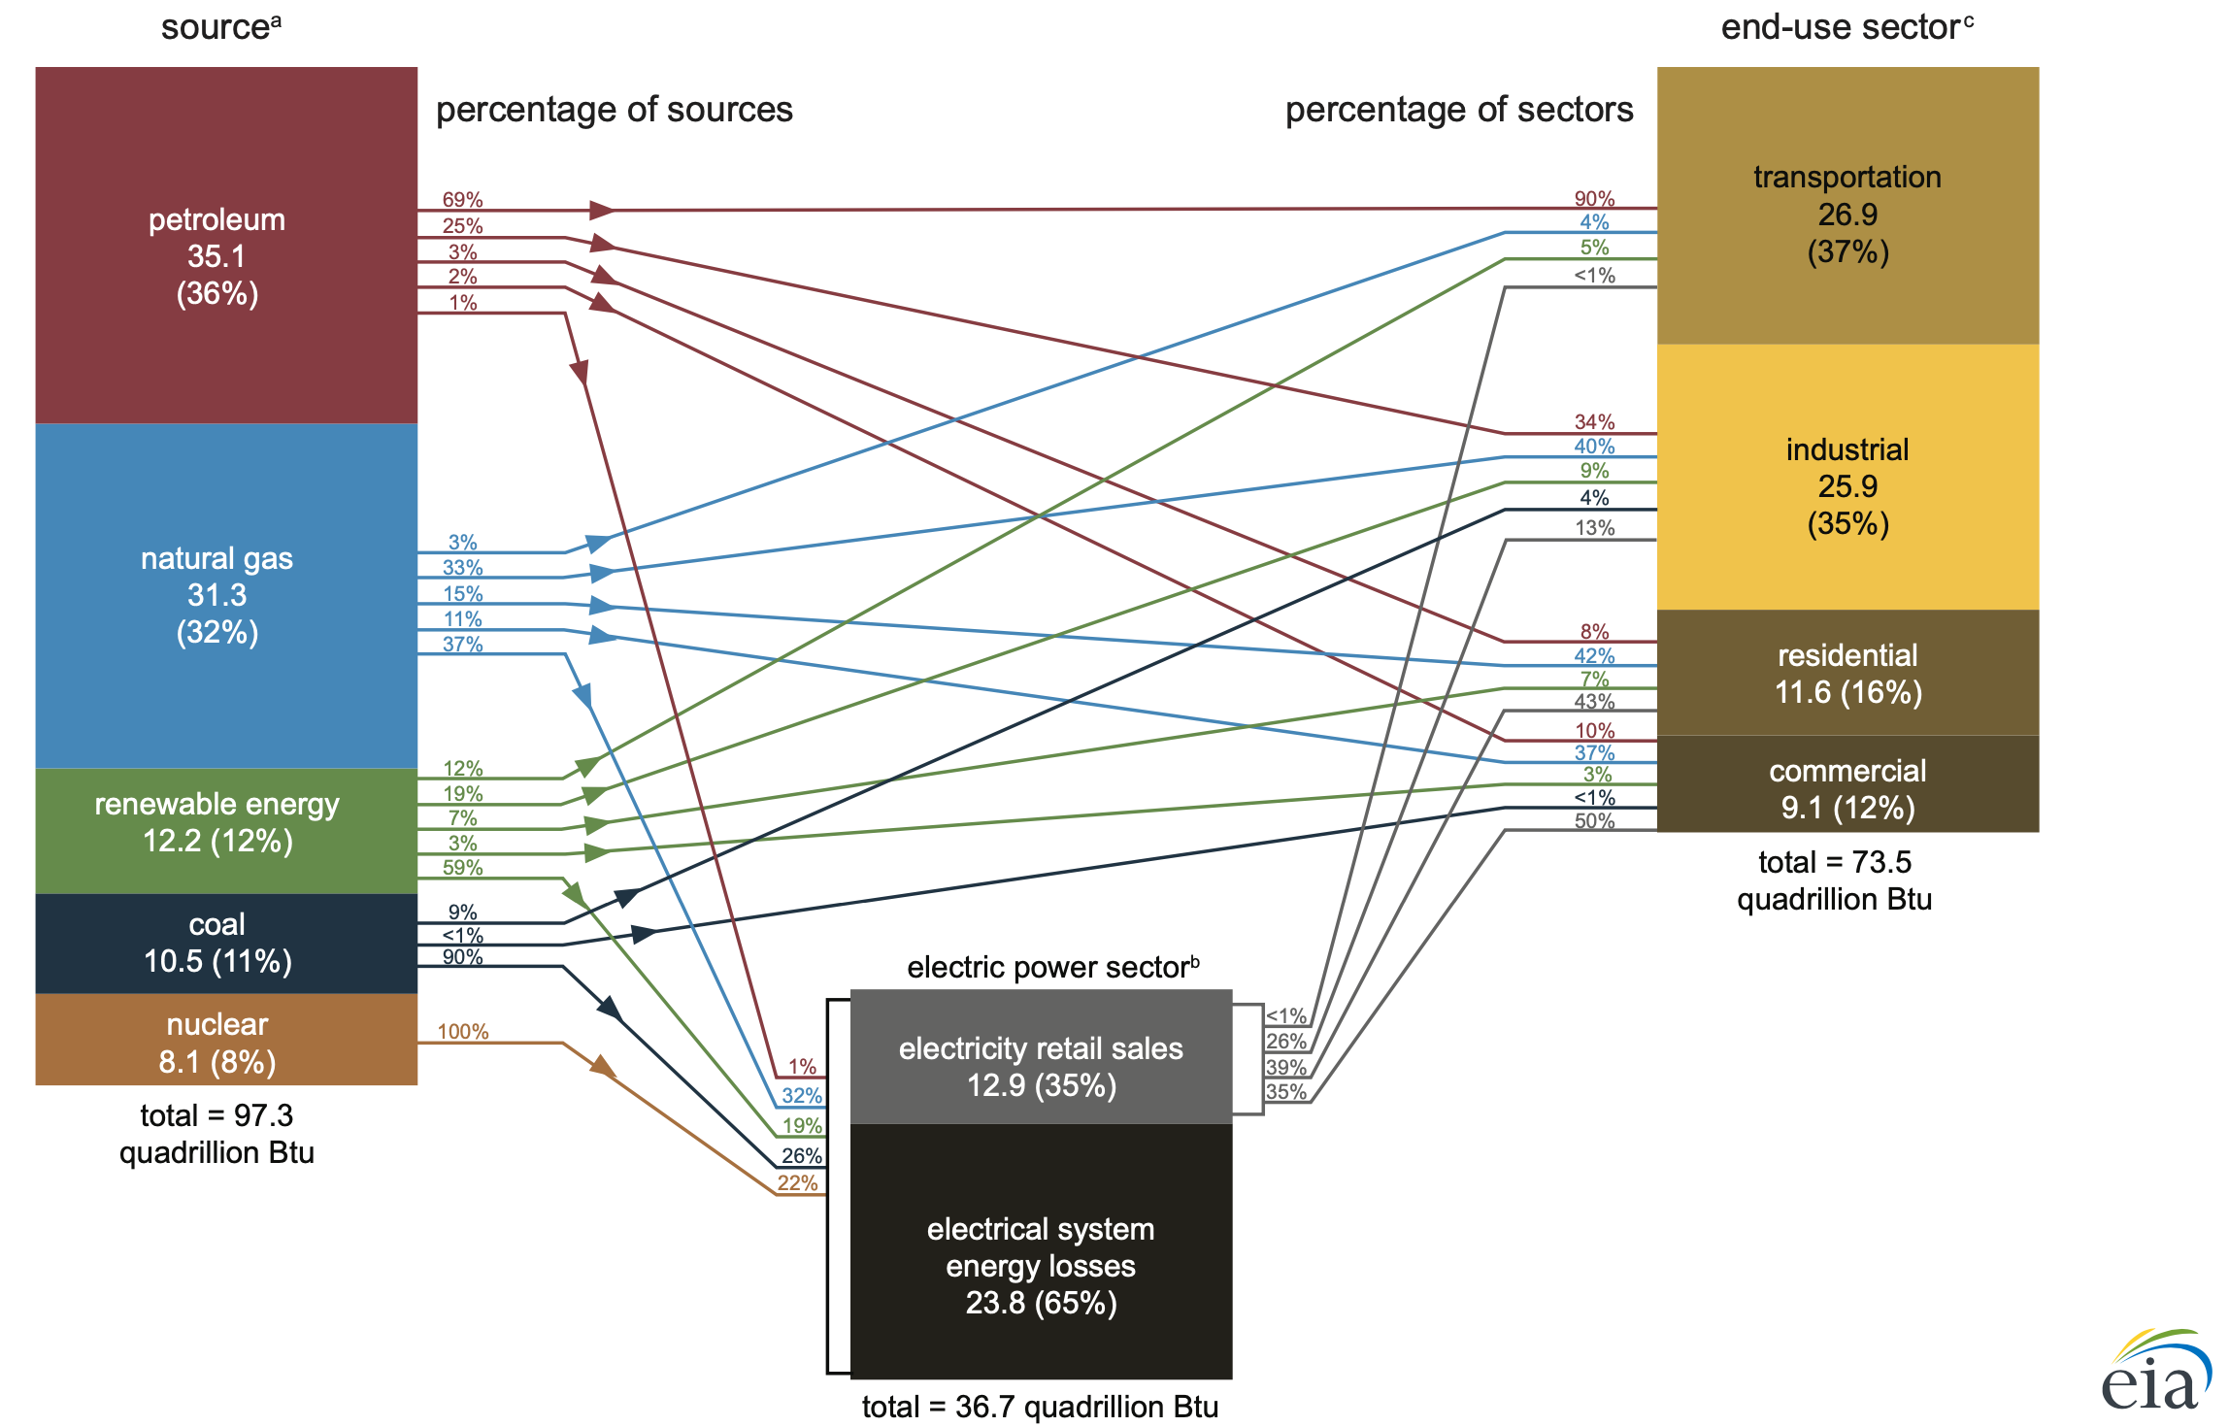
But which type of energy?
Our high school science teachers talked about all sorts of energy, including:
potential, kinetic, chemical, thermal, electrostatic, electromagnetic . . .
The U.S. (and other countries) similarly make use of all sorts of energies
as "explained" in this purportedly clarifying U.S. government figure: ¹
"U.S. Energy Facts Explained"
https://www.eia.gov/energyexplained/us-energy-facts/
Rather than making a frontal assault upon this (boggling) figure,
let's begin with the energy most directly affecting us as citizens & consumers:
Electrical Energy - the one delivered to us by electrons flowing through wires
(a.k.a. "Electricity")

Slide 4
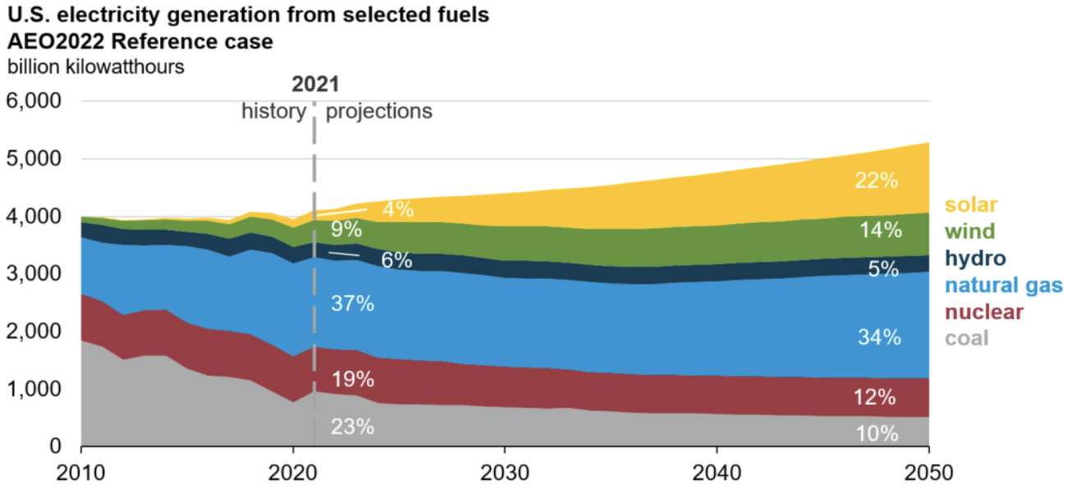
How much Electrical Energy does the U.S. produce / consume?
The U.S. Energy Information Administration (EIA) offers some key factoids & snapshots:
AVERAGE U.S. HOUSEHOLD Electrical POWER use in 2021: 886 kW-hrs / month ¹
(886 kW-hrs) / (30 x 24 hrs) => ~ 1-¼ kilowatts
TOTAL U.S. annual Electrical ENERGY production (projected to 2050): ²
2021 Total ~ 4000 billion kW-h / yr ~ 4 x 10¹⁵ W-h / yr
1) EIA FAQs 2023: https://www.eia.gov/tools/faqs/faq.php?id=97&t=3
2) EIA Annual Energy Outlook 2022 - Narrative, p17: https://www.eia.gov/outlooks/aeo/narrative/pdf/AEO2022_Narrative.pdf

Slide 5
Calling for a quick refresher on metric unit multipliers:
Especially for the very rarely used (and thus seldom remembered) LARGEST multipliers:
K or k = kilo = thousand = 1,000 = 10³
M = mega = million = 1,000,000 = 10⁶ (not to be confused with: m = milli = 10 ⁻³)
G = giga = billion = 1,000,000,000 = 10⁹
T = tera = trillion = 1,000,000,000,000 = 10¹²
Q or q = quad = quadrillion = 1,000,000,000,000,000 = 10¹⁵
Then, from the preceding figure (inserting 10¹⁵ = quad = Q):
U.S. ANNUAL ELECTRICAL ENERGY production: ~ 4 QW-h
And because AVERAGE ELECTRICAL POWER = ANNUAL ELECTRICAL ENERGY / 1 YEAR
using: hour / year = 1 h / ( 24 x 365 h ) = 1 / 8760 and: 4 QW / 8760 = 0.00046 QW
U.S. AVERAGE ELECTRICAL POWER generation: ~ 1/2 TW
An Introduction to Sustainable Energy Systems: WeCanFigureThisOut.org/ENERGY/Energy_home.htm

Slide 6
But U.S. Electrical Energy looks a LOT LESS GREEN than we often hear!
According to that EIA figure, the 2021 breakdown of U.S. Electrical Energy sources was:
2021: 23% Coal / 37% Natural gas / 19% Nuclear / ~ 19% Renewables ¹
Further, based on their knowledge of the U.S. power industry, the EIA predicts very slow greening:
2050: 10% Coal / 34% Natural gas / 12% Nuclear / ~ 41% Renewables
(with particularly weak growth of wind power: 55% over the 29 years 2021 to 2050)
1) ~ 19% Renewables because this figure's "selected fuels" do not include renewable biomass fuel

Slide 7
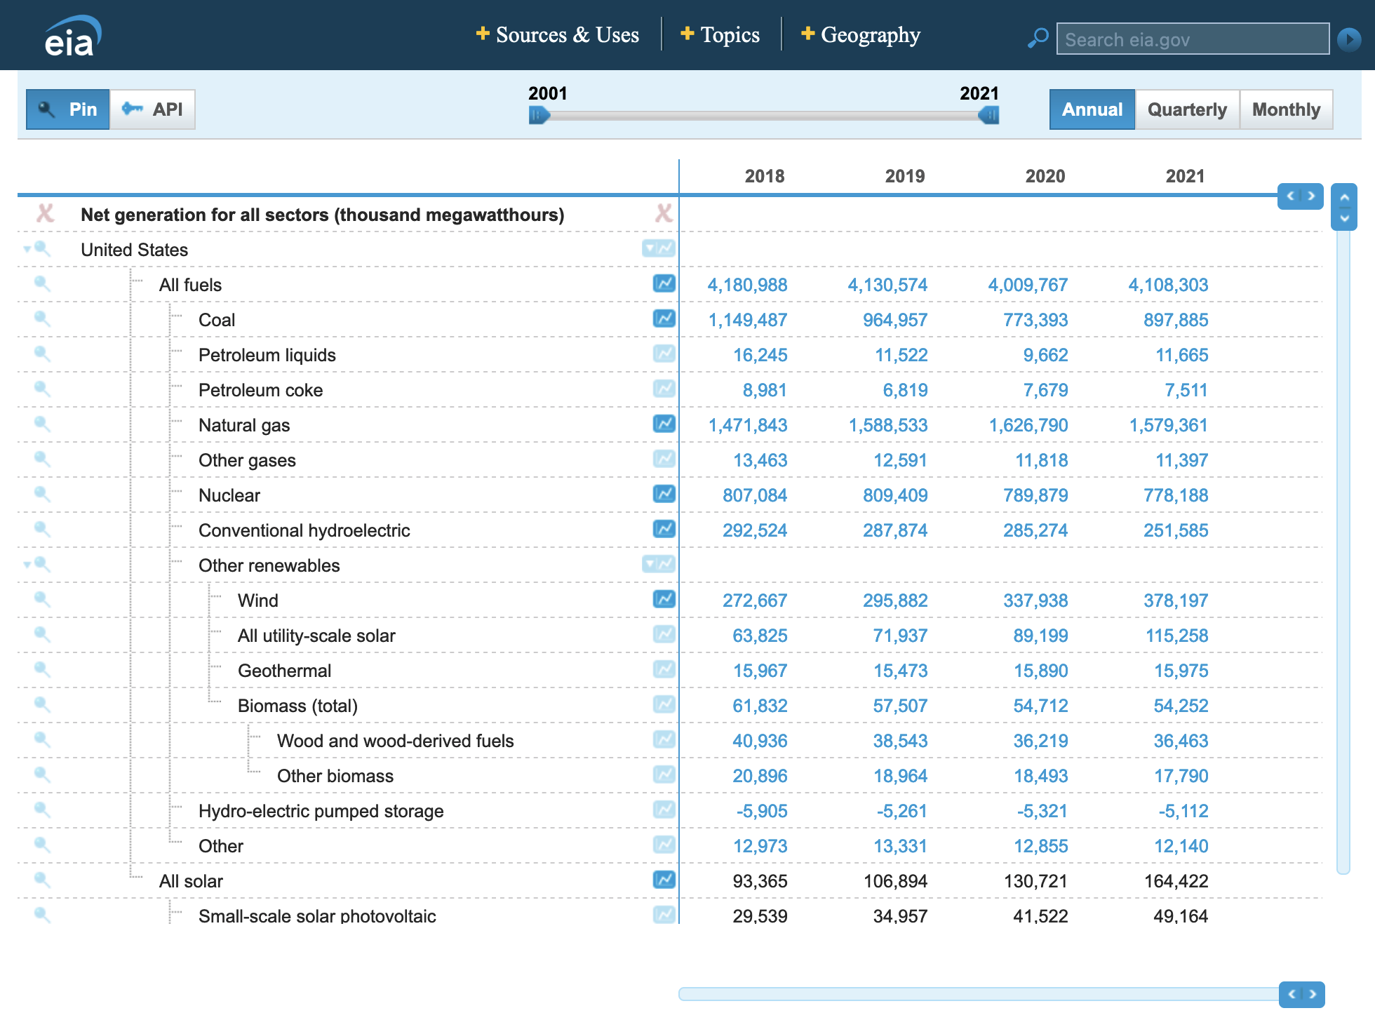
More detailed & recent data are provided by the EIA's Electricity Data Browser
Which has the advantage of being updated both monthly and yearly
But the disadvantage of data presentation via only often-hard-to-digest numerical tables
Screenshot from its webpage (link - also spelled out at the bottom of this page):
https://www.eia.gov/electricity/data/browser/

Slide 8
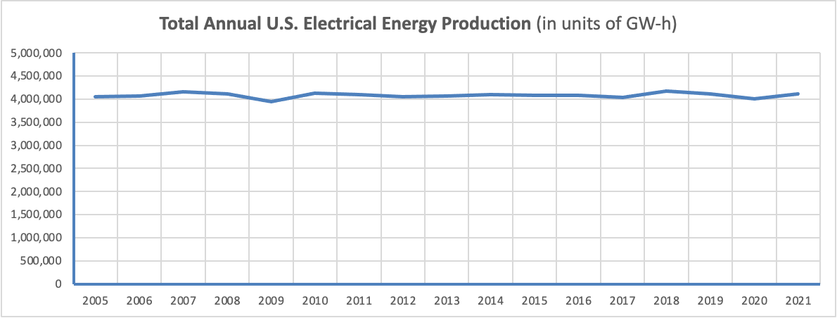
The top line yields my plot of Total Annual U.S. Electrical Energy Production:
Which, for over twenty years, has been remarkably constant at ~ 4.1 QW-h
"Remarkably" because, in the same period, U.S. population grew by over 13% ¹
and inflation-corrected U.S. Gross Domestic Product (GDP) grew by over 75% ²
How was stable electrical energy use achieved? Commonly cited factors include:
Widespread conversion from incandescent to LED lighting (5-8X more energy efficient)
Improved home construction, including much more energy efficient "heat pumps"
1) U.S. Census: https://www.census.gov/data/tables/time-series/dec/popchange-data-text.html
2) https://www.macrotrends.net/countries/USA/united-states/gdp-gross-domestic-product

Slide 9
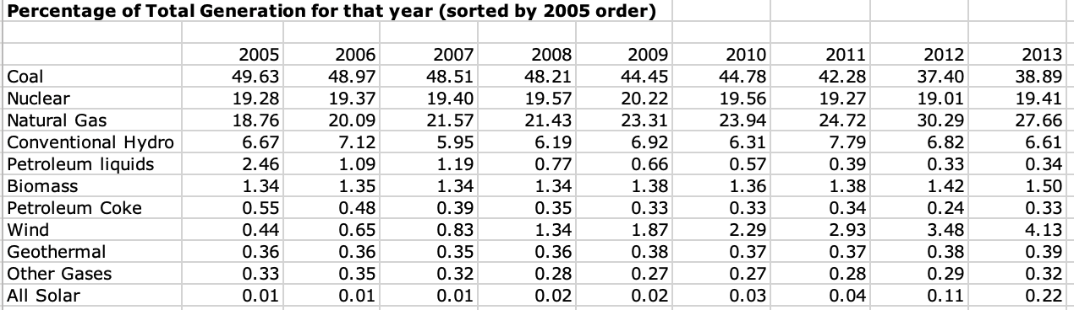
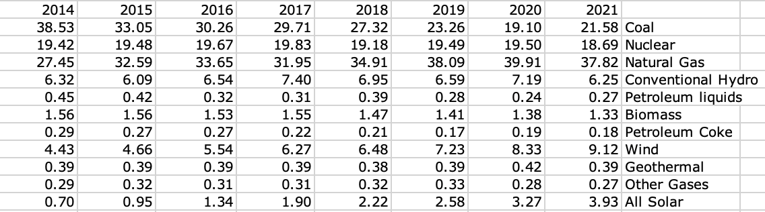
Annually I also add EIA Electricity Data Browser data to an Excel spreadsheet:
And use it to convert production numbers into percentages of total electrical energy:
(My complete speadsheet is available on this webnote set's Resources Webpage)

Slide 10
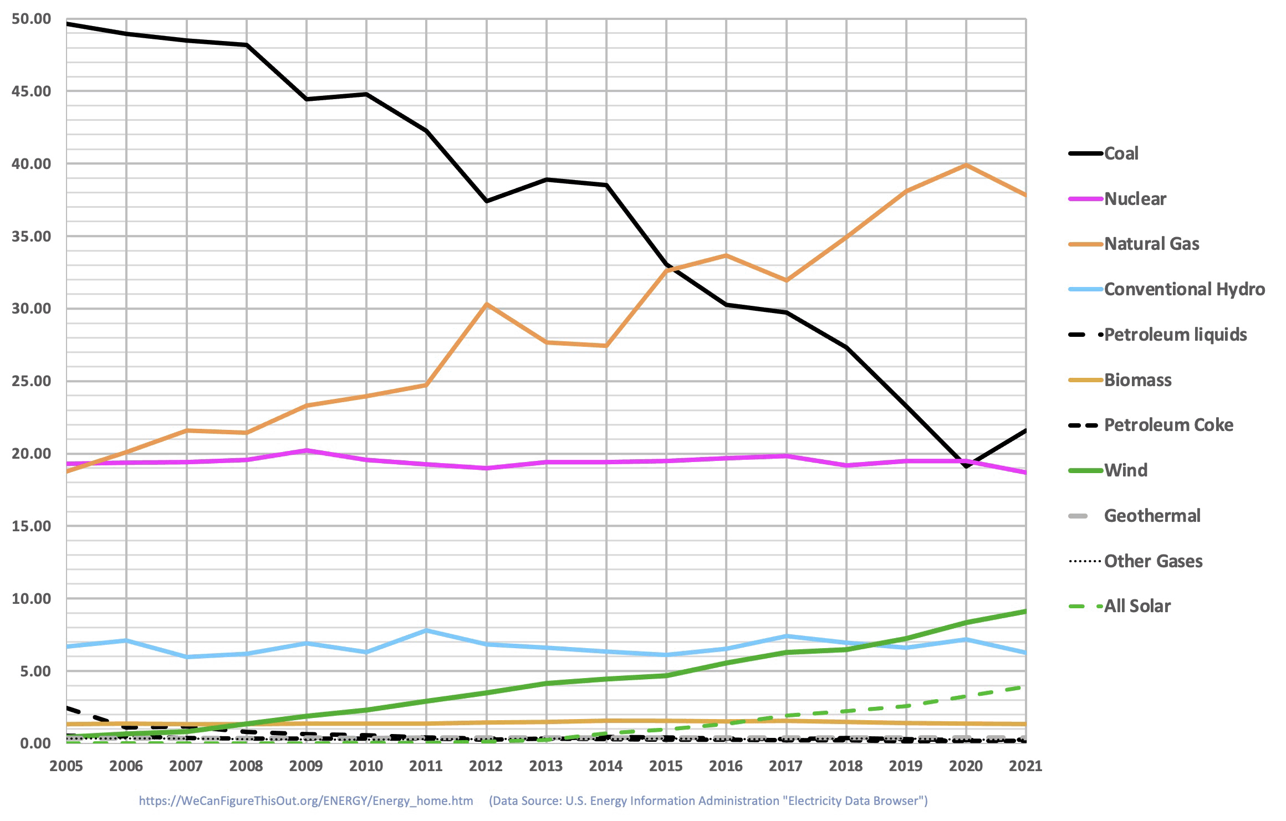
From which I plot: Percentage of U.S. Electrical Energy vs. Energy Source
(Line colors chosen to resemble later Washington Post figures)

Slide 11
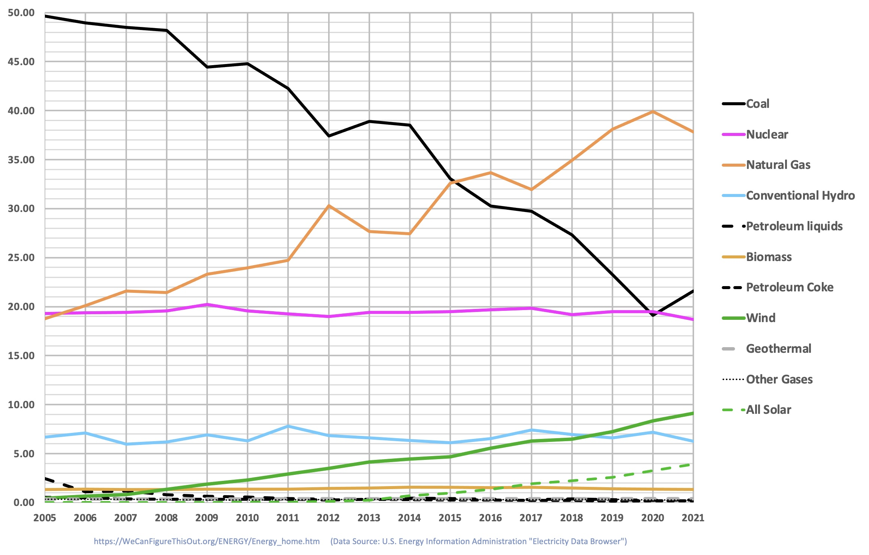
Or calling out latest reported percentages for the largest sources:
Natural Gas: 37.8%
Coal: 21.6%
Nuclear: 18.7%
Wind: 9.1%
Hydro: 6.3%
Solar: 3.9%
Biomass: 1.3%
An Introduction to Sustainable Energy Systems: WeCanFigureThisOut.org/ENERGY/Energy_home.htm

Slide 12
U.S. Electricity IS getting cleaner - but nowhere near as fast as often reported
The best news is that use of coal (our dirtiest fuel), has declined by ~ 60%
But ~ two thirds of that decline was offset by growing use of natural gas (NG)
which, contrary to massive disinformation campaigns, IS FAR FROM GREEN
Compared to coal power power plants, NG power plant GHG emissions are only
  ~20% lower (for "OCGT" NG plants) to ~ 40% lower (for "CCGT" NG plants) ¹
Further, while 39% of our electricity now comes from non-GHG emitting power plants
two thirds of that non-GHG electricity is from nuclear & hydroelectric power plants
The former being completely unacceptable to many people
    The latter being increasingly threatened by climate change droughts
Leaving the only unambiguous (but far less impressive) clean electricity gain as being
15 year growth of wind + solar electricity from near 0% to 13% ( 9.1 + 3.9%)
1) As fully explained in my noteset: FOSSIL FUELS (pptx / pdf / key)

Slide 13
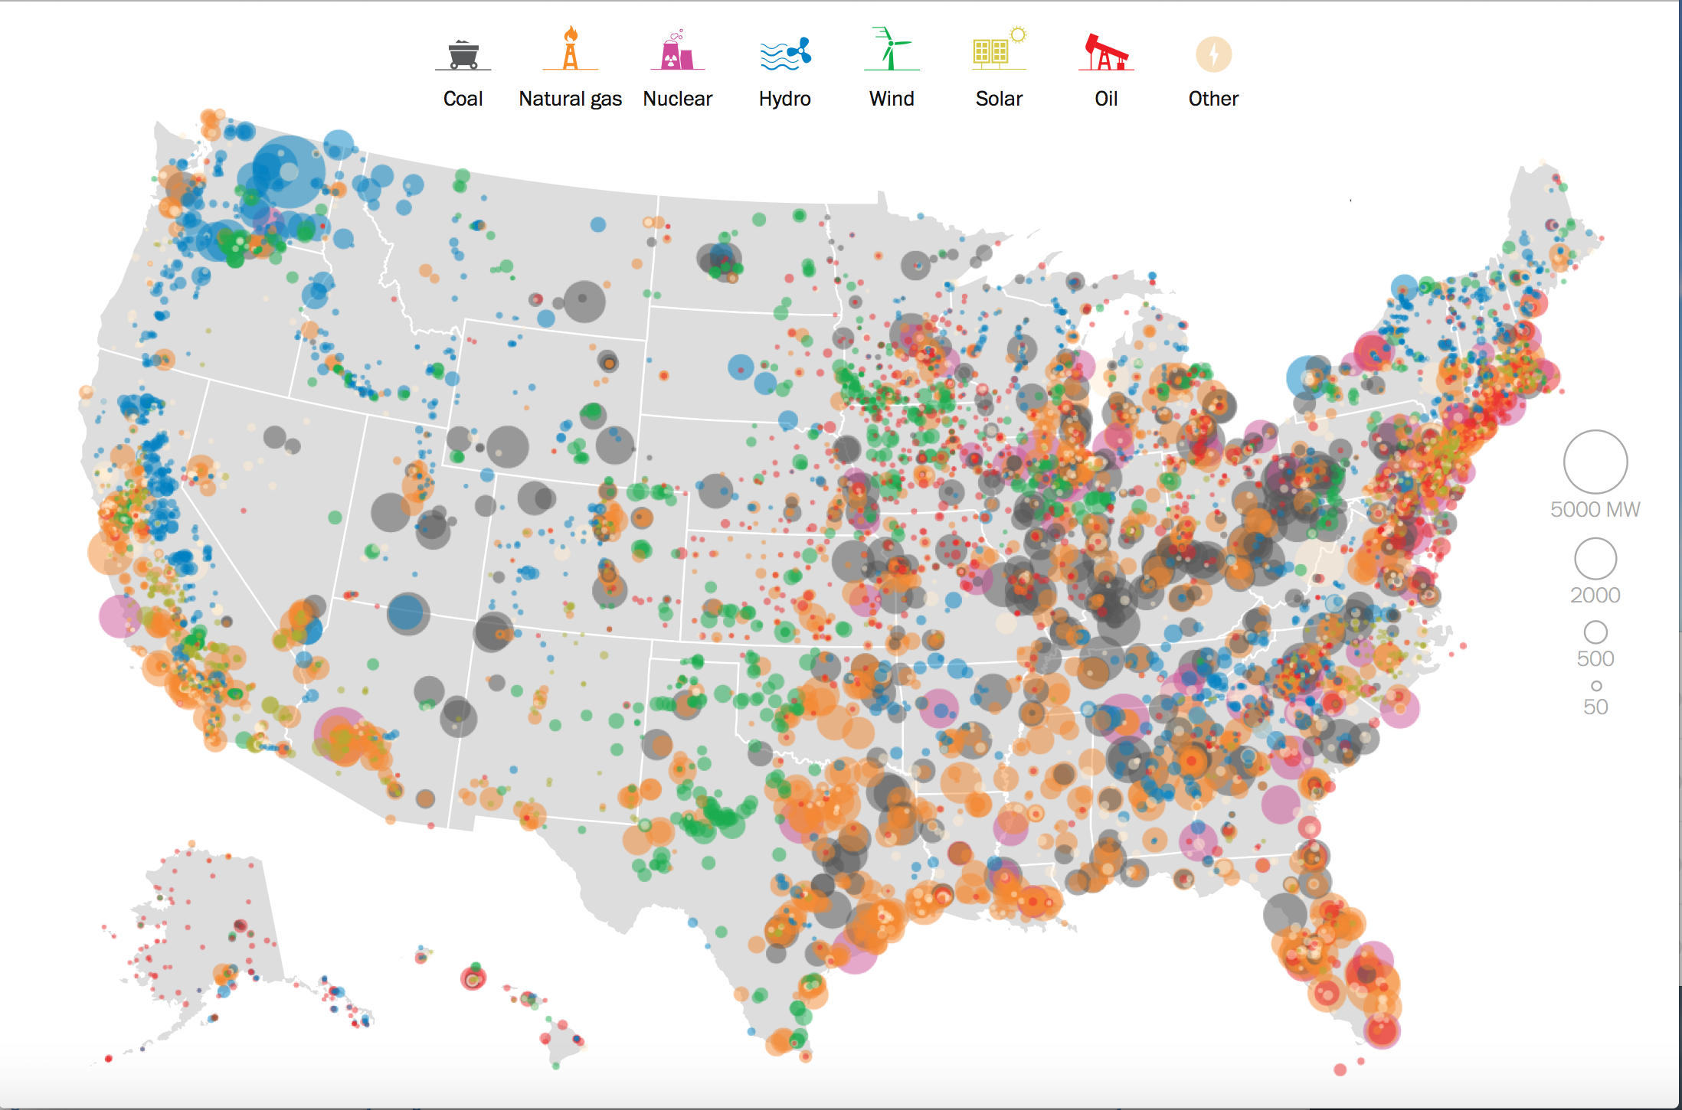
How do the Sources of U.S. Electricity vary across the U.S.?
The Washington Post's 2015 Geographic Breakdown of U.S. Electricity: ¹
1) http://www.washingtonpost.com/graphics/national/power-plants/

Slide 14
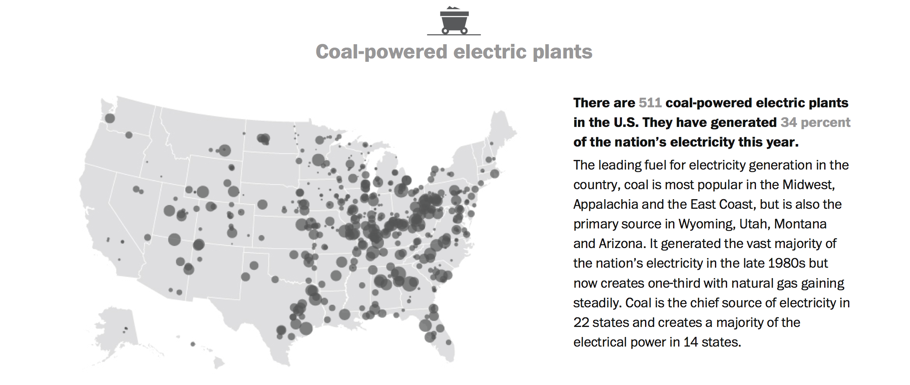
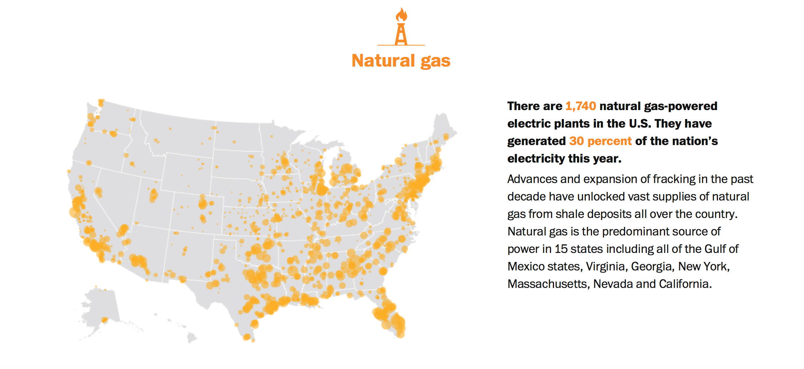
Coal (34% of U.S. power) and Natural Gas (30%):

Slide 15
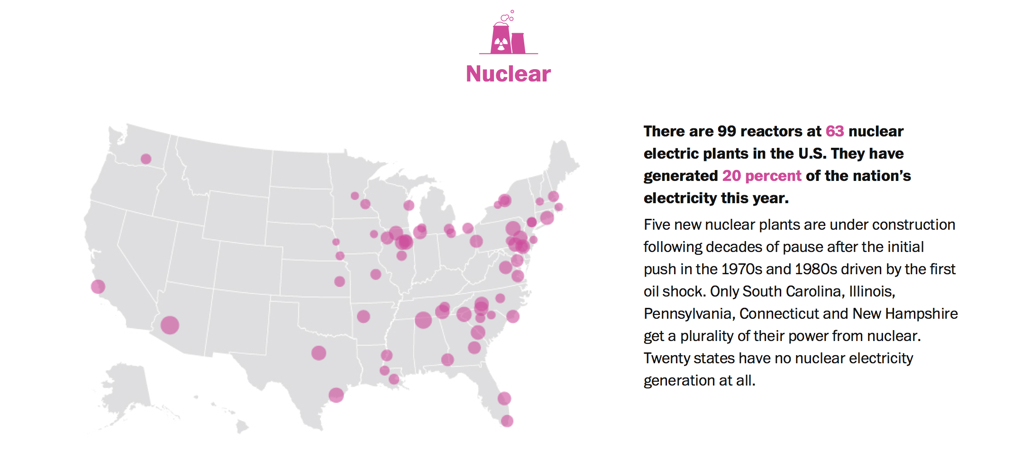
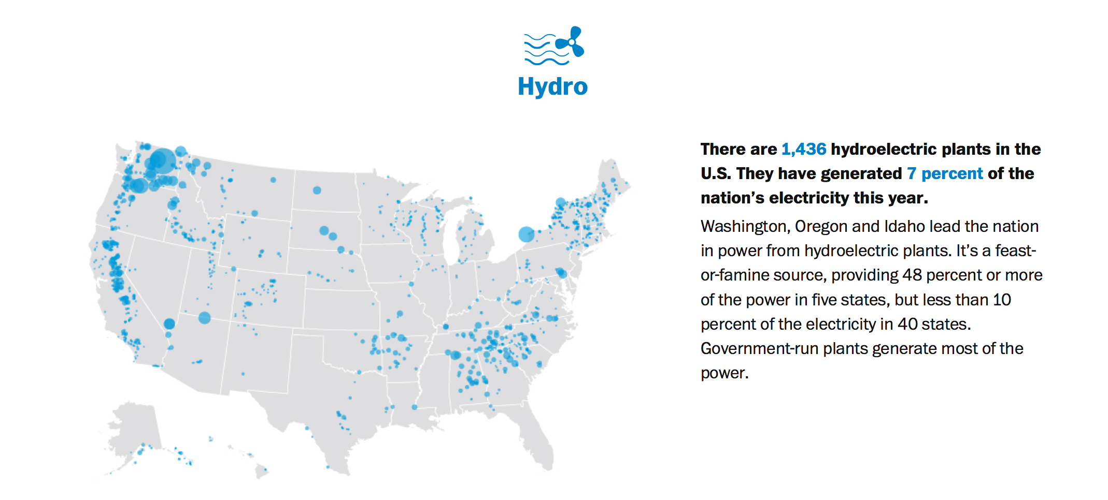
Nuclear (20%) and Hydroelectric (7%):

Slide 16
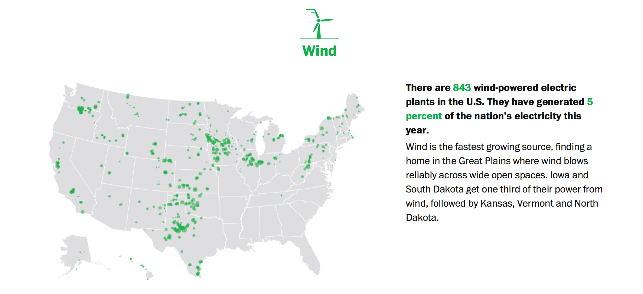
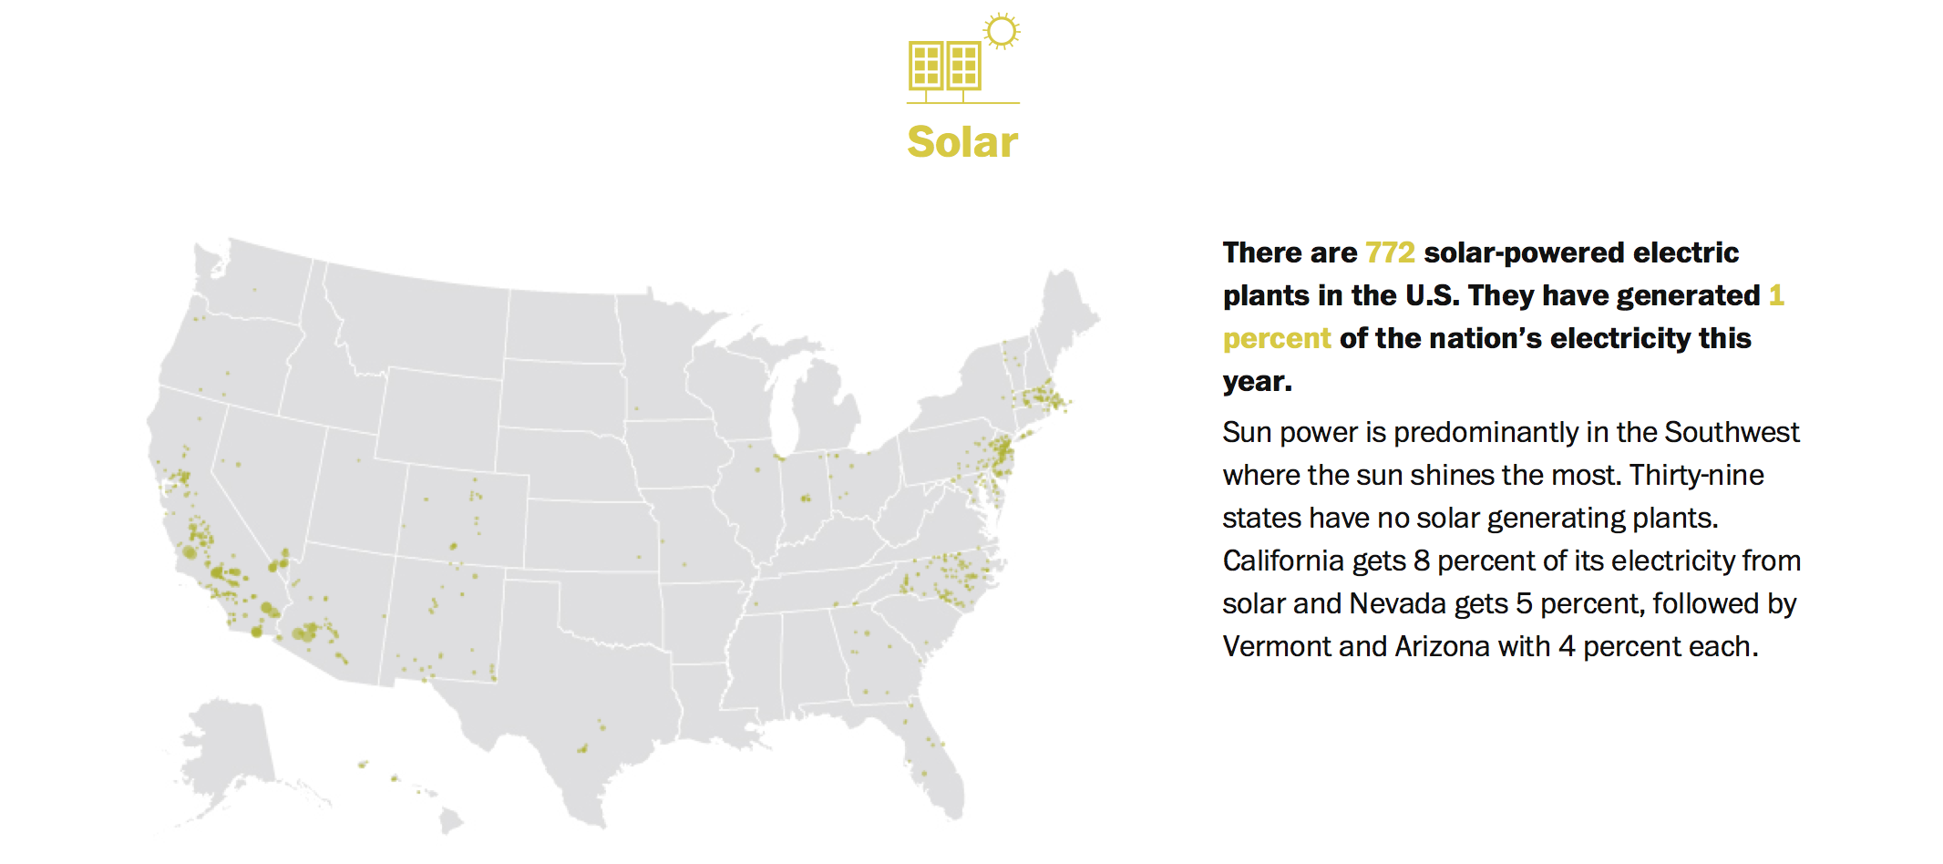
Wind (5%) and Solar (1%):

Slide 17
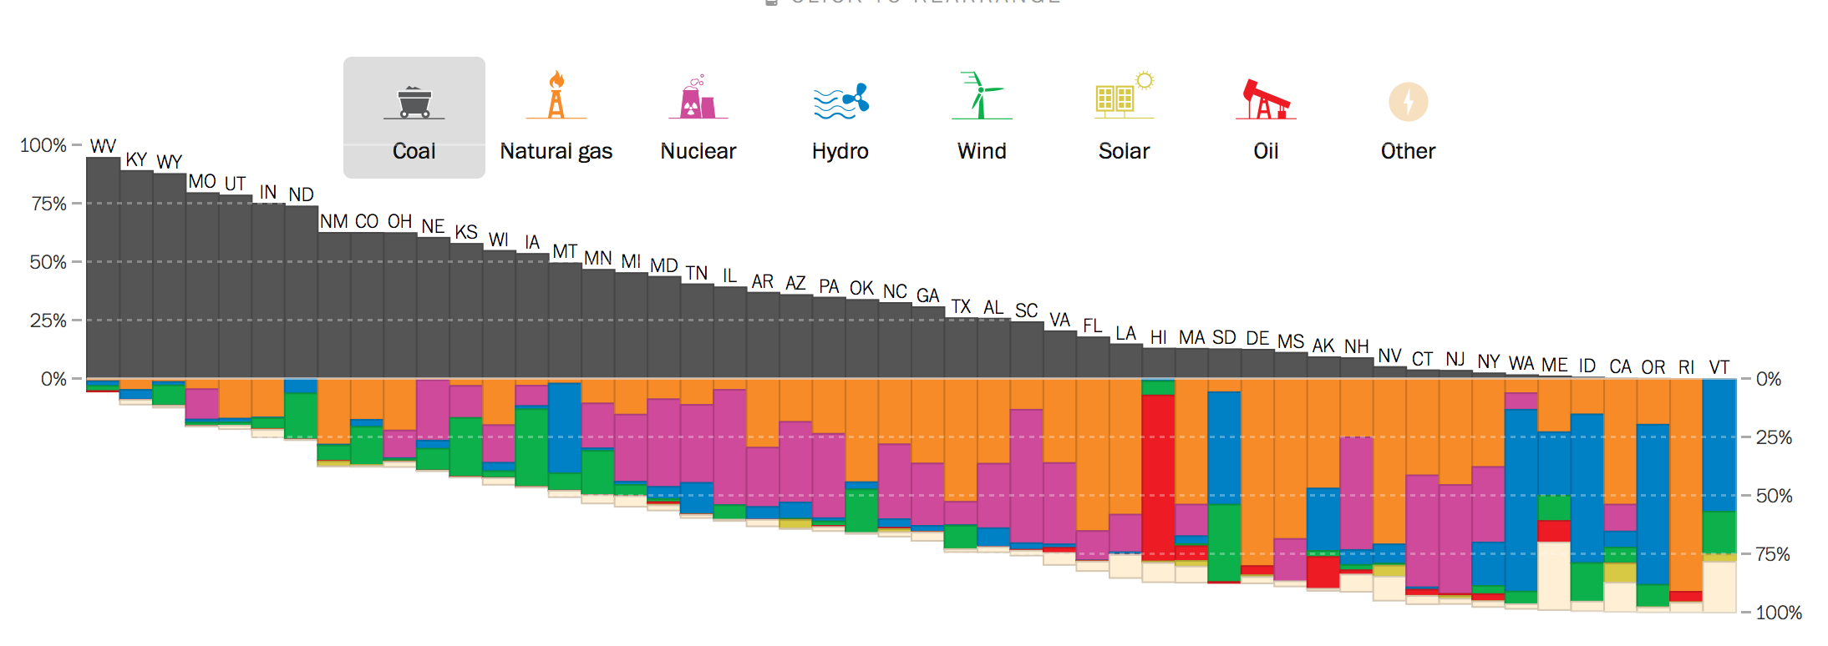
Is there truth to some state claims of being exceptionally green?
This 2015 Washington Post figure certainly pegs West Virginia as the least green
But the greenest, Vermont, succeeds only by importing Quebec's hydropower
Utah
Ohio
Idaho
West Virginia
Maryland
Virginia
Vermont
Pennsylvania
Washington
Texas
Massachusetts
California
New Hampshire
Source: http://www.washingtonpost.com/graphics/national/power-plants/

Slide 18
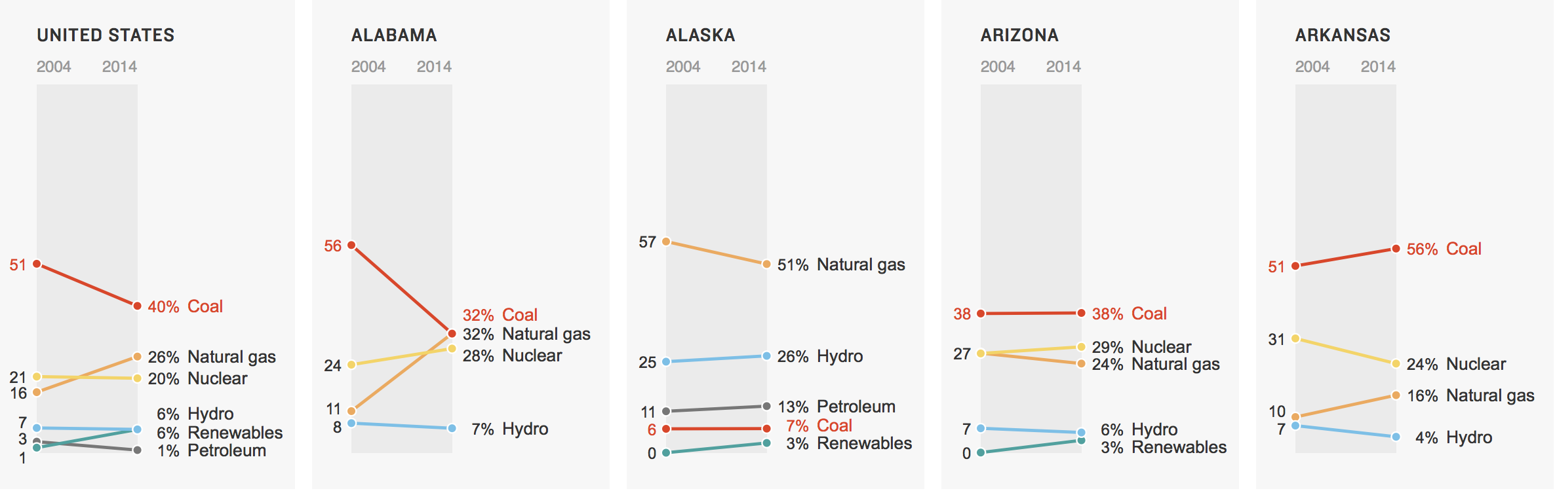
Ten Year Trends in State-by-State Sources of Electrical Energy:
Drawn from this National Public Radio article:
"Coal, Gas, Nuclear, Hydro? How Your State Generates Power" ¹
The 2004-2014 trend for total U.S. electrical power:
Then, on the five slides that follow, the trends for
Alabama through Georgia
Hawaii through Maryland
Massachusetts through New Jersey
New Mexico through North Carolina
South Carolina through Wyoming
1) http://www.npr.org/2015/09/10/319535020/coal-gas-nuclear-hydro-how-your-state-generates-power?utm_source=facebook.com&utm_medium=social&utm_campaign=npr&utm_term=nprnews&utm_content=20150910

Slide 19
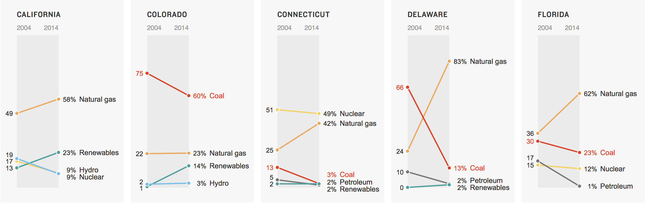
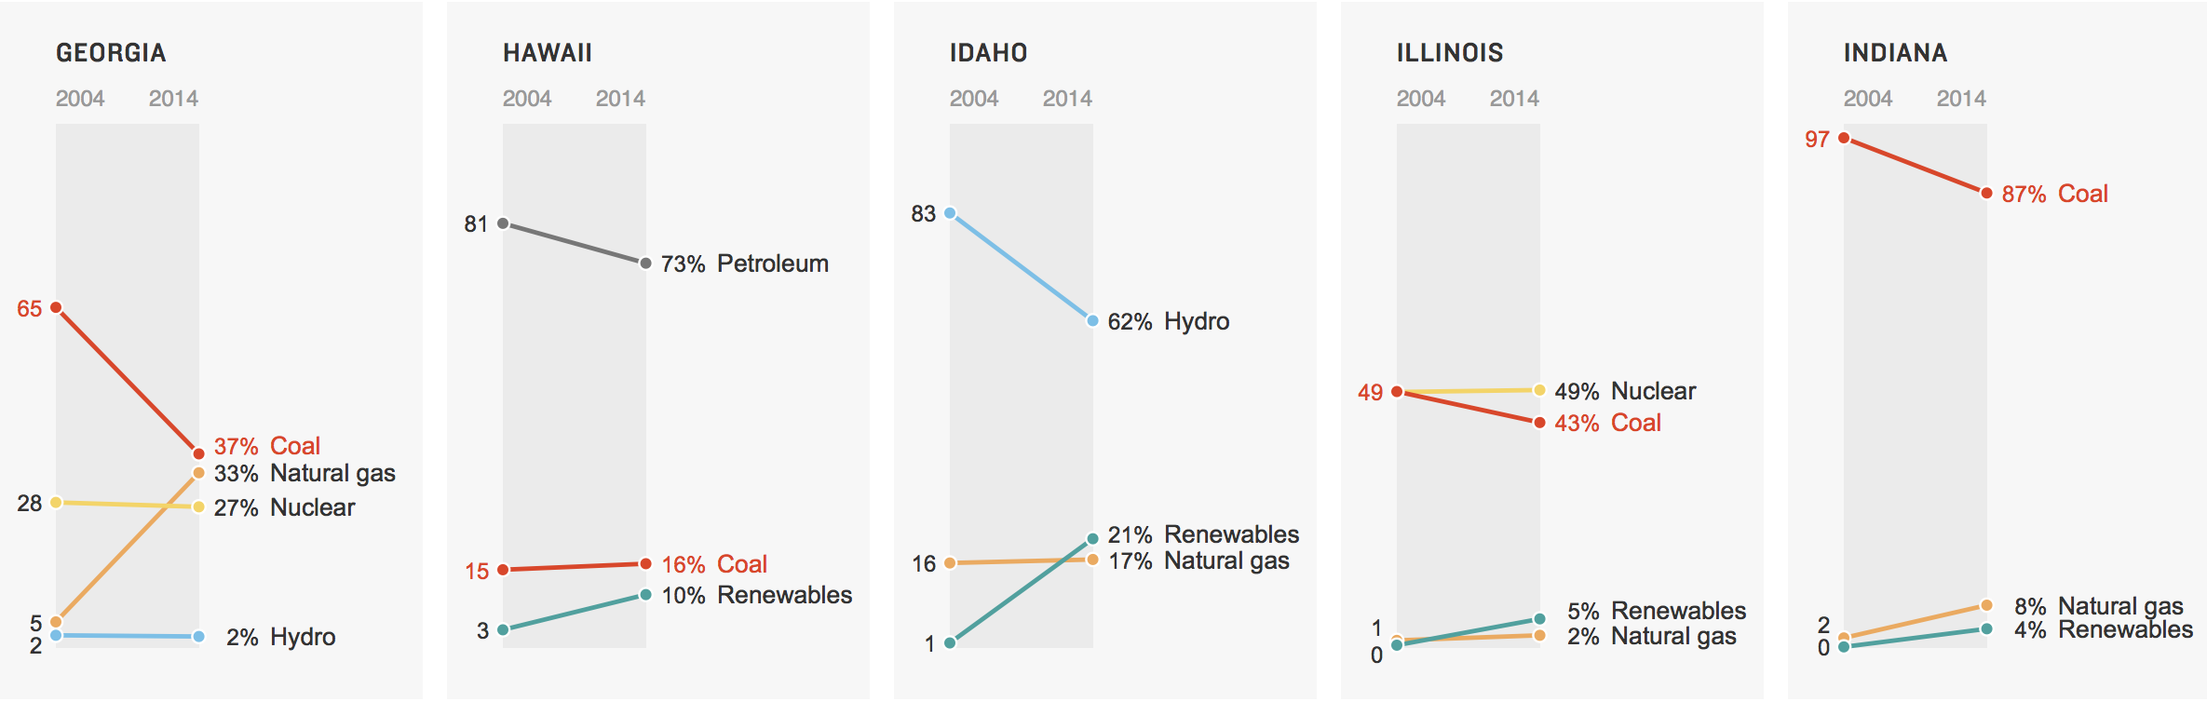
Alabama through Georgia:
http://www.npr.org/2015/09/10/319535020/coal-gas-nuclear-hydro-how-your-state-generates-power?utm_source=facebook.com&utm_medium=social&utm_campaign=npr&utm_term=nprnews&utm_content=20150910

Slide 20
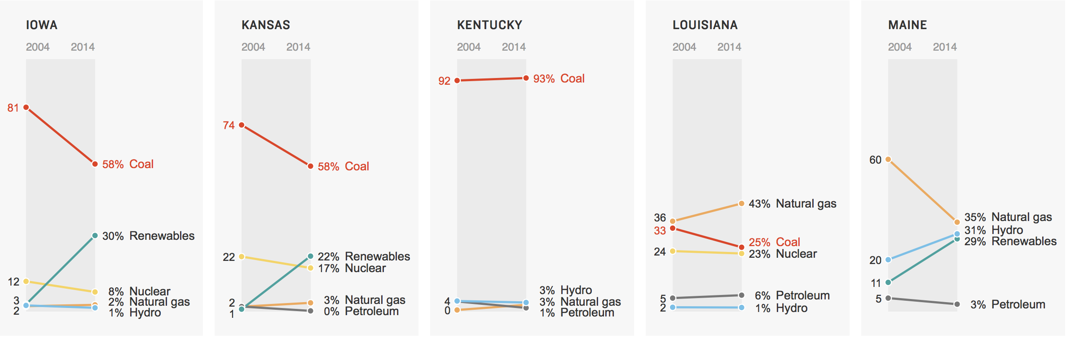
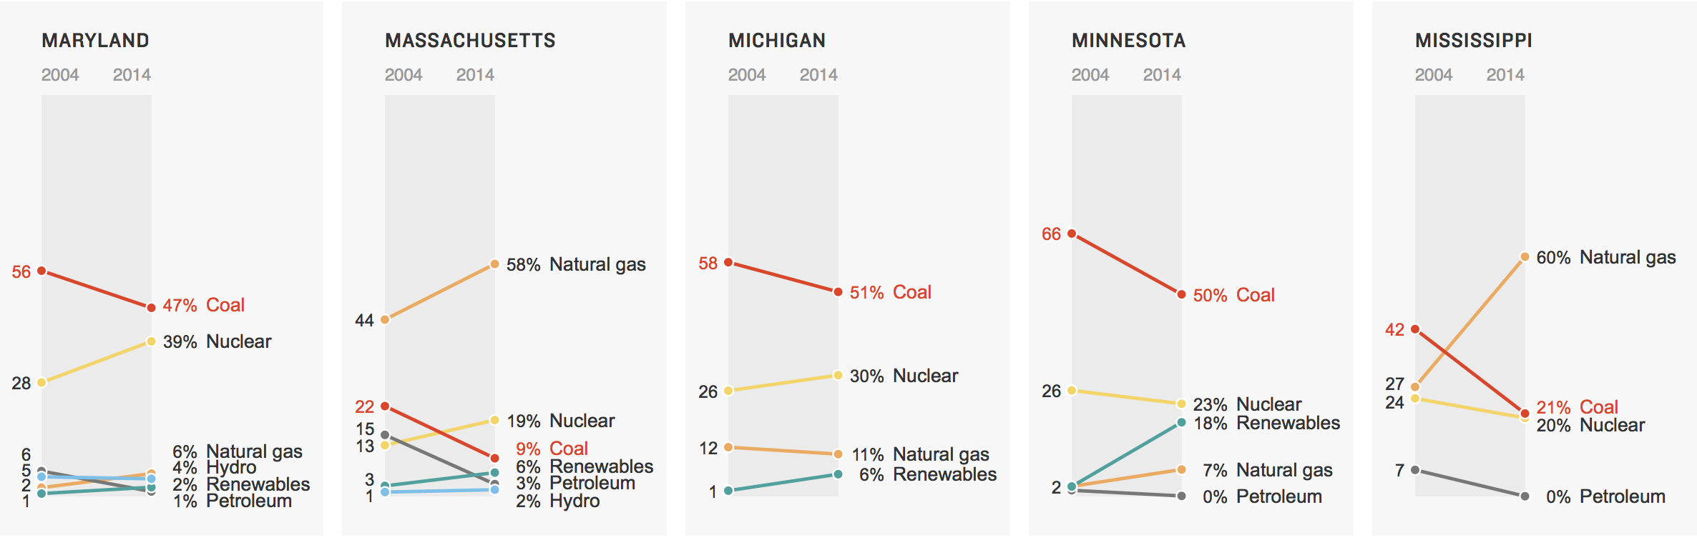
Hawaii through Maryland:
http://www.npr.org/2015/09/10/319535020/coal-gas-nuclear-hydro-how-your-state-generates-power?utm_source=facebook.com&utm_medium=social&utm_campaign=npr&utm_term=nprnews&utm_content=20150910

Slide 21
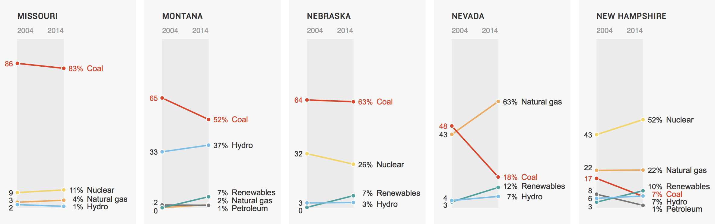
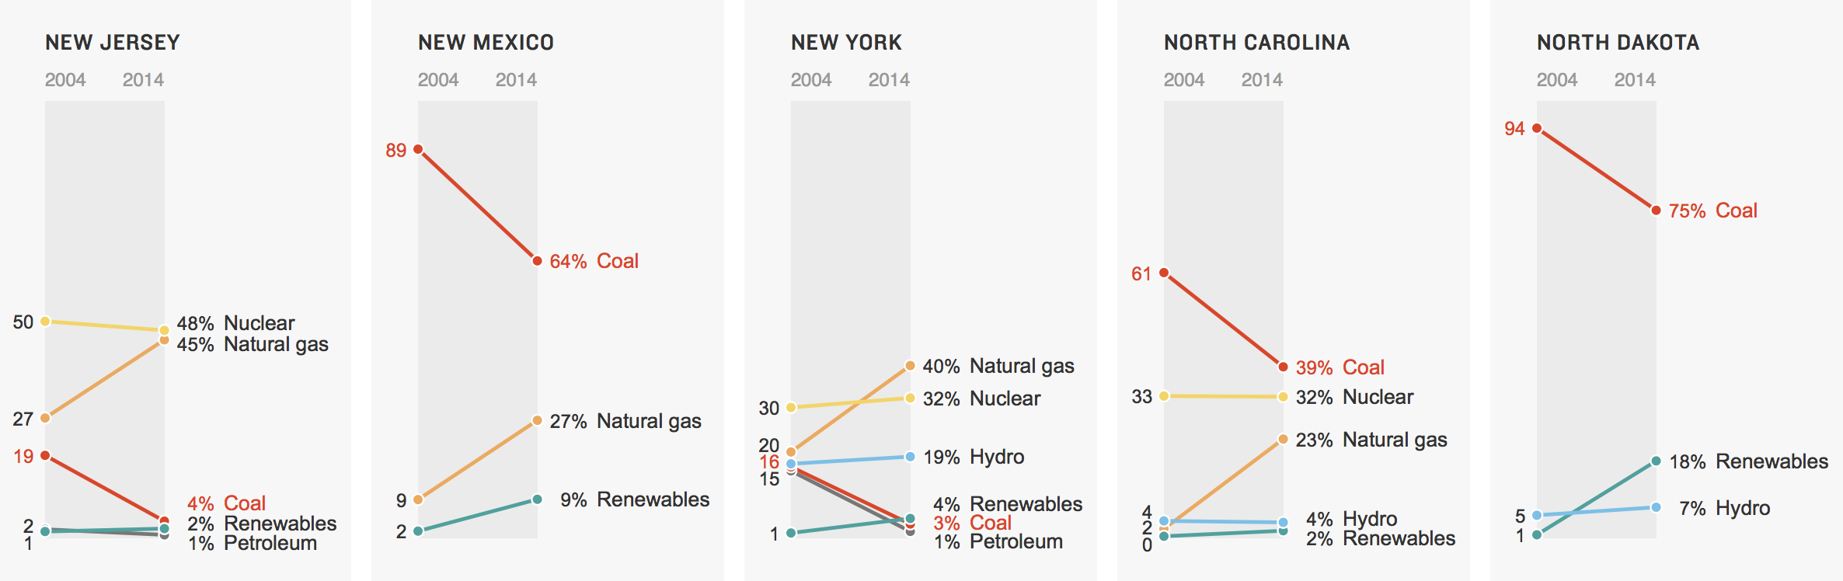
Massachusetts through New Jersey:
http://www.npr.org/2015/09/10/319535020/coal-gas-nuclear-hydro-how-your-state-generates-power?utm_source=facebook.com&utm_medium=social&utm_campaign=npr&utm_term=nprnews&utm_content=20150910

Slide 22
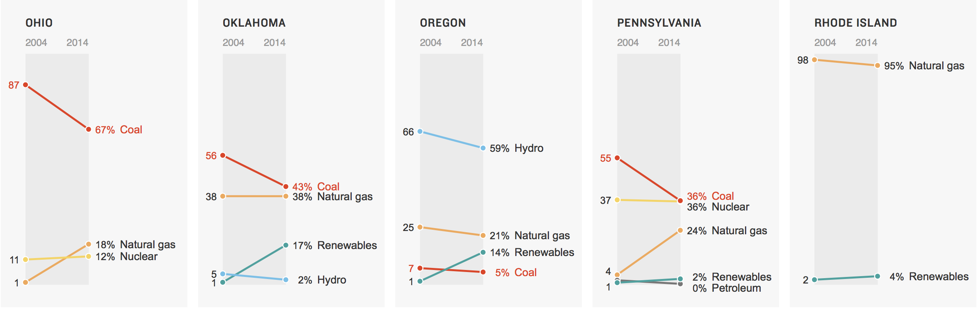
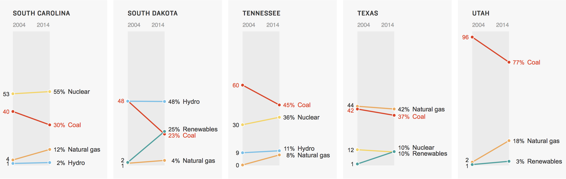
New Mexico through South Carolina:
http://www.npr.org/2015/09/10/319535020/coal-gas-nuclear-hydro-how-your-state-generates-power?utm_source=facebook.com&utm_medium=social&utm_campaign=npr&utm_term=nprnews&utm_content=20150910

Slide 23
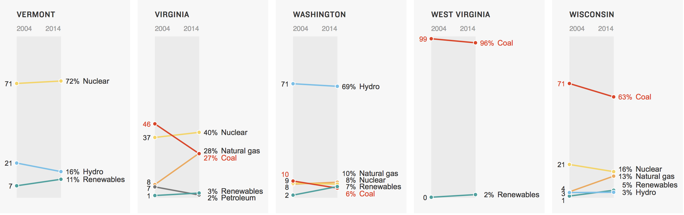
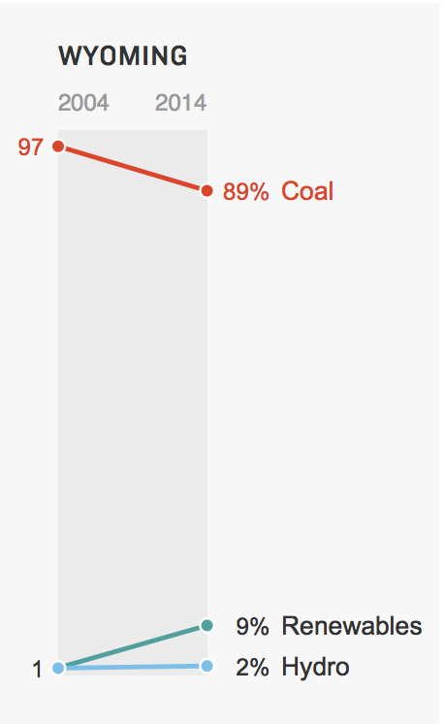
South Carolina through Wyoming
http://www.npr.org/2015/09/10/319535020/coal-gas-nuclear-hydro-how-your-state-generates-power?utm_source=facebook.com&utm_medium=social&utm_campaign=npr&utm_term=nprnews&utm_content=20150910

Slide 24
How could we make U.S. Electrical Energy more sustainable?
Natural Gas: 37.8%
Coal: 21.6%
Nuclear: 18.7%
Wind: 9.1%
Hydro: 6.3%
Solar: 3.9%
Biomass: 1.3%
Alternate scenarios:

Slide 25

Natural Gas: 37.8%
Coal: 21.6%
Nuclear: 18.7%
Wind: 9.1%
Hydro: 6.3%
Solar: 3.9%
Biomass: 1.3%
Analyzing the most recent data:
Coal + Natural Gas = (37.8 + 21.6 = 59.4)% of 4.1 QW-h = 2.5 QW-h
Coal + Natural Gas + Nuclear = (37.8 + 21.6 + 18.7 = 78.1)% of 4.1 QW-h = 3.2 QW-h
Nuc + Hydro + Wind + Solar + Bio = (18.7 + 6.3 + 9.1 + 3.9 + 1.3 = 39.3)% of 4.1 QW-h = 1.6 QW-h
Hydro + Wind + Solar + Bio = (6.3 + 9.1 + 3.9 + 1.3 = 20.6)% of 4.1 QW-h = 0.84 QW-h
Wind + Solar + Bio = (9.1 + 3.9 + 1.3 = 14.3)% of 4.1 QW-h = 0.59 QW-h
Changing to this: Would require this growth: of these sources:
0% (Coal + NG) (59.4 + 39.3) / 39.3 => 2.5X Nuc + Wind + Hydro + Solar + Bio
0% (Coal + NG) + fixed (Nuclear) (59.4 + 20.6) / 20.6 => 3.9X Hydro + Wind + Solar + Bio
0% (Coal + NG) + fixed (Nuc + Hydro) (59.4 + 14.3) / 14.3 = 5.2X Wind + Solar + Bio
0% (Coal + NG + Nuclear) (78.1 + 14.3) / 14.3 => 6.5X Wind + Solar + Bio
First scenario includes 2.5X growth of both Nuclear (intensely controversial) & Hydro (impossible?)
Second scenario includes 3.9X growth of Hydro (impossible?)
Which is why later notesets thoroughly analyze both Nuclear & Hydro Power!

Slide 26
Having examined U.S. Electrical Energy Production & Consumption
Let's now turn to U.S. TOTAL Energy Production & Consumption
Addressing questions such as:
What is the size of our non-electrical energy use?
How does that break down into climate-sustainable vs. non-sustainable parts?
How might non-sustainable parts be most expeditiously reduced or eliminated?
"U.S. Energy Facts Explained"
https://www.eia.gov/energyexplained/us-energy-facts/
Taking us back to that EIA figure which, in addition to its obviously complexity,
uses only an obscure, pre 20th century, UK based unit
(reputedly derived from the energy released by 1 burning wooden match):
The British Thermal Unit (BTU)

Slide 27
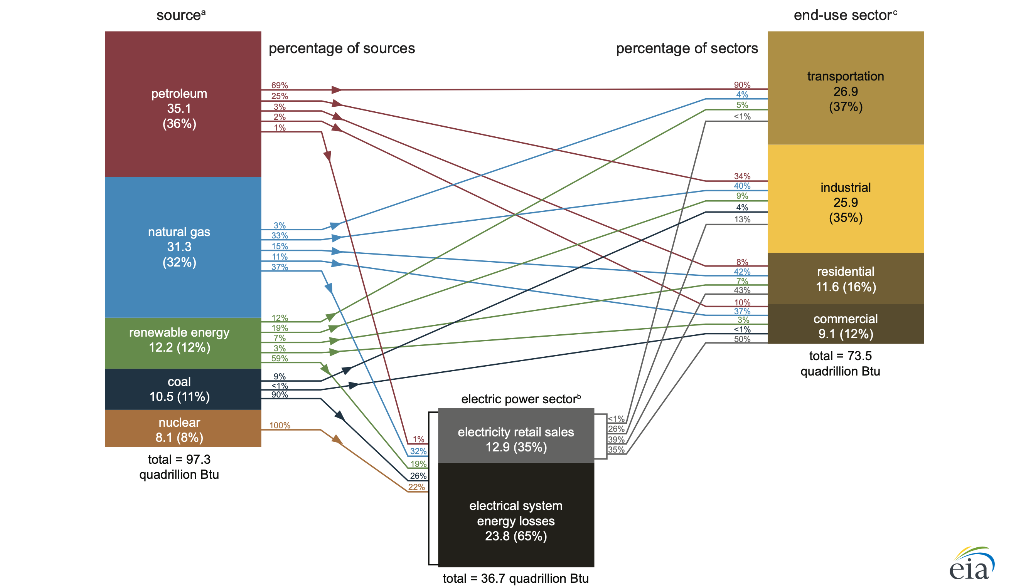
Here brought into the modern era by my addition of metric unit equivalents:
Using the conversion: ¹⁻⁵ 1 BTU = 0.2931 W-h => 1 quadrillion BTU = 0.2931 QW-h
10.3 QW-h
7.88 QW-h
7.59 QW-h
9.17 QW-h
3.39 QW-h
2.67 QW-h
3.58 QW-h
3.08 QW-h
21.5 QW-/h
2.37 QW-h
3.78 QW-h
28.5 QW-h
6.98 QW-h
10.8 QW-h
1) https://en.wikipedia.org/wiki/British_thermal_unit
2) https://www.rapidtables.com/convert/power/BTU_to_Watt.html
3) https://www.freeconvert.com/unit/btu-to-watt-hours
4) https://www.unitconverters.net/power/btu-it-hour-to-watt.htm
5) https://learnmetrics.com/convert-btu-to-watt/

Slide 28
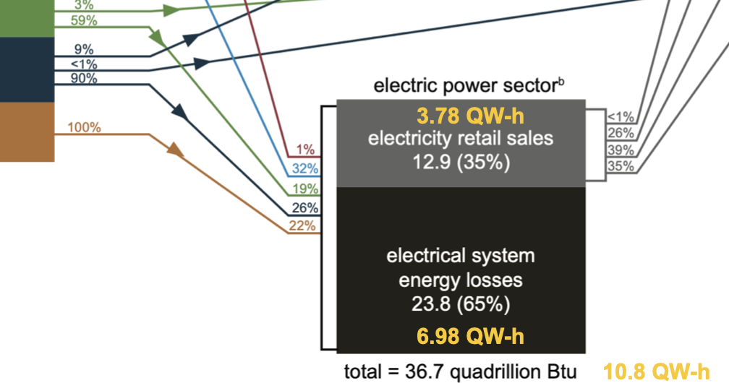
Digression: NASA got clobbered mixing unit systems ¹ - the EIA "missed that memo"
From the 2021 EIA Electricity Data Browser used early in this note set: ²
From the immediately preceding 2021 EIA U.S. Energy Facts Explained: ³
4.108 is significantly different than 3.78
Raising some doubts about EIA data accuracy & internal data sharing ⁴
1) Mars Probe Lost Due to Simple Math Error - Los Angelas Times (1 October 1999):
https://www.latimes.com/archives/la-xpm-1999-oct-01-mn-17288-story.html
2) https://www.eia.gov/electricity/data/browser/
3) https://www.eia.gov/energyexplained/us-energy-facts/
4) Confirming the advisability of always "figuring it out" for yourself (or at least double checking the "experts")

Slide 29
Returning to the whole figure: Why must it be so complex?
THE MAIN REASON: It tracks two very differently behaving types of energy:
1) Electrical Energy: Which can be transported easily and efficiently,
and at its final point-of-use converts its energy with very high efficiency:
  e.g., electric motors convert electrical to kinetic energy at near 100% efficiency
  or electric heaters convert electrical to thermal energy at 100% efficiency
2) Hydrocarbon Chemical Combustion Heat Energy: Which is transported in myriad ways,
and at its point-of-use converts its heat energy in many different low efficiency ways, e.g.:
  Fossil-fuel power plants convert heat to output electrical energy at ~ 33% efficiency ¹
  Fossil-fuel cars & trucks convert heat to vehicle kinetic energy at ~ 20% efficiency ²
1) See noteset: Generic Power Plant & Grid (pptx / pdf / key ) 2) See noteset: Greener Cars and Trucks (pptx / pdf / key)

Slide 30
Result: Electrical Energy tracking is easy / Combustion Heat Energy tracking is hard:
Because some applications use combustion heat energy directly (e.g., in furnaces)
While other applications use electricity generated by conversion from combustion heat energy,
done at some intermediate point (often, but not always, in a "Power Sector" power plant)
With that conversion efficiency depending strongly upon the exact technology used,
AND that conversion efficiency falling well below 100% (i.e., with heavy energy wastage)
Leading to these arrow-connected divisions
Energy Sources
End Use Applications
"Electric Power Sector"
(?????)

Slide 31
The Electricity Grid? YES & NO: It's the far right electricity output arrows
Power plants burning fossil-fuels to generate electricity? YES
Making descending red, blue, black input arrows chemical heat energy
Power plants fissioning uranium to generate electricity? NO
  Because nuclear energy is sourced & converted in the same plant
    (vs. hydrocarbons sourced but then converted in separate plants)
  Making nuclear's brownish descending input arrow electrical energy
But making the descending green renewable arrow very confusing because:
Wind, solar & hydro plants directly output electrical energy
While biomass/biofuel plants output chemical energy only converted
to electricity by entirely separate plants in the"electric power sector"
What exactly does the EIA INCLUDE within its center "Electric Power Sector"?
Electric Power Sector
Electricity
Grid
Grid bound
Energy conversion losses + electricity transmission losses
Further, if only 59% of renewable energy
goes to the Electric Power Sector
where does the remaining 41% go?

Slide 32
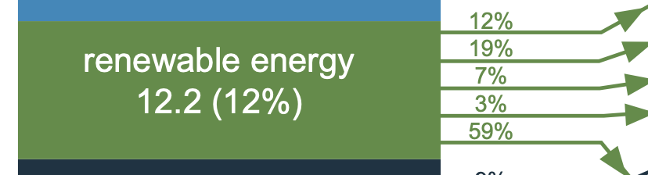
Its destination is revealed only by careful study of a 265-page supporting EIA document ¹
Drawing from that study's eleven chapters and five appendices,
the complete division of 2021 U.S. renewable energy is identified below
For our TOTAL Energy System to become more sustainable we must
grow those green energy flows + clean up our Electricity,
at the expense of petroleum, NG and coal energy flows
7.88 QW-h
7.59 QW-h
Ethanol & Biodiesel fuel combustion energy
Wood, waste & co-product combustion energy
3.39 QW/h
3.39 QW-h
Home solar cells + wood waste combustion energy
2.67 QW-h
41%
Commercial solar cells + wood/waste combustion
21.5 QW-h Total
Electricity
3.58 QW-h
59%
3.78 QW-h
6.98 QW-h
1) Monthly Energy Review, April 2022: https://www.eia.gov/totalenergy/data/monthly/archive/00352204.pdf

Slide 33
How much of Total U.S. Energy is tied to Greenhouse Gas (GHG) emissions?
2021 Electricity is 59.4% tied to GHG emissions: 3.78 QW-h = 2.25 QW-h + 1.53 QW-h
End-Use Sector Electricity inputs must similarly divided 59.4% / 40.6%, ultimately yielding:
7.88 QW-h
Total tied to GHGs: Total not tied to GHGs:
~ 7.4 QW-h ~ 0.4 QW-h ¹
~ 6.5 QW-h ~ 1.1 QW-h ²
~ 2.6 QW-h ~ 0.8 QW-h ³
~ 2.1 QW-h ~ 0.6 QW-h ⁴
______________________________________________
~ 18.6 QW-h ~ 2.9. QW-h Total
7.59 QW/-h
3.39 QW-h
2.67 QW-h
21.5 QW-h Total
3.78 QW-h
Incoming Electrical Energy alone = 3.78 QW-h => 2.25 QW-h + 1.53 QW-h
1) (90 + 4 + .594 x 0)% vs (5 + .406 x 0)% => 94% vs 5%
2) (34 + 40 + 4 + .594 x 13)% vs (9 + .406 x 13)% => 85.7% vs 14.3%
3) (8 + 42 + .594 x 43)% vs (7 + .406 x 43)% => 75.5% vs 24.4%
4) (10 + 37 + 0 + .594 x 50) vs (3 + .406 x 50) => 76.7% vs 23.3%

Slide 34
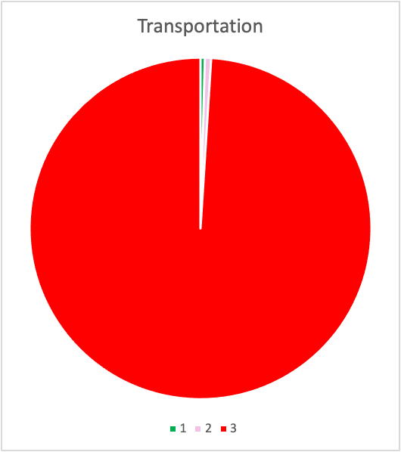
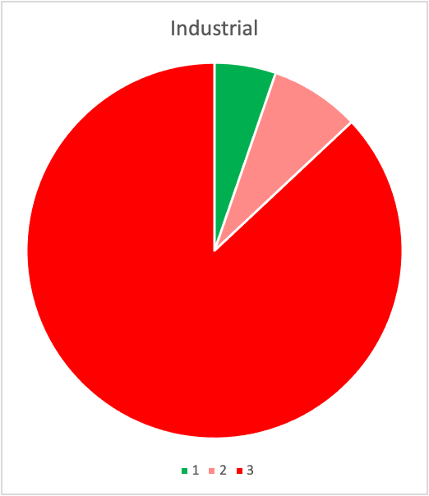
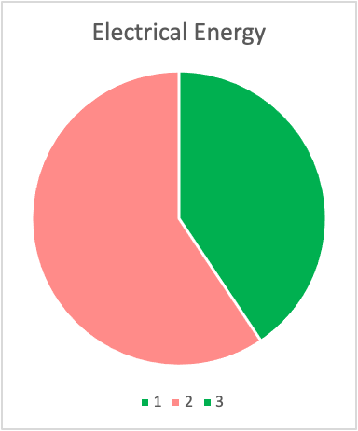
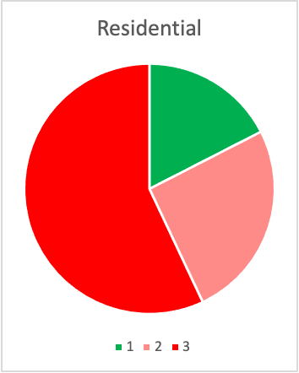
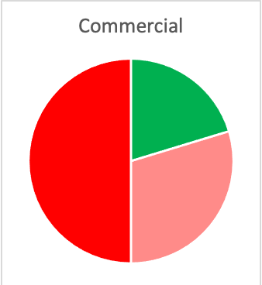
Or displaying those 2021 U.S. energy data in Pie Charts:
With pie chart areas scaled to be proportional to the energies they represent:
Electrical Energy Energy Consumption
Generation: (including green / red electrical + other red energy sources):
Link to the Excel worksheet in which I generated those pie charts:
https://wecanfigurethisout.org/ENERGY/Web_notes/Introduction/US_Energy_Production_and_Consumption_Supporting_Files/US Energy Pie Charts for 2021 worksheet.xlsx

Slide 35
Key observations regarding U.S. TOTAL Energy Consumption
Total Energy use is over 5X larger than Electrical Energy use alone (21.5 / 3.78)
Total Energy is also now 86.5% GHG emission based (18.6 / 21.5) versus its
Electrical Energy component which is now 59.4% GHG emission based (2.25 / 3.78)
Earlier we calculated that eliminating 2.25 QW-h of GHG-linked Electrical Energy required:
2.5X growth of ALL non-GHG Electricity sources or
even greater growth of deepest-green Wind + Solar + Bio
But Total Energy's GHG-linked input is instead 18.6 QW-h which
even excluding dirty electricity's 2.25 QW-h leaves 16.35 QW-h
Some suggest a strategy of just growing clean electricity to the point
that it could replace not only dirty electricity's 2.25 QW-h,
but also total energy's remaining dirty 16.35 QW-h ¹
But that would seem to require net clean electricity growth of:
(18.6 / 1.53 ) = 12X
Which I don't see that happening in a climate-acceptable time frame
7.88 QW-h = 7.4 + 0.4 QW-h
7.59 QW/-h = 6.5 + 1.1 QW-h
3.39 QW-h = 2.6 + 0.8 QW-h
2.67 QW-h = 2.1 + 0.6 QW-h
q-BTU
1) Forget ‘Reduce, Reuse, Recycle’ - The Atlantic, 25 Feb 2022:
https://www.theatlantic.com/newsletters/archive/2022/02/saul-griffith-electrify-everything-solution-save-humanity/622911/
21.5 QW-h = 18.6 + 2.9 QW-h
3.78 QW-h = 2.25 + 1.53 QW-h incoming Electricity

Slide 36
But improvement would be easier than those numbers suggest because . . .
Many tasks require dramatically more Fossil-fuel Energy than Electrical Energy
For such tasks, a conversion eliminating 1 unit of fossil fuel
    would require much less than 1 unit of replacement electrical energy
Meaning not all of that dirty 18.6 QW-h total energy need be replaced 1:1 with clean electricity
Three particularly effective AND timely conversions might be based on the following:
- Cars & trucks deliver fossil fuel energy to vehicle motion energy at efficiencies of 13 - 25%
vs. electric car energy conversion efficiencies of 70 - 75% ¹
- Furnaces transfer fossil-fuel energy to building air at efficiencies of 80 - 95%
vs. electric heat pump efficiencies of 300 to 400% ²
Which is achieved by NOT directly converting electric energy into heat
but by instead using it to move heat from outside air (or water) to inside air
- Water heaters transfer fossil-fuel energy to water at efficiencies of ~ 60%
vs. electric heat-pump water heaters achieving efficiencies of up to 400% ³
1) See my noteset: Greener Cars & Truck (pptx / pdf / key)
2) See my noteset: Energy Consumption in Housing (pptx / pdf / key) 3) Based on corrected U.S. Department of Energy document (link)

Slide 37
Using those observations to generate some (admittedly crude) rules:
Regarding Transportation:
1) For electric vehicles replacing fossil-fuel cars & trucks:
1 unit of Electrical Energy could replace ~ 4 units of Fossil-fuel Energy
Regarding Residences:
2) For electric heat pumps replacing fossil-fuel air ventilation furnaces:
1 unit of Electrical Energy could replace ~ 3.5 units of Fossil-fuel Energy
This rule applies ONLY to air ventilation furnaces because electric heat pumps
  cannot effectively heat other things to well above room temperature
3) For electric heat pump water heaters replacing fossil-fuel water heaters:
1 unit of Electrical Energy could replace ~ 5 units of Fossil-fuel Energy
NEXT STEPS: Figuring out WHERE such fossil-fuel replacements are most plausible / likely
Calculating AMOUNT of energy saved via those fossil-fuel to electric conversions

Slide 38
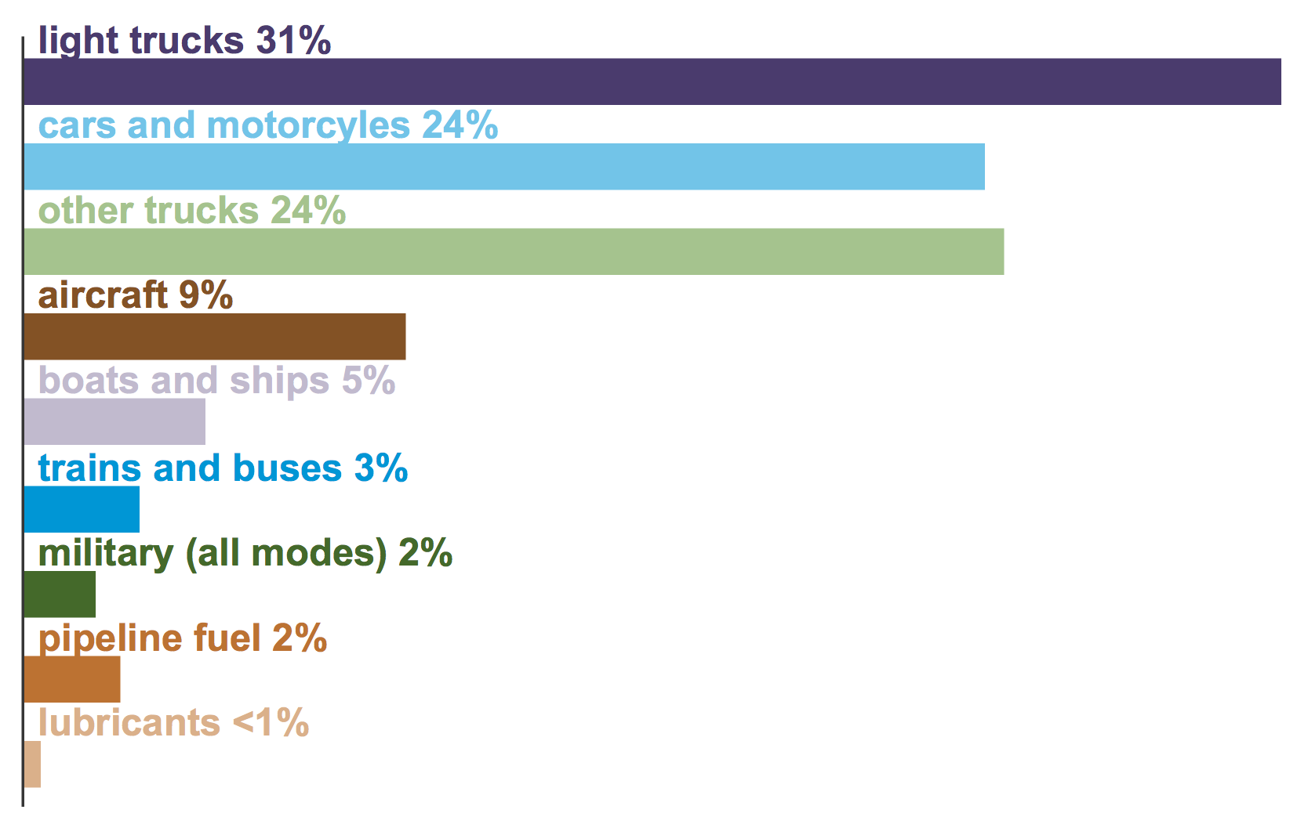
Applying my Transportation Vehicle Rule 1:
From my Energy in Transportation (pptx / pdf / key) notes,
2020 EIA breakdown of U.S. Transportation Energy Use: ¹
2021 figure from above:
7.88 QW-h
7.59 QW-h
3.39 QW/h
3.39 QW-h
2.67 QW-h
1) https://www.eia.gov/energyexplained/use-of-energy/transportation-in-depth.php
From the left, most plausible targets for electric vehicles = Light trucks, cars & motorcycles = 55%
Reasons for not including other targets are given in my Energy in Transportation noteset
From the right, U.S. Transportation's net fossil-fuel input = (90 + 4)% of 7.88 QW-h = 7.4 QW-h
Target vehicle fossil-fuel energy use is now = 55% of 7.4 QW-h = 4.1 QW-h
Applying rule 1 above, replacement electrical energy use = 4.1 QW-h / 4 = 1.0 QW-h
Rule 1 based net change in U.S. Energy Consumption = (1.0 - 4.1) QW-h = - 3.1 QW-h

Slide 39
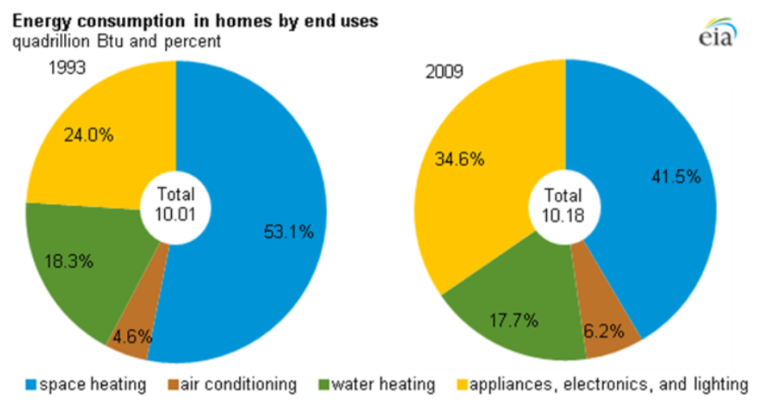
Applying my Residential Rules 2 & 3 is considerably more complicated:
From my Energy in Housing (pptx / pdf / key) notes,
an EIA breakdown of U.S. Home Energy categories: ¹
2021 figure from above:
7.88 QW-h
7.59 QW-h
3.39 QW/h
3.39 QW-h
2.67 QW-h
Having found no more recent breakdown, I'll make do with the above center 2009 percentages:
41.5% air heating / 17.7% water heating / 6.2% air cooling / 34.6% appliances + electronics + lights
Which seems reasonable given small 2009 to 2021 change in Total Home Energy (10.18 vs. 11.6)
Multiplying the 2009 percentages by the 2021 Total Home Energy of 3.39 QW-h (11.6 q-BTU)
For categories impacted by my rules 2 & 3, I get approximate 2021 energy uses of:
1.4 QW-h air heating / 0.6 QW-h water heating
1) DOE (EIA) Energy Data Facts - Residential: https://rpsc.energy.gov/energy-data-facts

Slide 40
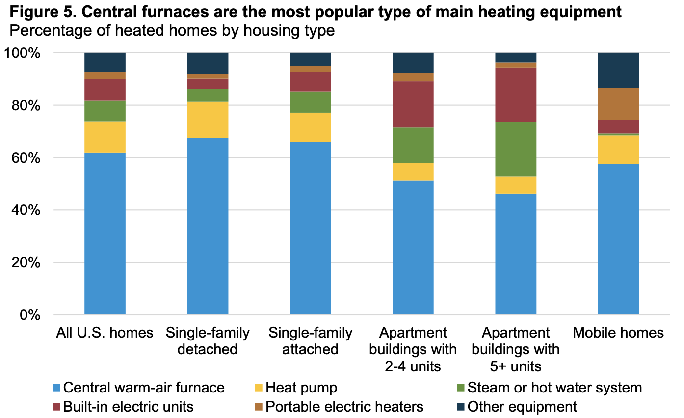
But in those two categories, what fractions are ALREADY cleaned up?
The EIA's 2015 Residential Energy Consumption Survey (RECS) ¹
  gives some (but, surprisingly, far from all of the useful) answers
Concerning Rule 2's home air heating conversion to heat pumps:
1) https://www.eia.gov/consumption/residential/reports/2015/overview/index.php
~ 70% of U.S. homes are still use fossil-fueled furnace, steam or hot water heating
Multiplying last slide's 1.4 QW-h total heating energy by that percentage => 1.0 QW-h
Invoking Rule 2 replacement by electric heat pumps => 1.0 QW-h / 3.5 = 0.3 QW-h
Rule 2 based net change in U.S. Energy Consumption = (0.3 - 1.0) QW-h = - 0.7 QW-h

Slide 41
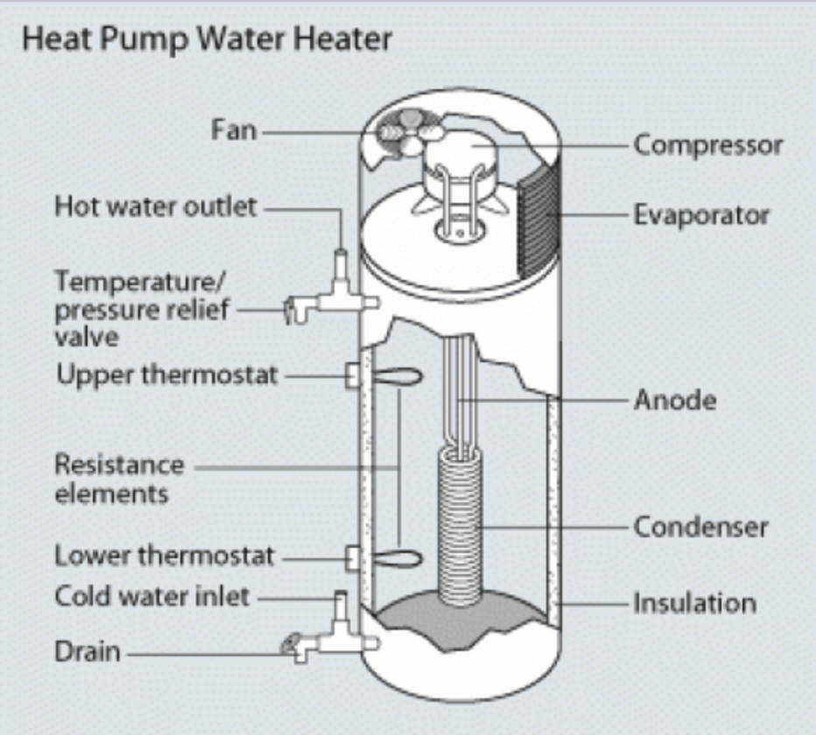
Concerning Rule 3 conversion to Heat Pump Water Heaters:
Beyond the most basic DOE / EIA explanations of how they work, ¹
these are so new that I found no DOE or EIA data on their extent of U.S. use
1) https://www.energy.gov/energysaver/heat-pump-water-heaters
But my decades of home ownership + Habitat for Humanity home construction
+ This Old House viewership suggest their deployment is still very small
So I'll assume ~100% of the U.S. 0.6 QW-h water heating energy is still fossil-fueled
Rule 3 replacement by electric heat-pump water heaters => 0.6 QW-h / 5 = 0.12 QW-h
Rule 3 based net change in U.S. Energy Consumption = (0.12 - 0.6) QW-h = - 0.5 QW-h

Slide 42
Summarizing savings due to Rule 1-3 fossil-fuel to electricity conversions:
But first sticking my neck out by inserting one more bold (but plausible) assumption that:
  Rule 1-3 Fossil-fuel to Electricity conversions could produce comparable
    Commercial sector and Residential sector changes in energy use, yielding this:
Sector 2021 EIA Energies Rule 1-3 changes Revised Energies
Transportation 7.88 = 7.4 + 0.4 QW-h - 4.1 + 1.0 QW-h 4.78 = 3.3 + 1.4 QW-h
Residential 3.39 = 2.6 + 0.8 QW-h - 1.6 + 0.43 QW-h 2.22 = 1.0 + 01.23 QW-h
Commercial 2.67 = 2.1 + 0.6 QW-h ~ (- 1.6 + 0.43 ) QW-h ~1.53 = ~0.5 + ~1.03 QW-h
______________________________________________________________________________________________________________
Subtotal 13.9 = 12.1 + 1.8 QW-h ~8.53 = ~4.8 + ~3.66 QW-h
In these three (of four) sectors, fossil-fuel to electricity substitutions thus offer:
A 39% decrease in energy use
AND a shift from (87% GHG-based / 13% green) to (56% GHG based / 46% green)
Based upon adoption of ONLY TWO already well-known & well-developed technologies:
Electric motor driven road vehicles Heat-pump driven air and water heaters

Slide 43
Revised estimate of Green-Electricity growth needed to drive out ~ all GHG-based energy
EIA data lead us to this earlier breakdown
of 2021 Total U.S. Energy Consumption:
Sector: 2021 EIA Energies:
Transportation 7.88 = 7.4 + 0.4 QW-h
Residential 3.39 = 2.6 + 0.8 QW-h
Commercial 2.67 = 2.1 + 0.6 QW-h
Industrial 7.59 = 6.5 + 1.1 QW-h
________________________________________________
Total 21.5 = 18.6 + 2.9 QW-h
Revised Subtotal for first three Sectors
based upon above Rule 1-3 substitutions:
=> ~8.53 = ~4.8 + ~3.66 QW-h
Yielding revised all-sector Total:
________________________________
16.1 = 11.3 + 6.59 QW-h
To eliminate revised 11.3 QW-h of GHG energy, today's 1.53 QW-h of green Electricity
would have to grow by ~ (11.3 / 1.53) = 7X (instead of the 12X calculated earlier)
Fossil-fuel to Electricity substitutions in the final Industrial sector
would further reduce GHG generation, but require greater growth of green electricity
Contradicting media reports that 3X growth alone might provide a U.S. path to full sustainability ¹
1) Page 5: Forget ‘Reduce, Reuse, Recycle’ - The Atlantic, 25 Feb 2022 (link)

Slide 44
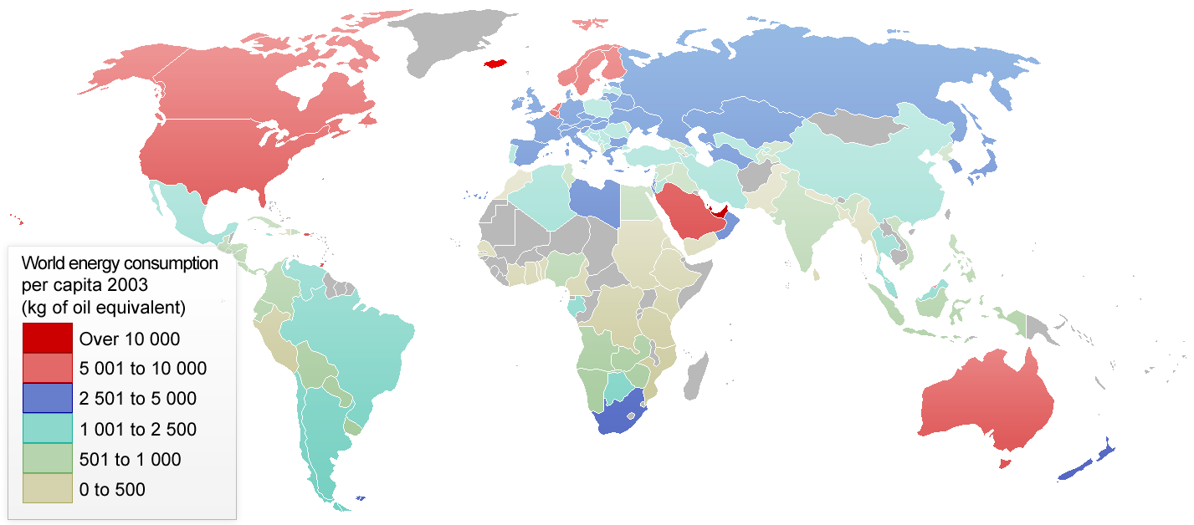
Finally: Putting Total U.S. Energy Consumption into a global perspective:
International Energy Agency 2003 map of per-capita energy consumption: ¹
Energy Conversion: 1 kg of oil equivalent ("koe") => 11.63 kW-h ²
1) http://en.wikipedia.org/wiki/List_of_countries_by_energy_consumption_per_capita
2) https://www.unitjuggler.com/convert-energy-from-koe-to-kWh.html

Slide 45
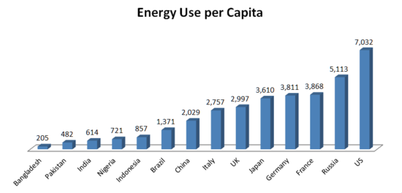
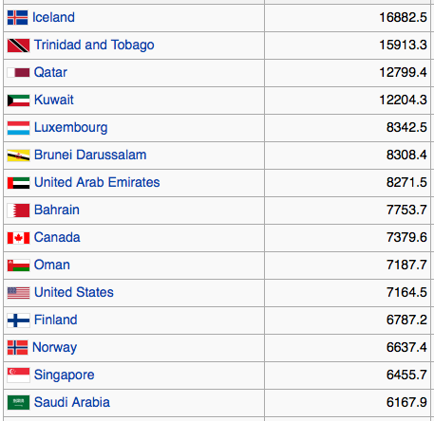
More recent data on per capita energy consumption:
An abbreviated bar graph (in kg oil equivalent per capita): Or, in rank order:
(World Bank 2011)
Very affluent but much more energy-thrifty countries:
Germany 4003.3
France 4030.5 ~ 50% of U.S. Energy use!
Japan 3898.4
Prompting this website's later recurring discussions about how,
with often surprisingly little inconvenience or pain,
the U.S. could substantially reduce its present day energy wastage
Figures: http://en.wikipedia.org/wiki/List_of_countries_by_energy_consumption_per_capita

Slide 46
In conclusion: We Americans have a history of profligate energy use
Comparably profligate countries have tended to fall in two groups:
1) Affluent countries able to afford the exceptional heating or cooling energy
desirable in their exceptionally hot or cold climates, such as:
  Australia, Canada, Finland, Iceland, Norway & Sweden
2) Countries with particularly abundant & accessible native energy sources, including:
Middle-eastern OPEC oil-exporting countries
Iceland, with its uniquely abundant Geothermal energy sources
AND the U.S. with its abundant oil, natural gas and coal reserves
With abundant fossil-fuels AND moderate climate, through almost the end of the twentieth century
we Americans paid very little attention to energy efficiency
Facing climate change, this noteset exposes the major challenges we now confront
But like many "energy experts" I remain cautiously optimistic because I see so many tools
Some that we Americans had - until recently - largely ignored (e.g., solar & wind energy),
Plus a large number still in development but with many progressing dramatically
Thus, echoing others, I see our real challenge as finding the will to run with these tools

Slide 47
Credits / Acknowledgements
Some materials used in this class were developed under a National Science Foundation "Research Initiation Grant in Engineering Education" (RIGEE).
Other materials, including the WeCanFigureThisOut.org "Virtual Lab" science education website, were developed under even earlier NSF "Course, Curriculum and Laboratory Improvement" (CCLI) and "Nanoscience Undergraduate Education" (NUE) awards.
This set of notes was authored by John C. Bean who also created all figures not explicitly credited above.
Copyright John C. Bean
(However, permission is granted for use by individual instructors in non-profit academic institutions)
An Introduction to Sustainable Energy Systems: WeCanFigureThisOut.org/ENERGY/Energy_home.htm

