Slide 1
Self-Assembly of Organic Molecules
Last week we discussed basic forms of self-assembly such as crystal growth
But these cannot create the complexity required for full blown nanotechnology
However, nature provides solution: Organic Chemistry + Molecular Biology = "life"
(Subjects of this and the lecture to follow)
Classes on organic chemistry spend endless time on memorizing lists of
chemical names or on hundreds of alternate synthesis procedures
I didn't want to be organic chemist myself,
but I did have a long and successful collaboration with organic chemists
Experience that led me to an understanding of how to exploit organic chemistry
via collaboration - an understanding I now want to share with you

Slide 2
I also have two other goals:
1) To bring to chemistry what WE have now learned about quantum mechanics
Chemists allude to the dark mysteries of s & p orbitals, pi bonds . . .
But they're really just standing-waves, like those in springs and water
Which, with your new experience, are now readily explained
2) To show how simple organic chemistry explains things affecting your daily life
Perhaps the chemists got around to this in CHE 300 or Org CHE 200
But they needn't have waited so long!!
With very simple chemistry / organic chemistry I can explain:
free radicals, anti-oxidants, trans-fats . . . and quite a bit more
A Hands-on Introduction to Nanoscience: WeCanFigureThisOut.org/NANO/Nano_home.htm

Slide 3
So, to begin: Demystifying atomic orbitals
Waves trapped in boxes => Standing waves = Atoms
It's that simple and its what most of Quantum Mechanics is about
Only becomes hairy if want PRECISE solutions => spherical coordinates . . .
But approximate solutions (treating atoms ~ cubical boxes) are almost intuitive
Origin of atomic "boxes" = attraction between electrons and nuclear protons
Potential Energy = - q _{electron} q _{nucleus} / R
Box in sense that electron waves are contained
But box that gets bigger for outer electrons
Energy
Distance between electron and nucleus

Slide 4
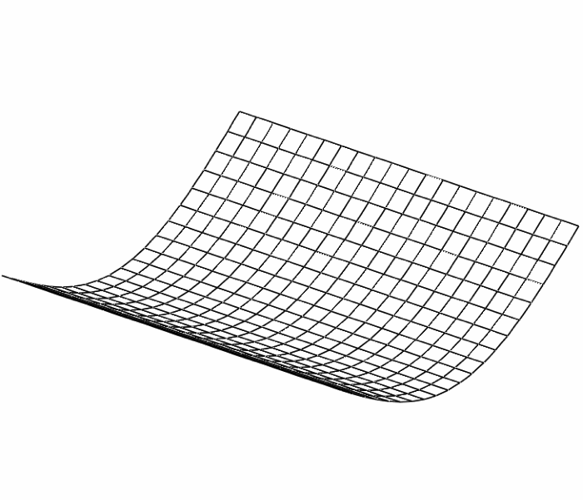
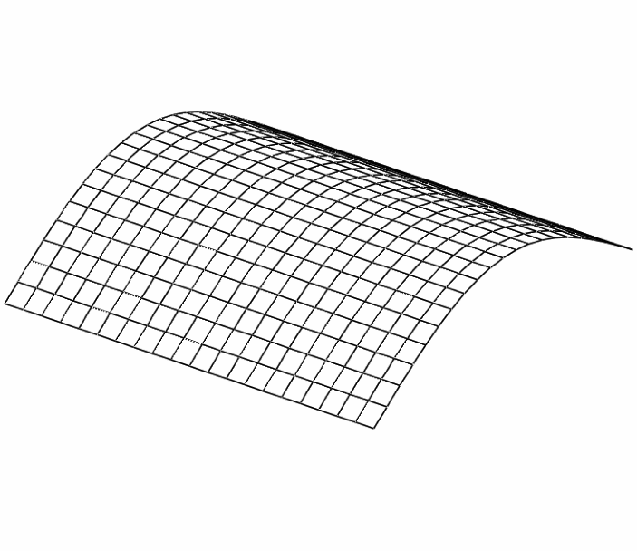
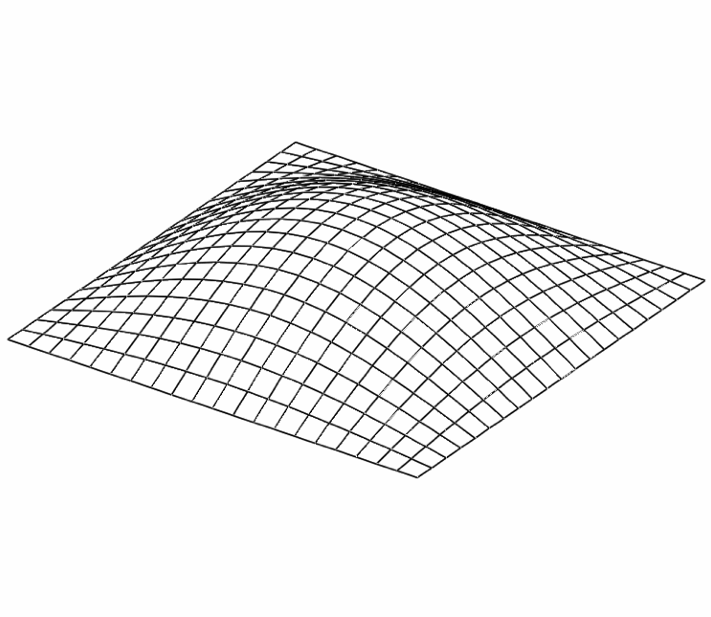
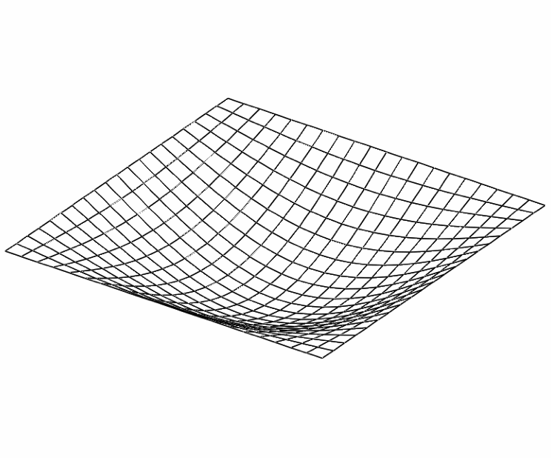
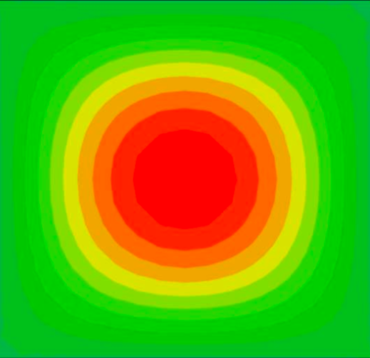
So let's figure out lowest energy electron standing wave:
Plane wave bouncing of opposite walls of a square box => standing wave
λ/2 standing wave in 1D box:
λ/2 standing wave in 2D box (i.e. λ/2 X wave + λ/2 Y wave = "Superposition"):
In 3D box: Add similar λ/2 wave in Z direction => spherical cloud:
What your Chemistry teacher called an "s orbital:"
Google images / Winona.edu

Slide 5
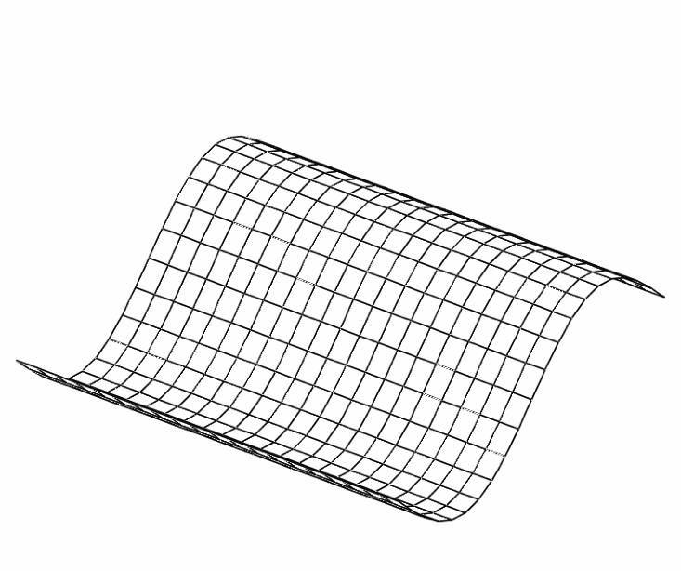
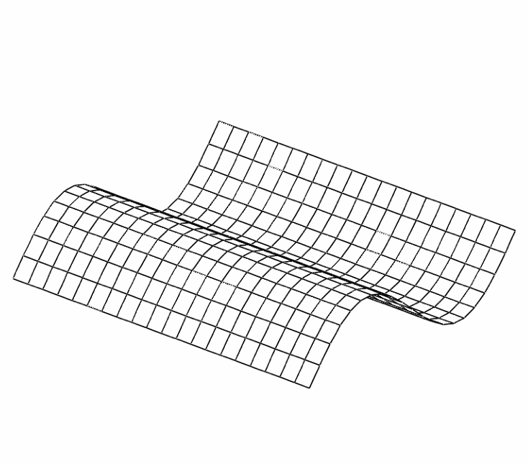
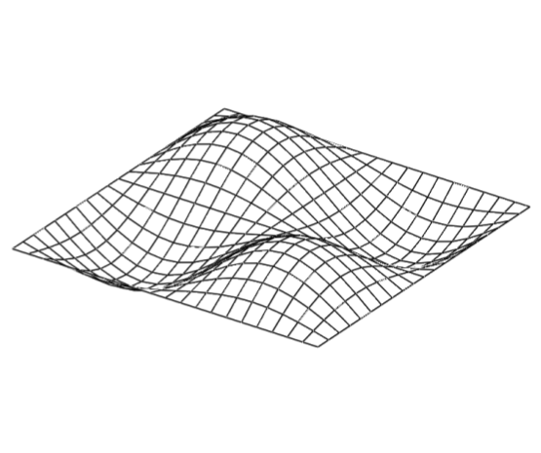
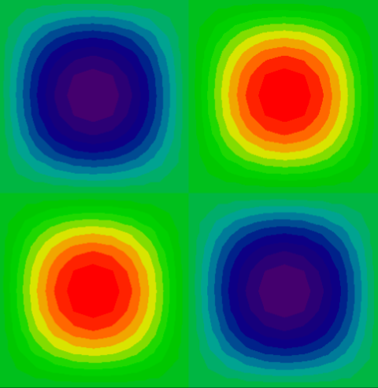
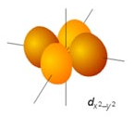
For more energetic electron standing waves: Add oscillations!
More oscillations: In 1D =
λ standing wave in 2D box (i.e. λ X wave + λ Y wave):
In 3D box: If keep 2D wave (above) but use only λ/2 wave in Z direction =>
What your Chemistry teacher called an "d orbital:"
Google images / Winona.edu

Slide 6
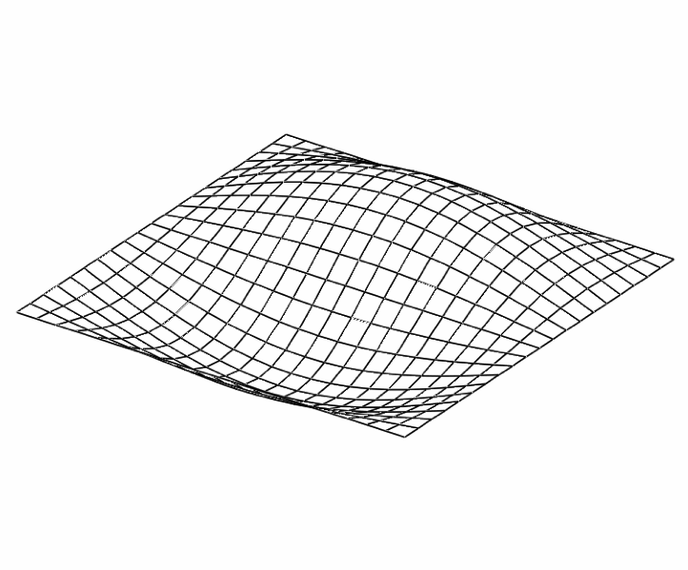
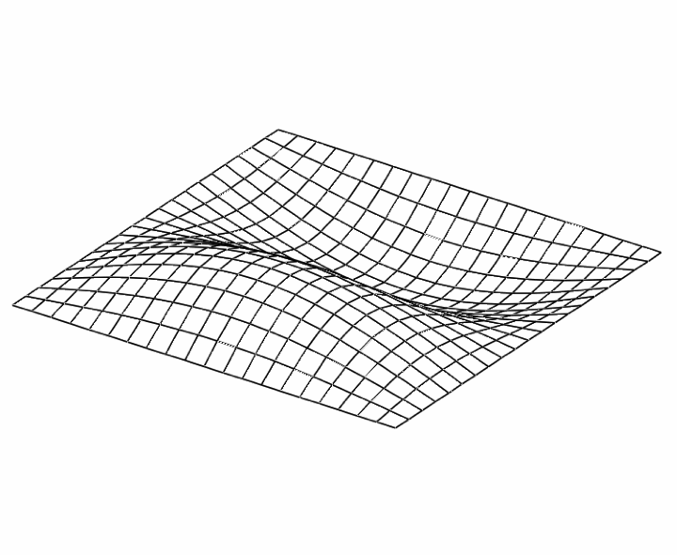
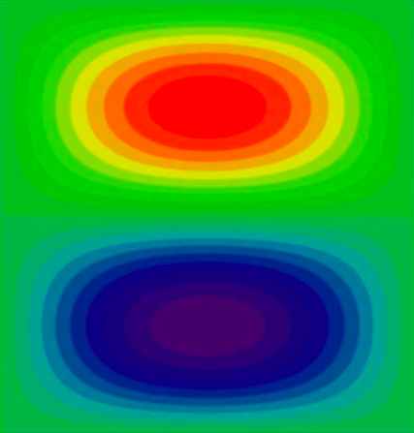
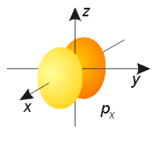
But we didn't HAVE to add oscillations in BOTH x and y directions!
In 1D: Full λ wave
In 2D box: ONLY add λ/2 oscillation in perpendicular direction!
Why? Because oscillations => Higher Frequency => Higher Energy
Adding only ½ oscillation in other direction= smallest step up in energy!
Yielding your Chemistry teacher's "p orbital:"
Google images / Winona.edu

Slide 7
But what about the other possible directions?
That is, why wouldn't the full set of second energy level waves be:
Each DOES involve simple standing waves
Only difference is direction of higher frequency wave: X vs. Y vs. Z
Each arrangement DOES keep charge away from earlier s orbital
Each arrangement DOES keep charge away from other p orbitals
So these are indeed three viable alternatives
Derived solely from standing waves / charge repulsion!!
Google images / Winona.edu

Slide 8
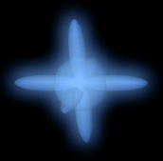
Yielding lowest energy electron waves (s p_{x} p_{y} p_{z}):
(Now represented as properly fuzzy clouds)
But what is difference in energy between this set of four trapped electron waves?
Can get the answer directly from our knowledge of waves:
Increased frequency (decreased wavelength) => Increased energy
Three p waves have identical wavelength => identical energy (no surprise)
Earlier "s" cloud only had 1/2 the oscillation, but was down in narrower part of box
So its wavelength (distance for full cycle of oscillation) is not much different
Hence, its frequency was similar => Not that much lower in energy
"A Hands-on Introduction to Nanoscience: WeCanFigureThisOut.org/NANO/Nano_home.htm

Slide 9
So we've accounted for first 4 electrons? No: 8
The above "orthogonal" waves helped electron waves avoid one another
But electrons have a property beyond their charge, and this is called "spin"
Name from Maxwell's Equation that says spinning blob of charge = electro-magnet
Pairs of magnets ATTRACT: Positioning their poles N-S to S-N
Attraction counters charge repulsion => Electron pairs share same wave pattern
What happens in atoms with MORE than above eight electrons?
Possibility 1) Add more complex "d" waves (standing waves with more oscillations)
Possibility 2) Use stretched out versions of s and p waves that exploit enlarging box
A Hands-on Introduction to Nanoscience: WeCanFigureThisOut.org/NANO/Nano_home.htm

Slide 10
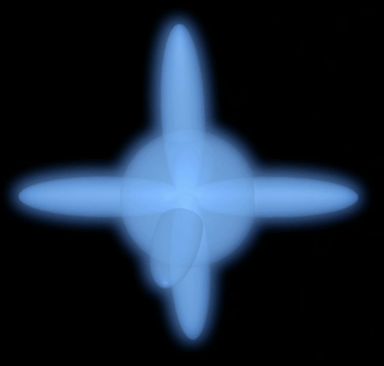
Nature ultimately uses both possibilities
But for organic chemistry (~ first few rows of periodic table) => Possibility 2
Nature just adds enlarged versions of s an p waves:
One set of orbitals in Next set of orbitals in
narrow part of box: wider part of box:
New expanded set of 8 electron waves largely avoid earlier (lower energy versions)
But because outer electron structure is similar, new set acts similarly =>
PERIODIC TABLE with repeated rows of 8 atoms. But what about first row?
Tiny p orbitals are too close to other electron clouds => too energetic => deleted

Slide 11
Leading to my "standing wave" version of the Periodic Table
Modified "Periodic Table" that leaves out atoms in middle part:
After the first (lone) energy level (→ H and He) we get
tight groups of four energy levels (capable of holding 8 electrons)
A Hands-on Introduction to Nanoscience: WeCanFigureThisOut.org/NANO/Nano_home.htm

Slide 12
Now, before continuing, we must answer a BIG QUESTION: Why does "organic" chemistry = carbon chemistry
Are we just being parochial? Failing to see other "paths not taken" (on earth)?
Reasons why Carbon might indeed be special:
1) Carbon has four bonding (valence) electrons = perfect number of bonds for 3D assembly
Bonds = electrons → which naturally repel on another
1 bond → line (1D): 2 bonds → chain (1D):
3 bonds w/ max separation → Plane (2D): 4 bonds w/ max separation → Tetrahedron (3D):

Slide 13
But ALL Column IV atoms have four bonding electrons!
So, as suggested by Sci-Fi, why couldn't "organic" life be based on Silicon?
Covalent Bonds = Pairs of electrons, coupled by magnetic "spin"
Strength of magnetic paring increases with distance over which the pair overlaps
Carbon is at the TOP of periodic table's Column IV → Smallest nucleus
Carbon Nucleus Nucleus + electrons C - C pair
Small core → Snuggle closely → Long overlap → SHORT (1.54 A) STRONG (3.6 eV) bond
A Hands-on Introduction to Nanoscience: WeCanFigureThisOut.org/NANO/Nano_home.htm

Slide 14
As compared to silicon:
Much larger core (14/6 times more protons, neutrons, electrons):
Silicon Nucleus Nucleus + electrons Si - Si pair
Much bigger separation: 2.35 A (versus carbon's 1.54 A)
And WEAKER bond: 2.3 eV (versus carbon's 3.6 eV)
A Hands-on Introduction to Nanoscience: WeCanFigureThisOut.org/NANO/Nano_home.htm

Slide 15
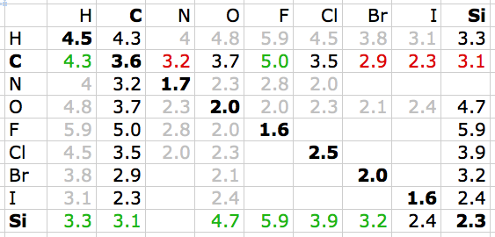
And compare non-self bonding energies:
Bond energies in units of eV (1 kcal/mole = 0.04336 eV):
Row 3) C-C bonds are stronger than most C-X bonds (big exceptions are bonds to H & F)
Row 10) Si-Si bonds are MUCH weaker than ALL Si-X bonds in table!!
Silicon very much WANTS to bond with something OTHER than itself
Carbon PREFERS to bond with itself => C chains, rings . . . = ”Organic" chemistry
A Hands-on Introduction to Nanoscience: WeCanFigureThisOut.org/NANO/Nano_home.htm

Slide 16
So now let's explore carbon bonding more deeply:
In Periodic Table's 1st row, all atoms could support two electron standing waves
Beyond first row, all atoms could support full set of 8 electron standing waves
But they won't add electrons above number of charge-balancing nuclear protons
In order to add BOTH electrons and protons => They must bond to another atom
As implemented in first row of periodic table by hydrogen:
Or, using the surprisingly powerful Lewis Representation:
Core of atom (nucleus + inner non-bonding electrons) = Atom's letter symbol
Bonding electrons = dots (max of 2 for H/He, max of 8 for other atoms)
Reaction of hydrogen bonding then becomes
H
H
H
H

Slide 17
Extending Lewis representation to other atoms:
- Number of bonding (valence) electrons = Column number = number of dots
- Atoms in right section have max of eight closely spaced energy levels
- Electrons like to pair
Eight possible electrons + pairing → 4 likely bond directions
H
B
C
N
O
F
I
VIII
II
III
IV
V
VI
VII
Note semi-standard color code used for atoms above
A Hands-on Introduction to Nanoscience: WeCanFigureThisOut.org/NANO/Nano_home.htm

Slide 18
Start to do some chemistry with this "Lewis" notation:
For instance, how would Boron and Fluorine form a compound?
After first spreading Boron's electrons out in different directions
+ 3 = Only way all electrons pair!
F
B
F
F
B
F
What about carbon bonding with hydrogen?
+ 4 =
Again, just spread an atom's electrons out, then pair them into bonds
H
C
H
H
C
H
H
A Hands-on Introduction to Nanoscience: WeCanFigureThisOut.org/NANO/Nano_home.htm

Slide 19
O
H
H
O
H
Oxygen plus two hydrogens: + 2 =
But what if add 3rd H? + 3 = → + ⁻
O
H
H
O
H
H
O
H
H
H
O
O
O
O
Self-bonding? + = Double bond = 2 sets of paired electrons
Or begin to mix things up a bit:
CO₂ Hydrogen Cyanide
O
C
O
H
C
N
A Hands-on Introduction to Nanoscience: WeCanFigureThisOut.org/NANO/Nano_home.htm

Slide 20
OK, but teach me something I don't sort of already know!
- DNA is incredibly floppy, and yet it maintains a taught double helix structure
- DNA bases are hydrogen bonded, and yet DNA splits apart at just 90C
- DNA fingerprinting is based upon the movement of CHARGES in electric fields
All explained by the Lewis structure of DNA's phosphate groups
and the negative charge that drives them apart:
P
O
O
O
C
O
O
C
C
O
O
C
P
P
O
O
C
Unpaired
electron
"Withdraws" (steals)
partner from elsewhere
A Hands-on Introduction to Nanoscience: WeCanFigureThisOut.org/NANO/Nano_home.htm

Slide 21
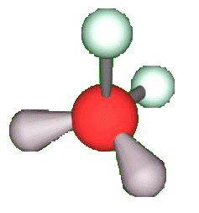
Onward: We also need to figure out the SHAPE of molecules
For that, key fact is:
Pairs of electrons, even if unbonded, act in same way as bonded pairs
Prime example is in H₂O:
Is this, in fact, a linear molecule?
NO, there are 4 pairs of electrons: Two bonded pairs, two unbonded pairs
Four independent repelling groups → tetrahedron
Pedantic chemistry teacher: "It's not an exact tetrahedron! Gray lumps =
John: "Show me where 1-2 degrees matters and I'll care!" unbonded pairs
H
O
H

Slide 22
Leading to bonding structure of more complex molecules:
Carbon: Comes with 4 bonding electrons - But has 8 easy places to put electrons
Simplest self-assembly = singly bonded chain ("alkane"):
But that leaves LOADS of unbonded, unpaired electrons:
Solution = Add hydrogens =
But is this really accurate? Are bonds all at right angles, in a single plane?
Of course not! We have four naturally repelling electron pairs →
C
C
C
C
H
H
H
H
H
H
H
H
H
C
C
C
C
H
H
C
C
C
C
H
H
H
H
H
H
H
H
H
A Hands-on Introduction to Nanoscience: WeCanFigureThisOut.org/NANO/Nano_home.htm

Slide 23
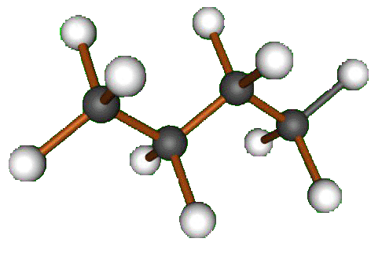
So real singly bonded carbon chain must look more like:
4 independent repelling bonds → Tetrahedra
Figure out number of independent bonds → Spread them out at far as possible
Physicists and chemists go on and on about sp2, sp3 . . . hybridization
But that is just the mathematical process of doing the same thing!!
Example: What if carbon chain had alternating single and double bonds:
Added enough H's to give each C necessary 4 bonds
=> only 3 independent bonds: 2 single + 1 double
H
H
H
C
C
C
C
H
H
H
A Hands-on Introduction to Nanoscience: WeCanFigureThisOut.org/NANO/Nano_home.htm

Slide 24
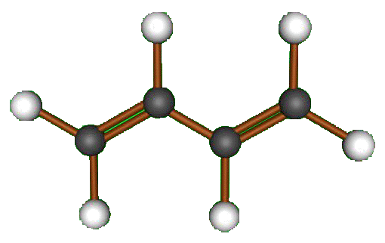
Three independent bonds repelling one another:
Planar, 120 degrees apart
So true structure of single-doubly bonded chain must be planar:
Then what about a single-triple bonded chain: H-C≡C-C≡C-H
Well, every C now has two independent bonds: 1 single + 1 triple
Will spread in opposite directions = a line: Exactly as in formula: H-C≡C-C≡C-H
A Hands-on Introduction to Nanoscience: WeCanFigureThisOut.org/NANO/Nano_home.htm

Slide 25
Everyday Application: “Free Radicals” & “Antioxidants”
These terms are all over the news (or at least in “health food” advertising)!
Radicals also come up in discussion of possible nanoscience hazards
What’s it all about?
Oxygen tends to steal electrons => “Oxidation” is defined as loss of electrons
For organics, this can be the same as losing Hydrogens:
H₂ = 2 lost electrons
H
H
H
H
H
H
H
C
C
C
C
H
H
H
H
H
H
H
H
H
H
C
C
C
C
H
H
H
H
H
H
H
H
C
C
C
C
H
H
H
H
H
A Hands-on Introduction to Nanoscience: WeCanFigureThisOut.org/NANO/Nano_home.htm

Slide 26
Representing bonds as lines, restructuring of the molecule is more obvious:
But what might make Hydrogens suddenly leave? FREE RADICALS
Molecule (“R”) with atom ("X") having unpaired electron:
Possible source of radicals? Surface of Nanotubes & C60 (more on this later)
How would these “Free Radicals” promote loss of Hydrogen (a.k.a. oxidation)?
H
H
H
H
H
H
H
C
C
C
C
H
H
C
C
C
C
H
H
H
H
H
H
H
H
H
R
X
A Hands-on Introduction to Nanoscience: WeCanFigureThisOut.org/NANO/Nano_home.htm

Slide 27
Free Radical Induced Oxidation
Free Radical approaching organic molecule:
If Hydrogen bond to radical is stronger, it can “steal” a hydrogen!
As organic looses electrons it will be driven to reconfigure its bonds
Oxidation => Major restructuring of molecules = Change in their biological function
H
H
H
H
H
H
H
H
H
H
H
H
H
C
C
C
C
H
H
C
C
C
C
H
H
C
C
C
C
H
H
H
H
H
H
H
H
H
H
H
R
X
R
X
H
R
X
H
A Hands-on Introduction to Nanoscience: WeCanFigureThisOut.org/NANO/Nano_home.htm

Slide 28
Oxidation could, for instance, convert chains to rings:
H
H
H
H
H
H
H
C
C
C
C
C
C
H
Oxidizing two hydrogens on ends of chain
H
H
H
H
H
H
H
H
H
H
H
H
C
C
C
C
C
C
Connect now radicalized end carbons
H
H
H
H
H
H
H
H
H
H
C
C
H
H
C
C
H
H
C
C
H
H
H
H
A Hands-on Introduction to Nanoscience: WeCanFigureThisOut.org/NANO/Nano_home.htm

Slide 29
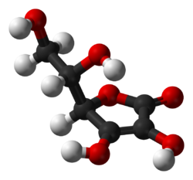
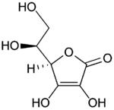
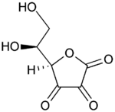
Antioxidant? = Molecules that can SUPPLY electrons
Or, supply Hydrogens that bring along their electrons
Classic example is VITAMIN C (ascorbic acid):
Normal configuration: After giving up two Hydrogens:
So “antioxidants” don’t STOP oxidation. They undergo oxidation!
Acting as sacrificial volunteers!
A Hands-on Introduction to Nanoscience: WeCanFigureThisOut.org/NANO/Nano_home.htm

Slide 30
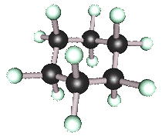
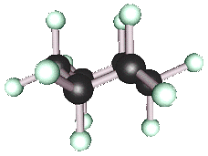
Or, moving toward nanotech headlines, consider rings:
Cyclohexane:
Cyclo = it's a ring
hex = with six atoms
ane = singly bonded
But notice how electrons/bonds
are still in an almost undistorted
tetrahedral geometry:
Figures on this (and the six pages to follow) are screenshots of interactive / manipulatable
3D models on WeCanFigureThisOut.org: WeCanFigureThisOut.org/VL/Nanocarbon.htm

Slide 31
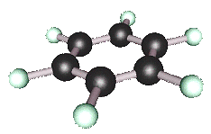
What if we strip off half of the hydrogens and try to flatten ring?
Carbon atoms are not very happy as each now has only three bonds!
Leaving each carbon as (including its neighbor's bonding electrons):
What happens to that very unhappy unpaired electron (at the top)?
But it's not a B-B, it's more of a cloud
Other electrons are in plane
So leftover electron wants to get OUT of that plane
C

Slide 32
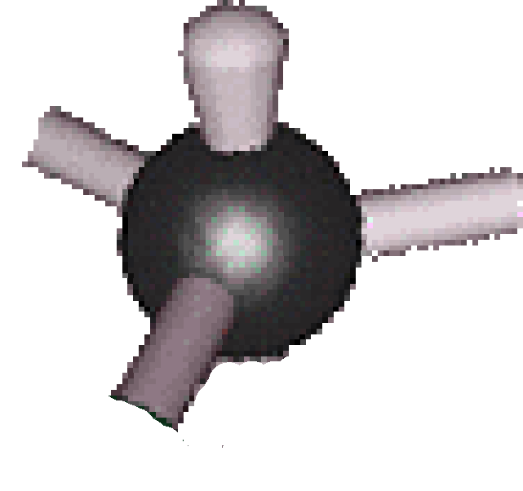
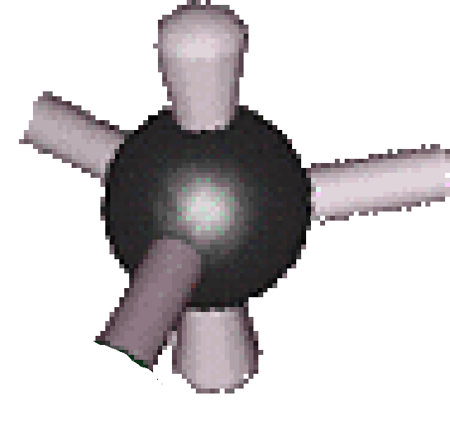
Two ways to get leftover electron out of that plane:
Alternative #1: Squeeze it upward (or downward) out of the plane
Produces unpaired electron pointing outward
=> FREE RADICAL => Oxidizer => Disorganizer
Possible on all "graphitic" surfaces (graphene, nanotubes, Buckyballs)
Alternative #2) Squeeze electron cloud both upward and downward
Like squeezing a water balloon in the middle:
DOES get leftover electron out of the crowded plane
But STILL leaves electron unpaired – how is this any better?

Slide 33
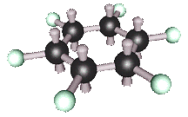
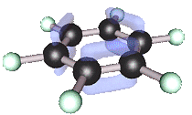
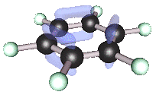
Because this configuration DOES allow for pairing/bonding:
Because those six electrons can now link up (bond) above and below plane:
OR:
Pairing #1 Pairing #2
A Hands-on Introduction to Nanoscience: WeCanFigureThisOut.org/NANO/Nano_home.htm

Slide 34
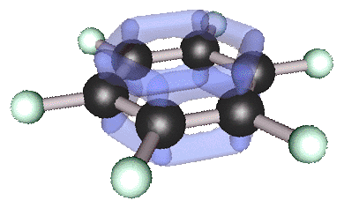
But which pairing is right?
BOTH! They both do the same thing and save the same amount of energy!
So "nature" USES both - switching rapidly between them giving:
It's called a "resonance bond"
It "resonates" rapidly back and forth between the two linkages!
Significance? "Resonant" electrons are no longer locked into a single position
They can move around (for instance under the influence of an electric field!)
This "Benzene" molecule can conduct electricity (where cyclohexane cannot!)
A Hands-on Introduction to Nanoscience: WeCanFigureThisOut.org/NANO/Nano_home.htm

Slide 35
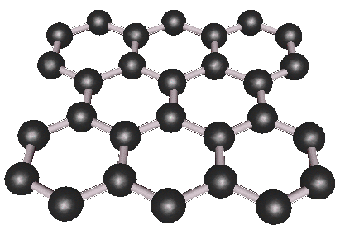
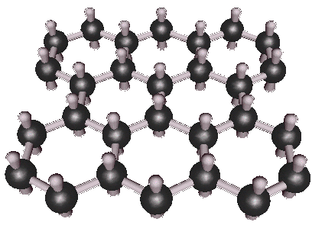
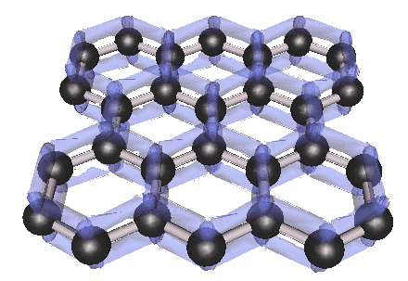
Connect the rings and get "Graphene"
Simple "ball and stick" representation
Accounting for all the valence electrons
Or showing resonant bonding that gives graphene its electrical conductivity:
A Hands-on Introduction to Nanoscience: WeCanFigureThisOut.org/NANO/Nano_home.htm

Slide 36
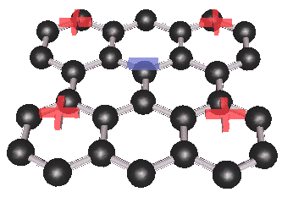
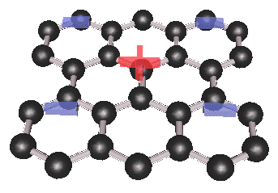
But mobile electrons can slosh around forming pockets of +/- charge:
OR:
What then happens if one sheet of graphene is positioned above another?
If top graphene sheet randomly assumes charge configuration left/above
Then complementary charging pattern will be INDUCED on bottom sheet
And sheets will then be attracted to one another:
+ - +
- + -
A Hands-on Introduction to Nanoscience: WeCanFigureThisOut.org/NANO/Nano_home.htm

Slide 37
It's called Van der Waals bonding
Very different than the covalent bonding we've been talking about
Van der Waals bonding is weaker: Not based on tight electron magnetic coupling
Van der Waals bonding is also not localized: It occurs over regions
What happens if molecule gets larger?
More room for electrons to slosh →
Bigger sloshes (larger deviations from neutrality):
So Van der Waals "bonding" gets stronger in larger molecules!
A Hands-on Introduction to Nanoscience: WeCanFigureThisOut.org/NANO/Nano_home.htm

Slide 38
Proof? Boiling points of similarly structured molecules:
Alkanes
CH₃CH₂CH₃
-42.1 C
CH₃CH₂CH₂CH₃
0.5 C
CH₃CH₂CH₂CH₂CH₃
36.1 C
Alcohols
CH₃CH₂OH
78 C
CH₃CH₂CH₂OH
97.4 C
CH₃CH₂CH₂CH₂OH
117.3 C
Amines
CH₃CH₂NH₂
16.6 C
CH₃CH₂CH₂NH₂
47.8 C
CH₃CH₂CH₂CH₂NH₂
77.8 C
Within a given family of molecules (column) longer the chain → higher the boiling point
Move between families (columns), different atoms "slosh charge" differently
→ Shifts whole family's boiling points up or down
Better name for Van der Waals bonding = "INDUCED-DIPOLE BONDING"
A Hands-on Introduction to Nanoscience: WeCanFigureThisOut.org/NANO/Nano_home.htm

Slide 39
Does this only occur for conductive molecules?
In preceding figures charge shifted from atom to atom
Possible in conductive, semiconductive, or molecules with “conjugated” bonds
But can also get Van der Waal / induced-dipole effects via simpler polarization:
Or for longer molecules:
So polarization of insulating molecules also yields VDW, growing stronger with length
A Hands-on Introduction to Nanoscience: WeCanFigureThisOut.org/NANO/Nano_home.htm

Slide 40
Van der Waals bonding helps hold cell membranes together:
Remember "lipid bilayers" in water where hydrophobic tails gathered together?
Electrons in tails polarize ("slosh")
producing Van der Waals bonding
So cell wall self-assembly has two components:
1) Hydrophillic heads orient out toward water
2) Hydrophobic tails drawn together by VdW
A Hands-on Introduction to Nanoscience: WeCanFigureThisOut.org/NANO/Nano_home.htm

Slide 41
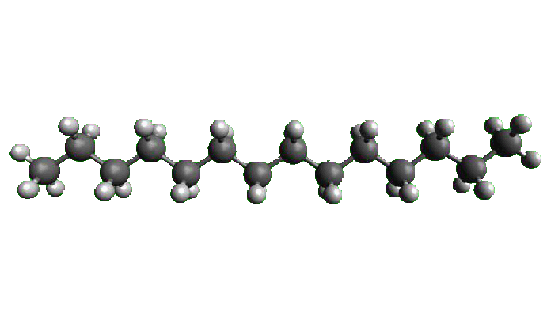
Everyday application: "Saturated Fats"
Here “saturated” means saturated with hydrogens: Saturated carbon chain (fat):
Straight saturated chains pack closely => Strong VdW bonding => High melting T
So they can SOLIDIFY within your arteries => Heart Attacks / Strokes

Slide 42
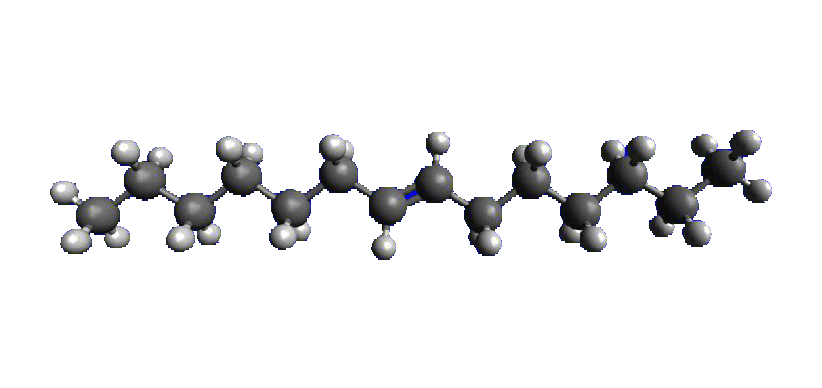
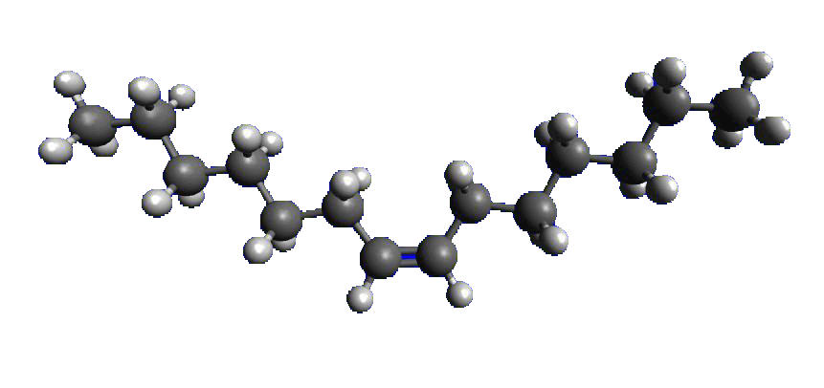
Change to "unsaturated" by removing pair of hydrogens:
Carbons that lost hydrogens form double bond. But 2 configurations are possible :
"TRANS" "CIS"
Producing these alternative full fat chain structures:
TRANS FATS are straight, like saturated fats But CIS FATS are kinky
Which do pack closely Which don't pack closely
So they too solidify in our arteries So they stay liquid in our arteries

Slide 43
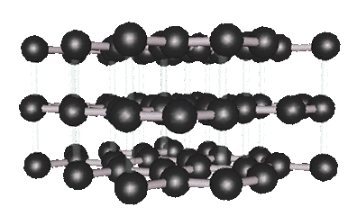
Getting back to graphene
Van der Waals bonding between graphene sheets forms GRAPHITE:
Although not shown, there are also "resonant bonds" → electrical conductivity
Weak Van der Waals interplanar bonds → Sheets slip or separate easily
Giving Graphite it’s well known lubricating properties
And providing the tape trick we use to obtain fresh "HOPG" layers for STM in lab
A Hands-on Introduction to Nanoscience: WeCanFigureThisOut.org/NANO/Nano_home.htm

Slide 44
What about other deliberately man-made molecules?
Field is called "Synthetic Chemistry" It is incredibly powerful!
But kept secret from those of us who never got beyond Chem 101
To describe its richness, we must first learn Organic Chemist's shorthand:
1) Carbon is EVERYWHERE, so get lazy and don’t draw it
If no atom identified at intersection of bonds, ASSUME it is C: =
2) In water, hydrogen is ALWAYS available to fill in any bonds left over, so get even lazier
Don't show hydrogen atoms OR their bonds, just infer their presence
(Can work out number because KNOW carbon must have 4 electrons in bonds)
C
A Hands-on Introduction to Nanoscience: WeCanFigureThisOut.org/NANO/Nano_home.htm

Slide 45
Which produces shorthand diagrams like the following:
"Fully saturated" alkane: "Conjugated" alternation of single / multiple bonds:
Rings of Cyclohexane: Or Benzene:
Or propyl alcohol (with extra OH group at end represented explicitly):
H
H
H
H
C
C
C
O
H
OH
H
H
H

Slide 46
Chemists build smaller molecules by addition and subtraction:
P
d
C
l
(
P
P
h
)
K
C
O
I
N
H
2
3
2
T
M
S
N
H
2
3
N
H
2
C
u
2
2
Step by step they add reagents
(black) to remove or add pieces
to the starting molecule
Gradually transform it into final product shown at bottom
Can actually pinpoint atoms such as which F is removed from benzene ring (? vs. ??)
How? Depending on ring position, F's bond slightly more strongly or weakly
I
,
T
E
A
M
e
O
H
,
C
H
C
2
l
T
M
S
A
3
0
m
i
2
1
1
n
8
8
%
1
2
6
h
,
R
T
,
9
2
%
F
F
1
.
F
F
)
B
F
E
P
d
C
t
O
l
(
2
P
P
h
)
3
2
3
2
F
N
H
F
I
F
C
B
2
C
H
N
O
r
,
C
u
I
5
1
5
6
-
1
2
H
ü
n
F
F
3
0
°
C
1
h
F
F
i
g
'
s
b
a
s
e
1
3
2
1
4
)
N
a
I
7
h
,
I
,
7
0
°
C
R
T
2
,
3
0
m
i
2
1
%
n
3
5
%
? vs. ??
S
A
c
F
F
H
S
O
1
5
F
S
A
c
2
4
M
e
O
H
,
C
H
C
P
d
C
l
l
(
P
P
h
)
,
C
u
2
3
2
I
2
2
r
e
f
l
u
x
T
E
A
,
6
h
,
7
h
,
7
0
°
C
F
F
1
6
5
0
%
4
7
%
F
F
F
S
H
F
F
1
Courtesy of Professor Jim Tour, Rice University
(from our DARPA MOLEapps collaboration)
A Hands-on Introduction to Nanoscience: WeCanFigureThisOut.org/NANO/Nano_home.htm

Slide 47
Followed by purification:
Because steps like those on previous slide are only 30-80% successful
That is, 30-80% of molecules do what was drawn, others do something else
So you must sort out intended from unintended products using:
1) Distillation: Different molecules = Different boiling points
Condense different components in progressively cooler regions
Exploits Van der Waals bonding!
2) Crystallization: Like molecules try to fit into single crystals, excluding unlike
Remember trying to freeze juice into popsicles? Sugar on outside - ice inside
3) Chromatography: Diffuse the mixture through paper, gel . . .
Same thermal energy per molecule = 1/2 mv², smaller molecules → higher v!

Slide 48
But to self-assemble larger structures, need other tricks
One useful trick employs an amine (left) and a carboxylic acid (right):
Where the following reaction can occur, linking the two sub-molecules:
Stripped off as water molecule After a little rearrangement
H
O
R1
N
C
R2
H
H
O
H
O
O
R1
N
C
R2
R1
N
C
R2
H
H
O
H
A Hands-on Introduction to Nanoscience: WeCanFigureThisOut.org/NANO/Nano_home.htm

Slide 49
Two every day applications of (just this one!) trick:
Double up reactive groups, one at each end of subunits:
Mix subunits together to produce a self-assembled polymer:
R1, R2 = C6 alkane => NYLON R1, R2 = benzene => KEVLAR
H
H
O
O
N
R1
N
C
R2
C
H
H
H
O
O
H
O
O
O
O
O
N
C
R2
C
N
R1
N
C
R2
C
N
R1
N
C
H
H
H
H
H
A Hands-on Introduction to Nanoscience: WeCanFigureThisOut.org/NANO/Nano_home.htm

Slide 50
That gives you a glimpse of organic chemistry's power
And, via standing waves, finally explains chemists' mysterious "orbitals"
The remaining challenge is to cope with all of the field's crazy names
And to do that, I offer: John's Organic Chemistry Cheat Sheet
(Derived from my own close collaboration with an organic chemist)
But for the penultimate form of nanoscale self-assembly,
we have got to follow this path all the way into biology
Which will bring us in the next hour to:
Nature's ultimate tool for self-assembly - DNA
A Hands-on Introduction to Nanoscience: WeCanFigureThisOut.org/NANO/Nano_home.htm

Slide 51
Credits / Acknowledgements
Funding for this class was obtained from the National Science Foundation (under their Nanoscience Undergraduate Education program).
This set of notes was authored by John C. Bean who also created all figures not explicitly credited above.
Copyright John C. Bean
(However, permission is granted for use by individual instructors in non-profit academic institutions)
A Hands-on Introduction to Nanoscience: WeCanFigureThisOut.org/NANO/Nano_home.htm

