Slide 1
The Fictions (?) of Nano Science Fiction
A central goal of this class is to try to figure out where nanoscience is taking us
But we've got to keep reminding ourselves that "We're not in Kansas Anymore!"
That is, that Nano is governed by a very different set of rules
Which makes simple extrapolation of present-day technology almost useless
Meaning that a lot of imagination will instead be required
To provide that, today I want to call upon professional "imagineers" of technology:
The Authors of Science Fiction
A Hands-on Introduction to Nanoscience: WeCanFigureThisOut.org/NANO/Nano_home.htm

Slide 2
Hold it!
Not only is science fiction FICTION, but it's often poor fiction at that!
There certainly IS a lot of boiler-plate Sci-Fi (e.g. never-ending series of Star Trek books)
But for very good reasons, Science Fiction has also been called Speculative Fiction
Scientist/authors of this "Hard Sci-Fi" spend a LOT of time thinking about the future
A prime example is (Sir) Arthur C. Clark who proposed:
- The geosynchronous telecommunications satellite (on which we now depend)
- The "beanstalk" (on which your generation might some day depend)
Authors include graduates (and drop-outs) from the very best technical schools
Caltech's contributions include: Larry Niven, Harry Turtledove (drop-outs)
David Brin (graduate and classmate of mine)
A Hands-on Introduction to Nanoscience: WeCanFigureThisOut.org/NANO/Nano_home.htm

Slide 3
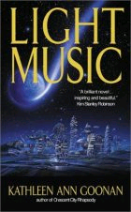

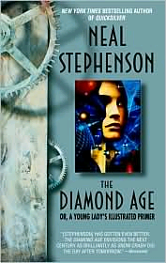



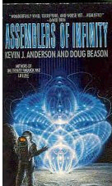




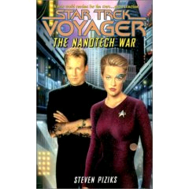





And there is a LOT of speculation about NANO in Sci-Fi:
For even more nano titles, see LibraryThing's list at: www.librarything.com/tag/nanotechnology

Slide 4
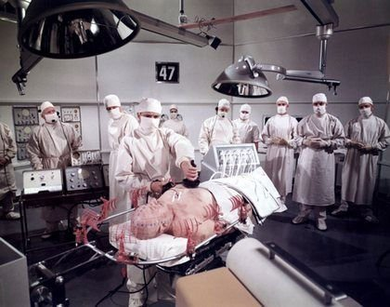
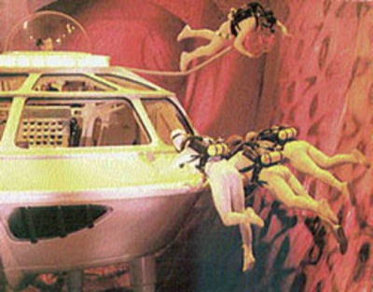
What is one of the most prevalent themes? Nanobots!
From the book and 1966 movie Fantastic Voyage:
Where medical team + sub are shrunk to treat an injured diplomat – from the inside!
OK, shrinking down people may be ridiculous
But in nanomedicine aren't we already pretty close to proposing Nano ROVs?
What MIGHT be the limits of a such a programmable nano machine?
A Hands-on Introduction to Nanoscience: WeCanFigureThisOut.org/NANO/Nano_home.htm

Slide 5
To answer we MUST take scaling into account:
At human scales (and larger) we are VERY concerned with MOMENTUM
We are a little bothered with FRICTION
But we almost ignore SURFACE TENSION, CHARGING, Van der Waals . . .
(The latter tend to counter momentum - but not very well)
But the balance of forces changes as things get smaller:
Momentum α Mass α VOLUME = L³
But ALL of the other above forces depend on contact AREA = L²
Are you sure about charging (a.k.a. "electrostatics")? Yes:
Because if object gets charged, repulsion of charges forces them to surface
So charge carrying capacity of the object varies as its surface area
A Hands-on Introduction to Nanoscience: WeCanFigureThisOut.org/NANO/Nano_home.htm

Slide 6
So what happens when we scale down?
From human (1 meter) scale to micro (1 micron) scale:
Mass and Momentum → (10⁶)³ = 10¹⁸ times smaller
All of the other surface dependent things → (10⁶)² = 10¹² times smaller
Making friction, surface tension, charging, VDW, a million times more important!
Becoming a billion times more important at the nanoscale!
Don't have to go even THAT far - Shift in forces is evident at MILLI (1mm) scale:
It’s why ants can fall unharmed from a million times their height
Δ Momentum tries to tear them apart - Charge (H-bonds) & VDW help hold them together
Ratio of cohesive to destructive forces is 1000 times more favorable
After fall, ant happily walks up a wall (exploiting the SAME shift towards cohesive forces)
A Hands-on Introduction to Nanoscience: WeCanFigureThisOut.org/NANO/Nano_home.htm

Slide 7
Must also take wave behavior into account:
Most electromagnetic waves are much larger than a nanometer
Radio waves are instead measured in millimeters to meters
Even the shortest visible light (blue) has a wavelength of ~ 400 nanometers
(Have to go all the way to X-rays or gamma rays to get into the nanoscale!)
With the consequences that:
Waves incident upon nano things will not change direction
Waves emitted by nano things will radiate outward in simple circles
And waves become circular if forced to pass through nano gaps
A Hands-on Introduction to Nanoscience: WeCanFigureThisOut.org/NANO/Nano_home.htm

Slide 8
Relevance to science fiction Nanobots?
Don't expect to see nano versions of transformer-like mechanical robot
Even if we COULD make and assemble nanoscale equivalent pieces
the balance of forces, light interaction etc. would be totally changed!
So how MIGHT you make a nanobot? Seem to be two (overlapping) paths:
1) Build very simple mechanical mechanisms:
Few or no sliding parts (VERY carefully engineered!)
When need movement, use natural (strong) forces to flex and bend
2) Follow biology's lead: Genetically alter / program cells, viruses . . .
But is a Pandora's box, tinkering with processes we incompletely understand
(Creating things that might happily infest our own bodies!)
A Hands-on Introduction to Nanoscience: WeCanFigureThisOut.org/NANO/Nano_home.htm

Slide 9
Requirements for an effective / entertaining SF nanobot:
SF Nanobots generally build or destroy things big enough to affect people, so:
REQUIREMENT #1) Nanobots needed in HUGE number (moles of them!!)
Only way to get ~ 10²³ ’s of them is if nanobots can replicate themselves
Problem: If can replicate themselves, how do we LIMIT their population?
Possibility and problem discussed long ago by mathematician John von Neumann
Hence: Self-Replicating Machines => “Von Neumann Machines” (staple of SF)
Or, if bio-based, Drexler called possible out-of-control growth “The Gray Goo”
So REQUIREMENT #1 has possible side-effect of annihilating all other lifeforms
A Hands-on Introduction to Nanoscience: WeCanFigureThisOut.org/NANO/Nano_home.htm

Slide 10
Other requirements for effective / entertaining SF nanobot:
REQUIREMENT #2) Nanobots must be able to see
So they can spot their prey - frequently, us!
REQUIREMENT #3) Nanobots must be able to communicate
So they can coordinate their actions - frequently, against us!
REQUIREMENT #4) Nanobots must be able to control their motion
So they can come after us!
And implicit in requirements 2-4 is the assumption of:
REQUIREMENT #5) Nanobot must think, or at least be programmable
A Hands-on Introduction to Nanoscience: WeCanFigureThisOut.org/NANO/Nano_home.htm

Slide 11
SANITY CHECK: Pause to compare with biology:
After all, the closest thing we’ve currently GOT to a nanobot is a biological cell!!
How well do cells satisfy above “requirements”?
- Satisfy requirements 1 & 5: Replication & programmability
- Flunk requirement 2: Cannot see
- Poor on requirement 3: Communicate only via randomly dispersed chemicals
- Lousy on requirement 4: Move almost entirely by “going with the flow”
Given that nature has had a few billion years to try out a huge number of schemes,
sort of suggests there might be flaws in our SF nanobot “requirements”
But let’s charge ahead anyway!
A Hands-on Introduction to Nanoscience: WeCanFigureThisOut.org/NANO/Nano_home.htm

Slide 12
Requirement #1: Nanobot Replication
The Beauty of a circular argument (allowed in fiction if not in fact):
If I really CAN make an effective nanobot
In addition to destroying things that nanobot will be able to make things
So as its second priority task (to occupy its spare time)
I'll program it to make copies of itself!
(it works for all of us macrobots, why shouldn't it work for nanobots?)
So the assumption of an effective nanobot guarantees replication!
A Hands-on Introduction to Nanoscience: WeCanFigureThisOut.org/NANO/Nano_home.htm

Slide 13
Requirement #2: Nanobot Vision
Example: Crichton's "Prey" invokes an eye created by nanobot swarm
Begins as manmade attempt to build micro-eye for medical diagnostics
“Eye” moves through circulatory system (w/o causing strokes)
Thus “eye” assembly MUST not be larger than red blood cells = 6 - 8 microns
HOW does it work? Nanobots form sphere with light entrance hole (i.e. like an eye!)
IMMEDIATE PROBLEM: Assumption that light enters ONLY via hole in sphere
Nanobots may not be opaque to light: Even multiple layers of nanobots
Cells, or MANY layers of cells, sure aren’t opaque (e.g. translucent skin)
(Will ignore this possibly critical initial problem)
A Hands-on Introduction to Nanoscience: WeCanFigureThisOut.org/NANO/Nano_home.htm

Slide 14
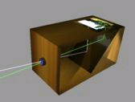
So basic idea is that of a pinhole camera / camera obscura:
http://en.wikipedia.org/wiki/Camera_obscura
Critical advantage of pinhole camera is that you do not need a lens
If assume light moves in straight lines, through tiny hole,
light from every point of object should project onto different point on screen
Thus producing image (albeit, upside down)
Used in earliest cameras
Also used in modern X-ray cameras (because cannot build lenses for X-rays!)
A Hands-on Introduction to Nanoscience: WeCanFigureThisOut.org/NANO/Nano_home.htm

Slide 15
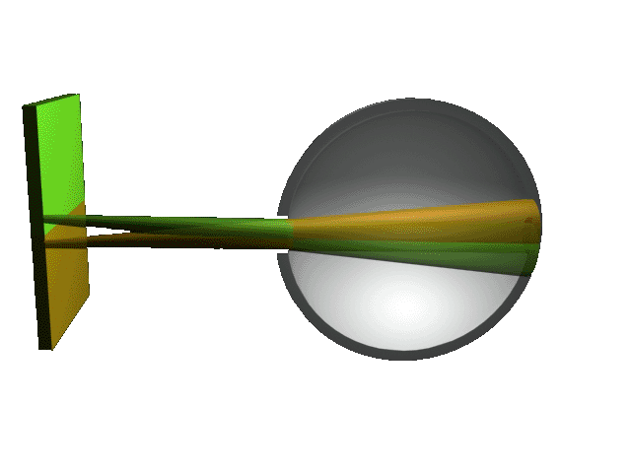
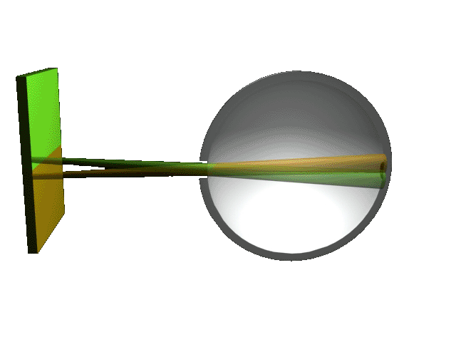
How tiny a hole is required?
Crichton’s micro-eye is only ~ 7 micron in total diameter
Back imaging area of sphere is thus ~ 1/2 (4 pi r²) = 2 pi (3.5 micron)² ~ 75 micron²
What if want nanobot eye to see as sharply as image on PC screen?
PC screen ~ 1024 x 768 pixels ~ 800,000 pixels
All of which must fit into that 75 micron² area on the back surface of this eye
So area per pixel = 9.4 x 10⁻⁵ micron² ~ (10 nanometers)²
Smaller the hole in the eye, smaller the beam from each point, smaller its pixel:

Slide 16
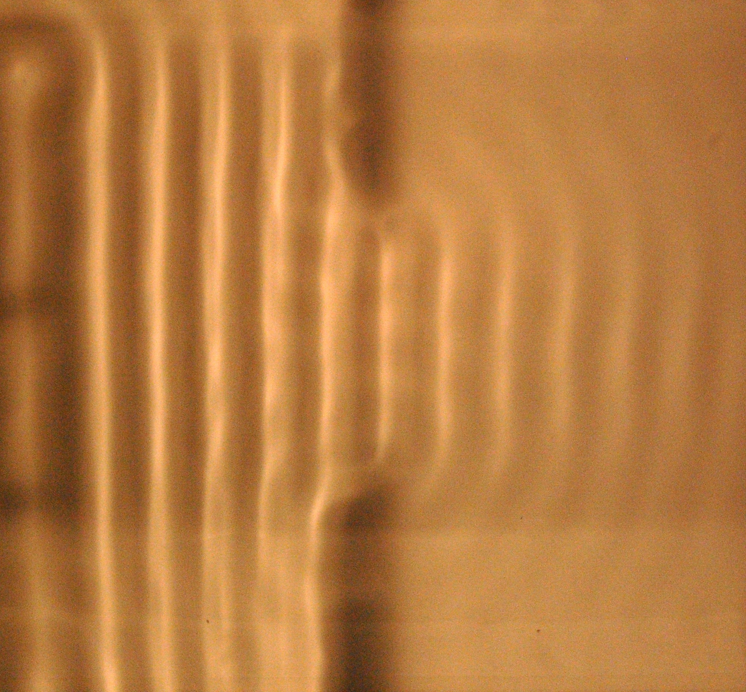
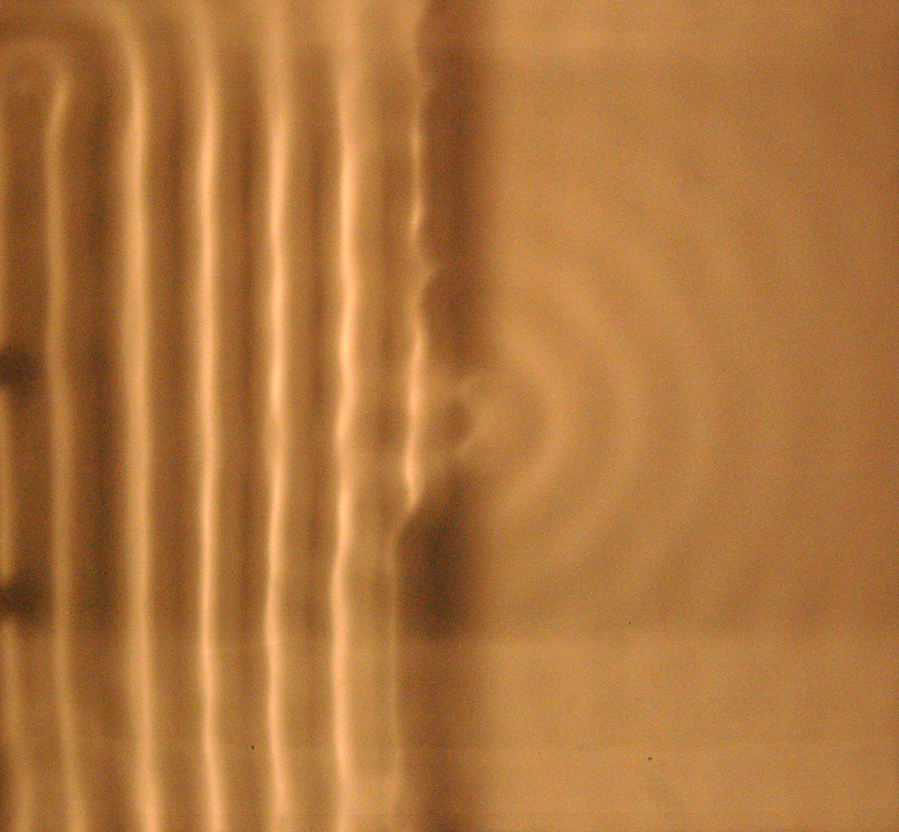
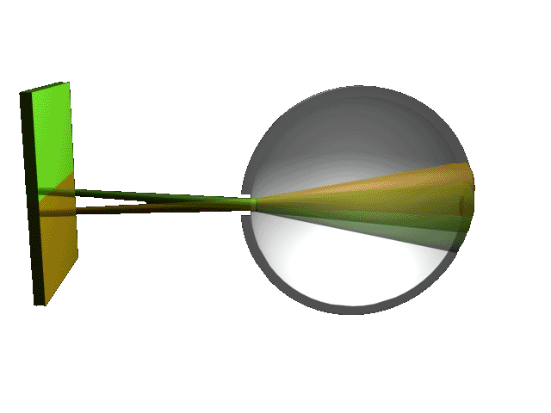
How tiny a hole is required (continued)?
So, hole in Crichton’s nano-eye should be ~ 10 nanometers in diameter, right? Problem:
Lecture 2 / Water ripple tank labs:
Waves strongly DIVERGE when slit < λ
Due to DIFFRACTION!!
SHORTEST wavelength light (blue) ~ 0.35 micron = 350 nanometers = OOPS!
Micro Eye’s opening = 10 nm << 350 nm wavelength => a LOT of diffraction spreading:
Macro eye + large aperture Macro eye + small aperture Micro eye + nano aperture

Slide 17
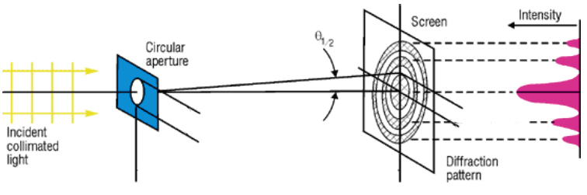
How to quantify?
It’s a combination of simple light projection through / light shadowing by aperture:
That is, assumption of light moving in exact straight lines
Plus diffraction spreading of individual light “beamlets”:
Exact solution very difficult, but approximation was proposed by J.M. Petzval in 1857:
Suggested just taking the sum of the two above phenomenon:
Shadow of aperture + edge “Fraunhofer” Diffraction spread =>
http://cord.org/step_online/st1-4/st14eiv2.htm
d
Y
D
A Hands-on Introduction to Nanoscience: WeCanFigureThisOut.org/NANO/Nano_home.htm

Slide 18

Comes directly from our ripple tank images:
Waves through a small aperture:
Waves through a larger aperture:
A Hands-on Introduction to Nanoscience: WeCanFigureThisOut.org/NANO/Nano_home.htm

Slide 19
Petval's equation fitting this behavior:
d
D = Diameter of “eye”
d = Width of eye’s opening (aperture)
Y = Width of pixel (beam’s spread at back of eye)
Y=?
D = 7 microns
From Petzval’s analysis of pinhole camera design:
Y ~ d + 2 λ D / d = projection of aperture + diffraction spread at edges
Makes sense - size of aperture (d) enters twice:
For LARGE eye and aperture (D, d ~ same order of magnitude): Y => d + (~λ) => d
But for small aperture, second term (diffraction) blows up: Y = 2 λ D / d
A Hands-on Introduction to Nanoscience: WeCanFigureThisOut.org/NANO/Nano_home.htm

Slide 20
Plugging in some numbers
d
Y=?
Creighton’s eye + blue light + our hope for PC like resolution:
Y = d + 2 λ D / d => 10 nm + 2 x 350 nm x 7 micron / 10 nm
~ 500 microns But entire eye is only 7 microns tall (!@#@#!)
So back off and instead enlarge aperture to 100 nm:
Y = d + 2 λ D / d => 100 nm + 2 x 350 nm x 7 micron / 100 nm = 50 microns (!@#!)
Finally, in desperation, try a 1000 nm (1 micron) aperture:
Y = d + 2 λ D / d => 1000 nm + 2 x 350 nm x 7 micron / 1000 nm = 5 microns
Single pixel ~ 25 micron² Back of eye ~ 75 microns² => Max of about 3 pixels
D = 7 microns
A Hands-on Introduction to Nanoscience: WeCanFigureThisOut.org/NANO/Nano_home.htm

Slide 21
Or perhaps more accurately . . .
Formula above assumed “screen” was many, many wavelengths back from aperture
So that the screen would be in the “far-field” wave distribution
But Creighton’s nano eye was max of ~ 20 light wavelengths in diameter = “near field”
To model accurately, need full simulation of near-field “Fraunhofer" diffraction pattern
Which I actually found in a paper on X-ray camera design by K. Mielenz of NIST !!
He suggested actual resolution is about 4X better than Petzval’s formula
So final 1 micron aperture “eye” (above) actually yields ~ 1 micron beam / pixel width
With 75 micron² imaging area on back of sphere could then fit ~ 100 pixels
A Hands-on Introduction to Nanoscience: WeCanFigureThisOut.org/NANO/Nano_home.htm

Slide 22
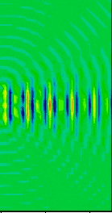
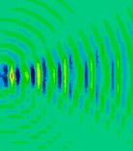
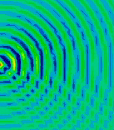
Revised number IS more consistent with our experience:
In ripple tank labs / simulations for lecture 2, beams only blew up when gaps => λ
d ~ 10 λ: d ~ 5 λ: d ~ 1 λ:
Means 1 micron aperture should be ~ optimum for tight beams of all light colors:
Aperture (1000 nm) = (2 to 3) x (350 - 600 nm) = (2 to 3) x λ light
Thus for Crichton’s 7 micron eye, best 1 micron aperture design => ~ 100 pixels total
Cover of “Prey” at Cover of “Prey” at Happy hunting
normal resolution: 100 pixel resolution: nanobots!
A Hands-on Introduction to Nanoscience: WeCanFigureThisOut.org/NANO/Nano_home.htm

Slide 23
What about Creighton's later eye based on large CLOUD of nanobots?
With eye size increased from 7 microns to 1-2 meters, resolution no longer a problem:
1-2 meters
But still have problems with:
a) How do individual nanobots determine their desired position in macro eye?
b) How do individual nanobots MOVE to that desired position in macro eye?
c) How do individual nanobots COMMUNICATE their illumination & position?
d) How (where and by what) is cumulative information processed into image!!!!!
First: Tackle generic nanobot REQUIREMENT (#3 on earlier pages) of communication
A Hands-on Introduction to Nanoscience: WeCanFigureThisOut.org/NANO/Nano_home.htm

Slide 24
Requirement #3: Nanobot Communication
Given trouble we had with nano vision, maybe we should now mimic biology:
Alternative a) Communication via chemicals?
Chemical = Molecule => ballpark volume of (1 nm)³
To qualify as a nanobot, its size shouldn’t exceed (100 nm)³ = 10⁶ nm³
So nanobot would only consist of at most ~ 10⁶ molecules
Nanobot better not waste molecules (using itself up) => Needs closed environment
But if nanobots themselves CREATE required enclosing shell = MACRO BODY
That is: human beings ARE enclosures (via skin cells) of nanobots (more cells)
So that practical chemical communication requires a non-nano body = cheating
A Hands-on Introduction to Nanoscience: WeCanFigureThisOut.org/NANO/Nano_home.htm

Slide 25
Nanobot Communication (cont’d)
Alternative b) Communication via sound?
NO WAY individual nanobots are going to be able to set up significant sound vibrations!
Alternative c) Communication via photons (light, radio . . . )?
Nano things certainly CAN emit and absorb photons
Analyze in terms of WHERE energy would come from and likely SIZE of photons
Outside of nutrient rich macro living bodies, best energy source = SOLAR ENERGY
This IS what Crichton proposed for his nanobots!
For clear sky, at noon, on equator, solar illumination ~ 1 kW / m²
Nanobot max surface area ~ (100 nm)² With 100% efficient light conversion:
Nanobot max solar power = (1 kW / m²) x (100 nm)² = 10⁻¹¹ watts
A Hands-on Introduction to Nanoscience: WeCanFigureThisOut.org/NANO/Nano_home.htm

Slide 26
Solar powered nanobot communication:
But I like to think at molecular level (and was trained as physicist) so converting:
10⁻¹¹ watts = 10⁻¹¹ Joules / s = 10⁻¹¹ Coulomb - Volts / s ~ 6 x 10⁸ eV / s
Pretty respectable number, particularly if nanobot rationed it carefully
But energy is captured in molecular reconfigurations, e.g. ADP => ATP
“Adenosine diphosphate” => “Adenosine triphosphate” (Textbook section 10.3.3.2)
And released into communicating photons by reverse reaction, e.g. ATP => ADP
Energy released? ATP => ADP releases ~ 7 kcal / mole:
7 kcal / mole = 7 x (2.6 x 10²² eV) / (6.02 x 10²³) ~ 0.3 eV
Dividing nanobot max solar power into photons of this size => 2 x 10⁹ photons / s
A Hands-on Introduction to Nanoscience: WeCanFigureThisOut.org/NANO/Nano_home.htm

Slide 27
Are 2 x 10⁹ photons / sec enough?
What are odds of a given photon successfully reaching desired partner nanobot?
Crude estimate: If nanobots separated by R, probability ~ nanobot area / 4 pi R²
That is, proportional to fraction of surrounding sphere that partner nanobot occupies
P (R) ~ (100 nm)² / 13 R² R = 1 micron => P = 8 x 10⁻⁴
R = 1 millimeter => P = 8 x 10-10
R = 1 meter => P = 8 x 10-16
With 1 micron nanobot spacing, need to send 1300 photons for partner to receive 1
With nanobot’s 2 x 10⁹ photons per second could send 1 Mbit/sec of info to partner
So solar powered photons MIGHT work for communication
But prospects worsen quickly with larger separations

Slide 28
What about other nanobot requirements?
REQUIREMENT #4) Nanobots must be able to control their motion
No way! See our textbook’s chapter 9 on Nanoscale Fluid Dynamics
It provides the hard numbers to back up the phrase “blowing in the wind”
That is, submicron particle in a fluid or even in the air, has ~ no control over where it goes
In Prey, Crichton DID anticipate problem by saying nanobots only came out in still air
But even in still air, nanobots are going to “swim” with nano speed:
No way they could swarm out of caves 100’s of meters away
Or keep up with fleeing humans (both of which “occur” in Prey)
Leading me to a final nanobot score card:
A Hands-on Introduction to Nanoscience: WeCanFigureThisOut.org/NANO/Nano_home.htm

Slide 29


Overall nanobot scorecard:
REQUIREMENT #1) Nanobots must self-replicate:
Based on circular argument (or copying the one proven technique = bio-reproduction)
REQUIREMENT #2) Nanobots must be able to see:
REQUIREMENT #3) Nanobots must be able to communicate:
But only when very close (e.g., when large numbers confined to small spaces ~ cheating)
REQUIREMENT #4) Nanobots must be able to control their motion:
REQUIREMENT #5) Nanobots must be programmable:
Didn’t really discuss: Conclusion based on existing bio examples (discuss more in lecture 13)
A Hands-on Introduction to Nanoscience: WeCanFigureThisOut.org/NANO/Nano_home.htm

Slide 30
How natural nanobots (cells) nevertheless succeed:
They DELETE the two preceding failed requirements:
REQUIREMENT #2) Nanobots must be able to see:
They don’t SEEK out things, they are taken all over the place (see below)
But RECOGNIZE (via chemistry and/or shape) when they’ve arrived where they want to be
REQUIREMENT #4) Nanobots must be able to control their motion:
Fluid motion (flow and diffusion) take them EVERYWHERE inside their space
Nevertheless they get to specific required THERE fast enough (textbook page 329-30):
Time for complete cell mixing = (Cell Diameter)² / (Diffusion Coefficient of Molecule)
=> 40 milliseconds for 2 micron cell
Time for any 2 molecules to contact = (Cell Dia.)³ / (Diffusion Coefficient of Mol.) (Mol. radius)
=> 400 milliseconds for 2 micron cell and 10 nm radius molecules

Slide 31
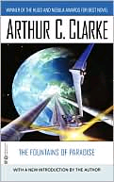
If my Sci-Fi imagineers blew nanobots, did they get anything right?
Or, at least, anything right with respect to nanoscience / nanotechnology?
Strangely, Nano may soon make one of Sci-Fi's BIGGEST ideas possible:
The “Beanstalk”
Proposed by Arthur C. Clarke in his 1979 novel "The Fountains of Paradise"
But what is a Beanstalk?
A Hands-on Introduction to Nanoscience: WeCanFigureThisOut.org/NANO/Nano_home.htm

Slide 32
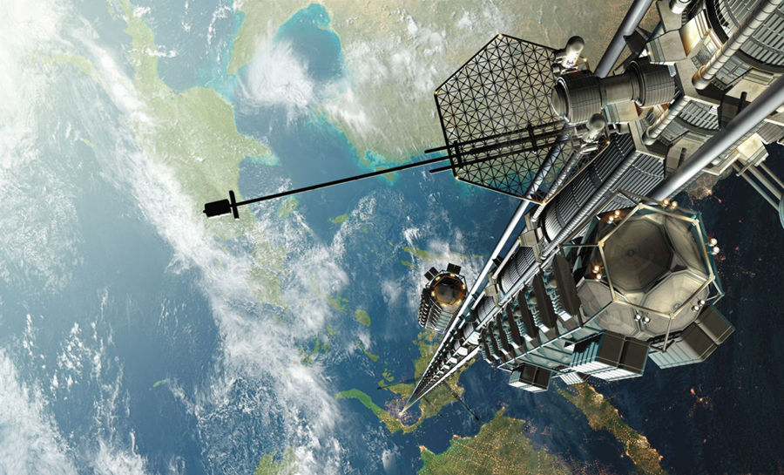
This is a Beanstalk:
Google images: http://www.blog.speculist.com/archives/2004_12.html
Also known as a “Skyhook” or as a “Space Elevator”
A Hands-on Introduction to Nanoscience: WeCanFigureThisOut.org/NANO/Nano_home.htm

Slide 33
It’s actually an old idea . . . But with a BIG problem
Proposed by Russian scientist Konstantin Tsiolkovsky, in 1895
Satellite’s orbit = balance between centrifugal force & gravitational force
Higher it goes, weaker the gravity, slower the orbit required
Near-earth orbit (R ~ 6,500 km) ~ 90 minutes
Moon orbit (R ~ 385,000 km) ~ 30 days
35,786 km orbit = one day → Over equator, stays above fixed point → “Geosynchronous Orbit”
Tsiolkovsky: Satellite is happy, earth is happy, tie together with rope + elevator
Problem: Rope is not happy, all but top of it is moving too low and slow to orbit
Load on rope => Good fraction of its own 35,000 km length => SNAP!
Need incredibly LIGHT yet STRONG rope!!!
A Hands-on Introduction to Nanoscience: WeCanFigureThisOut.org/NANO/Nano_home.htm

Slide 34
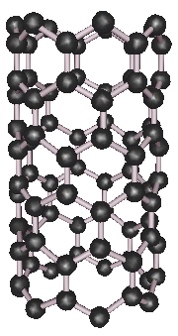
Analysis by U. Washington Physics Prof. John G. Cramer:
In his December 2001 Alternate View column in Analog Magazine (link to cached copy)
Tension at top of rope = 92 Giga Pascals = 13.3 MILLION pounds per square inch!
But he also estimates that: Carbon nanotube (CNT) rope might attain strength 50% larger!
HOWEVER: 36,000 km long single carbon nanotubes cannot now be grown
Even ONE continuous METER is beyond our current capability
So Cramer assumed rope woven from short fibers (like normal rope)
Assumes bonds between CNTs are as strong as bonds within CNTs
Not the case with normal fibers, not presently the case with CNTs
Also, Cramer’s estimate of CNT strength = 3-10 times larger than figure I got from other experts
But we ARE in the ballpark, and “experts” have been wrong or superceded before
(i.e. I wouldn’t invest in it yet, but not sure I’d bet against it either)
A Hands-on Introduction to Nanoscience: WeCanFigureThisOut.org/NANO/Nano_home.htm

Slide 35
Overall conclusions about nano science fiction:
Biggest weakness has been its extrapolation of macro behavior to nanoscales:
Ignores rebalancing of forces. In particular: Nano importance of surface forces
Likely eliminates ideas such as classic nano-mechanical robot
But some of the BIG science fiction ideas may yet turn out to be correct:
Such as the very BIG space elevator idea becoming practical via nanotube cables
And even nanobots are plausible if ideas are suitably modified:
Forget about self-directed motion and “go with the flow”
Forget about nano-vision and just recognize when you arrive where you want
But this mimics biological function (even if that feels like cheating)
Bio also likely required to achieve self-replication (if not computation)
Bearing in mind that uncontrolled self-replication could end up being damned dangerous!
A Hands-on Introduction to Nanoscience: WeCanFigureThisOut.org/NANO/Nano_home.htm

Slide 36
Credits / Acknowledgements
Funding for this class was obtained from the National Science Foundation (under their Nanoscience Undergraduate Education program).
This set of notes was authored by John C. Bean who also created all figures not explicitly credited above.
Copyright John C. Bean
(However, permission is granted for use by individual instructors in non-profit academic institutions)
A Hands-on Introduction to Nanoscience: WeCanFigureThisOut.org/NANO/Nano_home.htm

